Slide 1
A Stakeholder Advisory Committee: Reconstituting, Repurposing, Revitalizing
Judy Conner, M.S., C.P.G.
Texoma AAA Director
Randy McBroom, PhD
TCOG Deputy Executive
Director

Slide 2
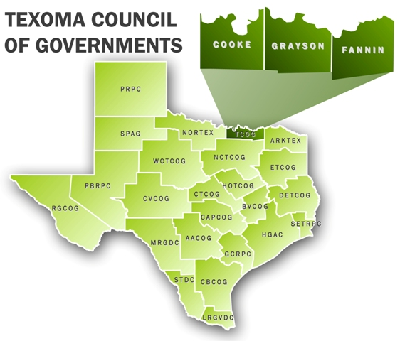
Texoma Council of Governments
Texoma Council of Governments (TCOG)
The Texoma Council of Governments (TCOG) is a voluntary association
of local governments in Cooke, Fannin, and Grayson Counties that works
directly with citizens and local jurisdictions to improve and advance
economic vitality and quality of life in Texoma.

Slide 3
Advisory Committees – Pro & Con
Roles and Benefits of a Well-Constituted Advisory Committee
Represents interests of stakeholders.
Believes in the agency’s mission and goals and guiding the development and coordination of the purpose.
AAA: advises on all matters relating to the development of the Area Plan, the administration of it and the procedures conducted under the Plan.
Provides valuable input/feedback from a variety of interests.
Can provide authoritative advice on various topics.
Enhances positive visibility and championing of agency to the community.

Slide 4
Advisory Committees – Pro & Con
How Advisory Committees can Lose Purpose and Become Dysfunctional
Special Interests “Highjack” a Committee.
Can Gain a Majority, and/or Intimidate Other Members.
Bylaw Revisions That Are Not Thought Through
Example: 15 member board, possible quorum of 3 members
Losing Sight of Mission and/or Values.
Examples: Mission Creep or Mission Ossification
Overlapping and Confusion with Other Boards
Example: Advisory Board and Foundation Board With Overlapping Memberships
Lack of Rotation of Board Members and/or Officers

Slide 5
Advisory Committees – Pro & Con
Elements of Functional and Dysfunctional Advisory Committees
Functional
Dysfunctional
Clear Mission Guides Committee
Clear, Unambiguous Bylaws
Engaged Committee Members
Mission and Bylaws Guide Decisions/Advice
Meetings Follow “Roberts Rules of Order”
Mission Creep/Ossification or Overlap with Other Board
Unclear, Inconsistent
Bylaws
Untrained, Disengaged Committee Members
Special Interests Dictate or Intimidate Decisions
Chaotic Meetings, often “High-jacked”

Slide 6
Dealing with Dysfunction
When and How to Reconstitute Dysfunctional Advisory Committees
When? – When Committee No Longer Serves Its Purpose
How? – Very Carefully (You Will Catch Some Darts)
Co-opt a “Champion” - A Member Who Sees the Dysfunction
First Things First – Clarify the Mission and Purpose of the Committee
Work with Champion (and Possibly a Consultant) to Rewrite Bylaws
Take Your Time (But You Will Not Get It Perfect)
Seek Input From Any Other Active Members

Slide 7
Dealing with Dysfunction
Elements of Reconstituted Bylaws
Mission and Purpose are Clearly Stated
Membership – Clear on Number of Members; Length of Terms; Succession; Rotation (Term Limit); Reconsideration; Ex-Officio Members
Very Clear on How Potential Members are Nominated
Composition of the Membership (Especially if Required by Law or Policy)
Member Responsibilities (Expectations and Duties)
Meetings (Designate Annual Meeting – Beginning of Terms, Officer Selection)
Be Sure to Address Non-Attendance

Slide 8
Dealing with Dysfunction
Elements of Reconstituted Bylaws - Continued
Definition of Quorum – It’s Up to You!
A quorum shall be a majority of the voting membership
Officers – Keep it Simple and As Few As Possible
Limit Succession (Two consecutive terms in any single office are permitted.)
Secretary – Ex-officio Staff Member if Possible
Committees – Standing and Ad Hoc
Amendments to Bylaws
How much notice is given – (60 days, for example)
How many votes to pass – often 2/3 of the total voting membership

Slide 9
Questions – Contact Information
Question Time
Judy Conner, M.S., C.P.G., Texoma AAA Director Texoma Council of Governments 1117 Gallagher Drive
Sherman, TX 75090
jconner@tcog.com
(903)813-3575
Randy McBroom, PhD, Deputy Executive Director
Texoma Council of Governments 1117 Gallagher Drive
Sherman, TX 75090
rmcbroom@tcog.cog
(903)487-6580

