Slide 1
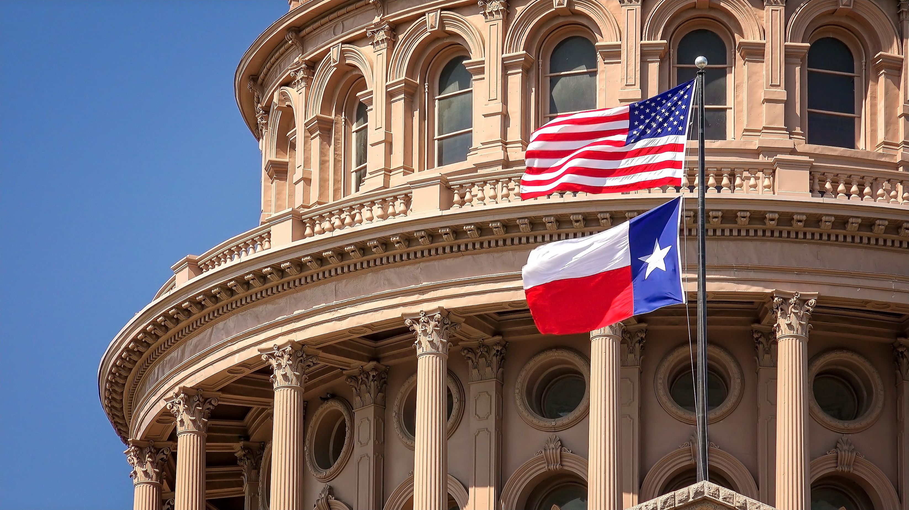

Strengthening Partnerships
Texas Elder Justice Resources & Collaboration
TARC Austin
Lyn Scott
Chief Executive Officer, Guardianship Services, Inc. | Texas Elder Justice Coalition Co-Lead

Slide 2


The work rarely fits in one lane.
The person in front of us may have one problem.
The system may see six.
Safety
Money
Capacity
Legal
Health
Crime
The handoff between lanes is where collaboration matters most.

Slide 3
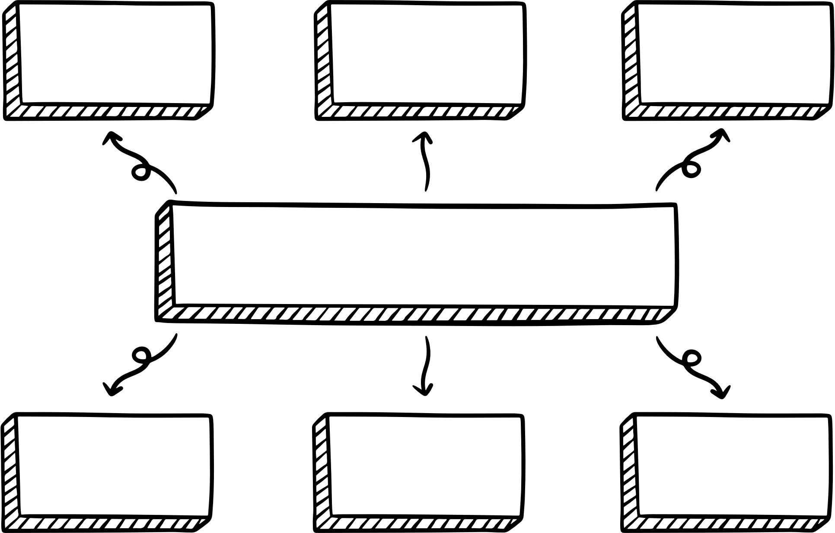
TEJC: a statewide table, not another silo.
A multidisciplinary network built to connect people who already do the work.
Financial
Institutions
Regulators &
Community
Healthcare &?Capacity
Texas Elder Justice Coalition
APS & Aging
Services
Law
Enforcement
Prosecutors &
Legal Aid

Slide 4

Know your lane. Know the next lane.
You do not have to solve every problem.
You do need to know who can. A strong referral is an intervention.

Slide 5
What collaboration looks like in practice
The goal is not a perfect system. It is a faster, safer path to the right response.
RECOGNIZE
CONNECT
COLLABORATE
RESPOND
What is actually happening?
Who else needs
to know?
What can each partner contribute?
What happens next for the person?

Slide 6
One situation. Multiple doors.
An anonymized financial exploitation scenario.
FINANCIAL INSTITUTION
Secure accounts • trace/recover funds
Older adult reports significant account losses.
  Some funds may be recoverable.
  Additional transactions are still being reviewed.
  The person is frightened and unsure what to do next.
  The financial institution can address the account — but not every consequence.
LAW ENFORCEMENT
Report • investigate • preserve evidence
VICTIM SUPPORT / AGING
Safety • navigation • follow-through
LEGAL / REGULATORY
Remedies • reporting • escalation

Slide 7
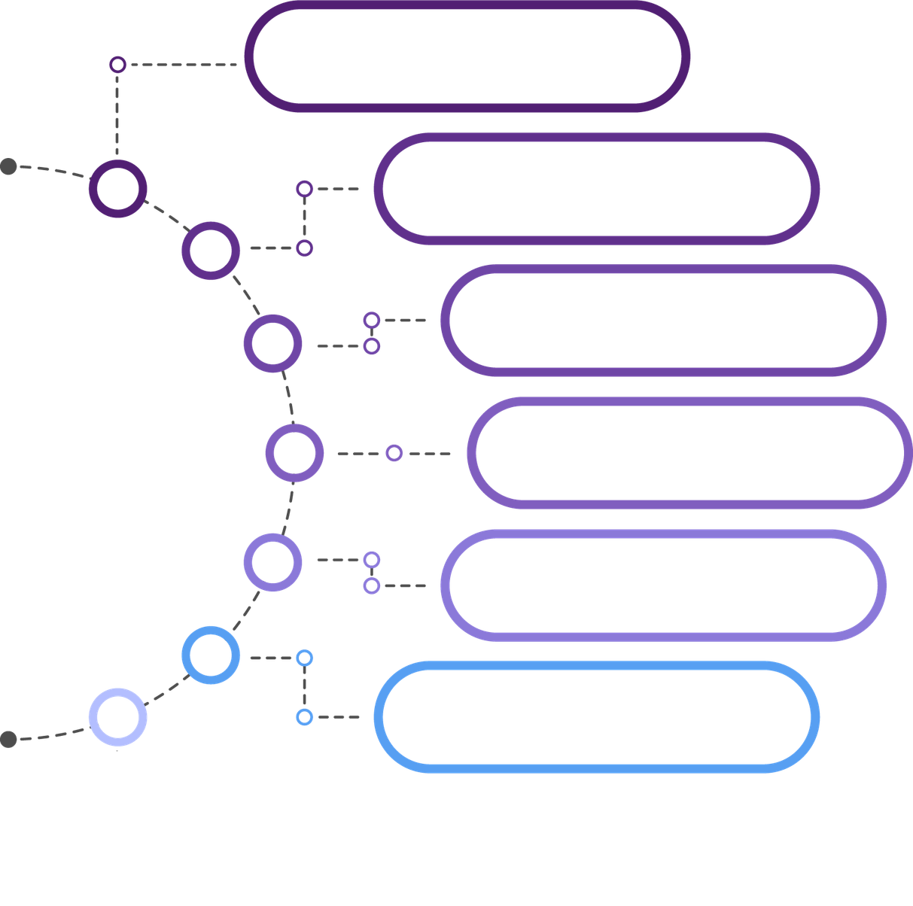
When you don't know who to call…
Is someone in immediate danger?
Is capacity in question?
Is there a civil/legal remedy?
Start with the problem — not the program.
Is money still moving?
Is a crime suspected?
Who can stay with the person through the next step?

Slide 8





Texas resources worth having in your phone
A starter set — not an exhaustive directory.
Texas Adult Protective Services
Abuse, neglect & exploitation reporting / response
DOJ National Elder Fraud Hotline
Federal elder-fraud assistance and referrals
Legal Aid & local aging networks
Civil remedies, benefits, housing and support
2-1-1 Texas
Local health and human-service navigation
FBI Internet Crime Complaint Center (IC3)
Cyber-enabled fraud reporting
TEJC / local multidisciplinary partners
Connections when the issue crosses systems
Build your local list before you need it.

Slide 9

Build the relationship before the case.
BEFORE
  Know names, not just agencies
  Understand each partner’s authority
  Clarify referral expectations
  Share training and resources
  Practice the handoff
DURING
  Move faster
  Ask better questions
  Reduce duplication
  Protect evidence and options
  Keep the person from getting lost

Slide 10
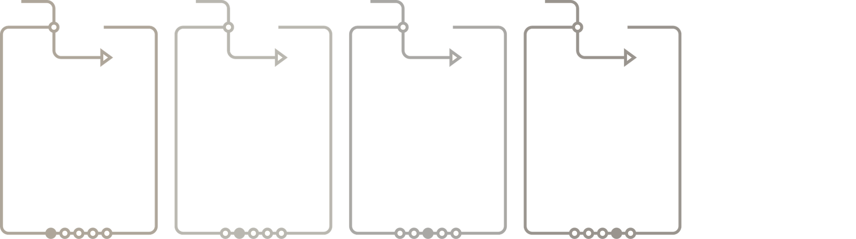
Where TARC fits
You are often the connector between a person, a problem and the next resource.
SEE
Notice changes, risk, coercion or unusual financial behavior
ASK
Clarify what happened and what the person wants
CONNECT
Make a warm referral to the right partner
STAY
Help the person understand and complete the next step
You may not own the case. You can still change the outcome.

Slide 11
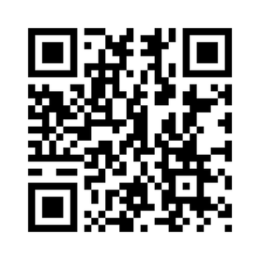
Stay connected to the network
txelderjustice.org/join-network
  Statewide education and shared learning
  Partner connections and introductions
  Virtual meetings and Partner Spotlights
  Texas Elder Justice Summit
  Emerging issues, resources and opportunities to collaborate
Lyn Scott, TxCG
Chief Executive Officer
Guardianship Services, Inc. | Texas Elder Justice Coalition

Slide 12

THANK YOU
The strength of the response depends on the strength of the relationships that existed before the crisis.

