Slide 1
Scams and Fraud Targeting Older Texans
New Protections and Opportunities
Ann Baddour, Texas Appleseed
Stephanie Mace, AARP Texas

Slide 2
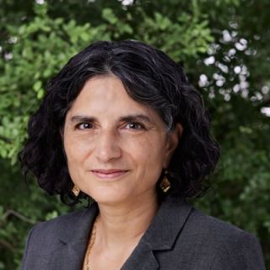
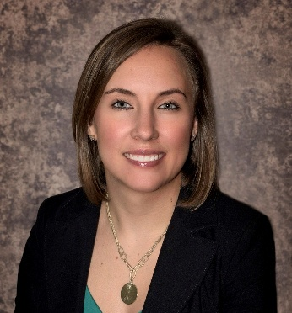
Ann Baddour
Texas Appleseed
abaddour@texasappleseed.org
Stephanie Mace
AARP Texas
smace@aarp.org

Slide 3
Agenda
The Scam and Fraud Ecosystem
New Protections: Solar Panel Sales Fraud and Scams
Policy Opportunities:
      Adoption Crypto Kiosk Protections
Online Advertiser Accountability
Additional Resources for FCIC & Law Enforcement
Opportunities to Get Involved

Slide 4
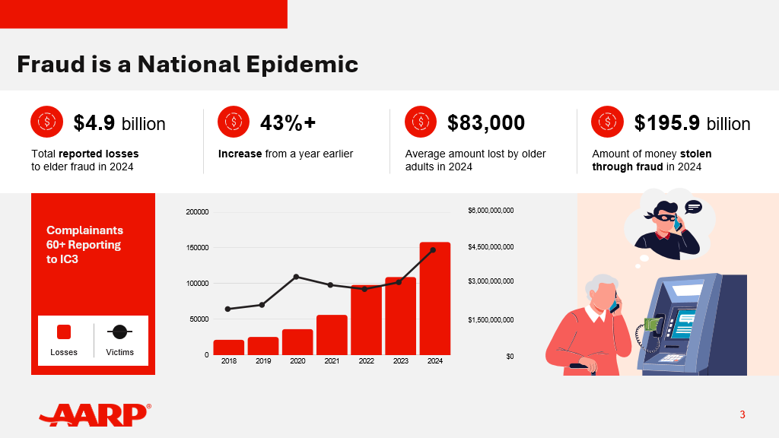
Presentation:
The Scam and Fraud Ecosystem
New Protections: Solar Panel Sales Fraud and Scams
Policy Opportunities:
      Crypto Currency Kiosks
Online Advertiser Accountability
Resources for FCIC & Law Enforcement
Opportunities to Get Involved

Slide 5
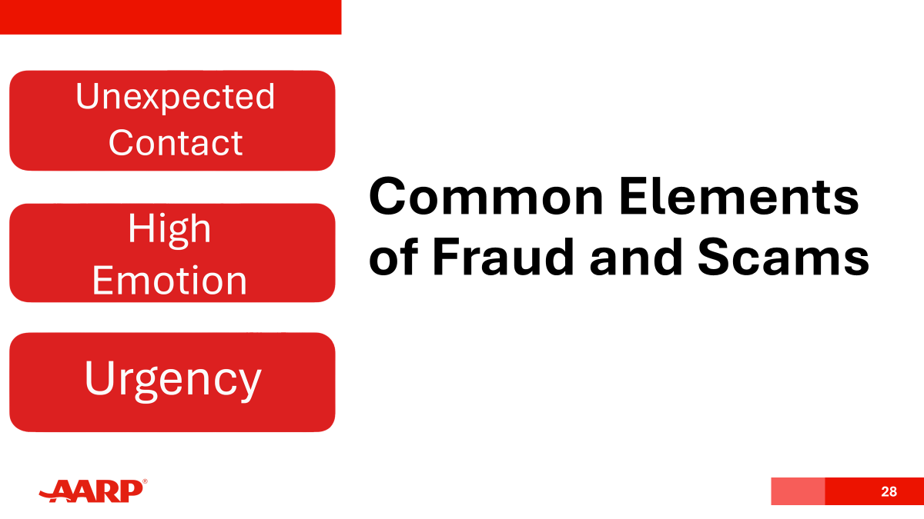

Slide 6
Why Fraud is Growing
Technology
Social Media
AI voice cloning
Deepfakes
Automated phishing
Faster Payments
Instant money transfers
Less time to stop transactions
Easier targeting
Fake ads
Investments Scams
Data Exposure
Breaches
Oversharing online
Public records

Slide 7
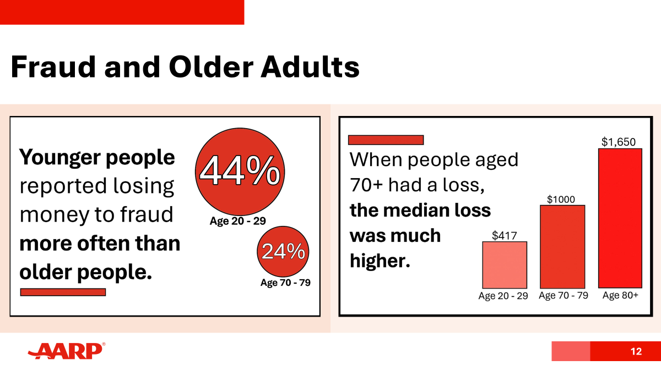
Presentation:
The Scam and Fraud Ecosystem
New Protections: Solar Panel Sales Fraud and Scams
Policy Opportunities:
      Crypto Currency Kiosks
Online Advertiser Accountability
Resources for FCIC & Law Enforcement
Opportunities to Get Involved

Slide 8
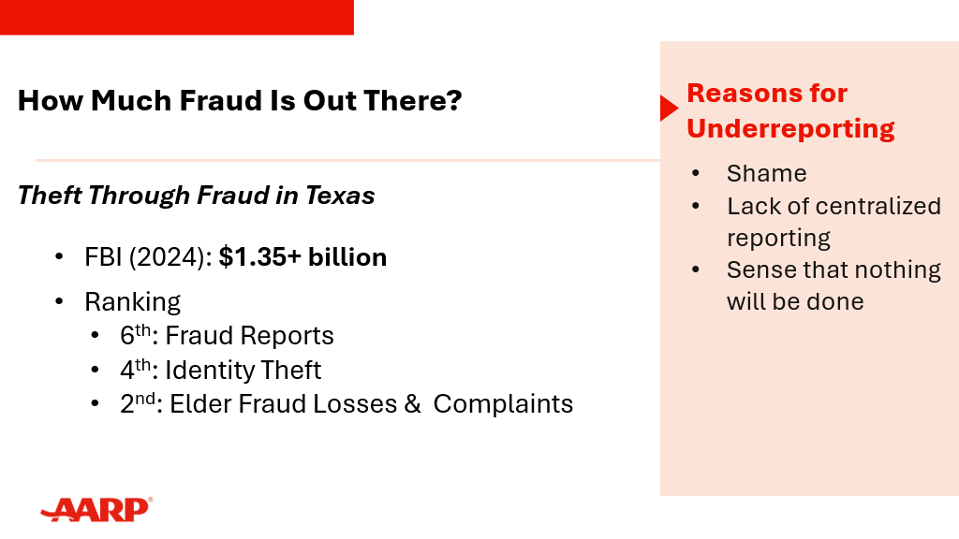

Slide 9
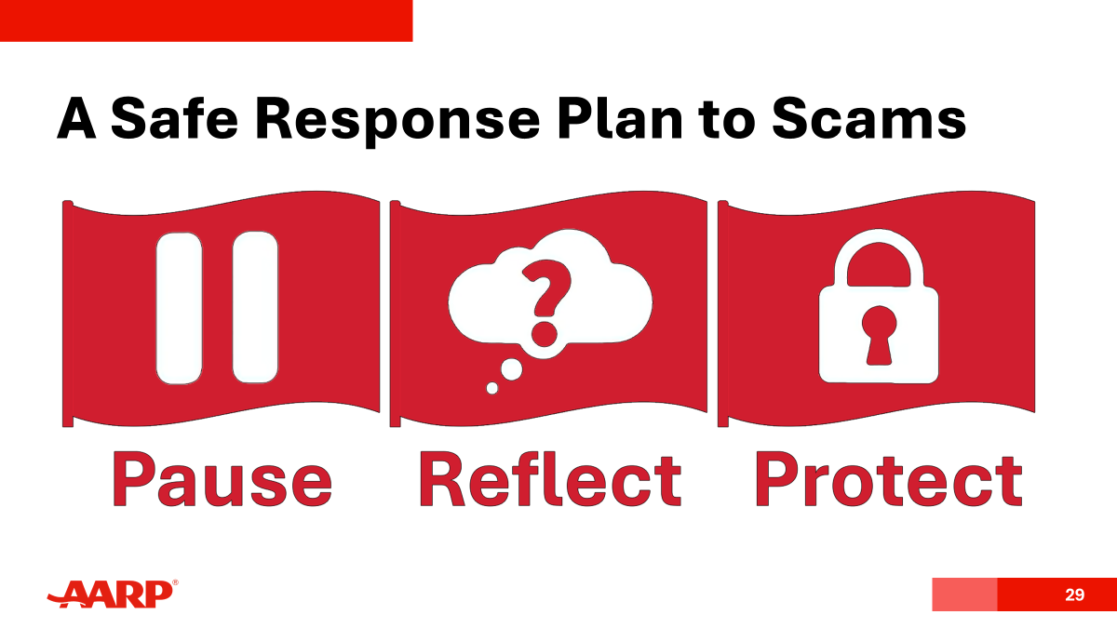

Slide 10
New Protections: Solar Panel Sales Fraud and Scams

Slide 11
SOLAR PANEL LANDSCAPE IN TEXAS
Adoption of Residential Rooftop Solar has Increased
From 2018 to 2025, Texas power from rooftop solar increased by 818%.
Texas ranks second in the US for residential solar power generation.
Federal tax incentives allowed up to 30% tax credit for qualifying residential solar panel systems fueled growth, but are no longer available. Local incentives may still exist.
Significant weather events
  Winter Storm Uri (2021)
  2023 Winter Storm
  Hurricane Beryl (July 2024)
Year | Total Generation (GWH)
2018 | 528
2019 | 756
2020 | 1,290
2021 | 1,884
2022 | 2,575
2023 | 3,709
2024 | 4,443
2025 | 4,844
Residential Small Scale Solar Power Generation in Texas, 2018 to 2025
https://www.eia.gov/electricity/data/eia861m/

Slide 12



PARTIES INVOLVED IN THE SOLAR PANEL PROCESS
Sales & Retailers
Pitch and provide solar panels to homeowners, primarily door-to-door.
Installers
Responsible for the installation of solar panels, primarily independent contractors.
Lenders
Arrange financing for the solar panels, often with unfavorable terms for the homeowner.
Notes:
The means by which solar panels are being sold today in the US is fundamentally broken; really easy for those sales to not meet the consumer’s expectations

Slide 13
COMMON SOLAR PANEL-RELATED COMPLAINTS
False or misleading statements:
Claiming that solar panels will eliminate or significantly reduce monthly electric bills
Telling consumers that they are guaranteed to get tax credits, rebates, or other incentives without explaining necessary qualifications
Unsatisfactory service:
Incomplete, non-functioning, or delayed installation
Failure to connect system to the grid and roof damage
Problematic sales practices:
Fraudulent tactics to obtain contract signatures without consent of the customer and establishing fake email addresses to send contracts to, so the customer never sees the actual agreements.
Targeting older Texans and non-English speakers who may not fully understand the transaction.

Slide 14
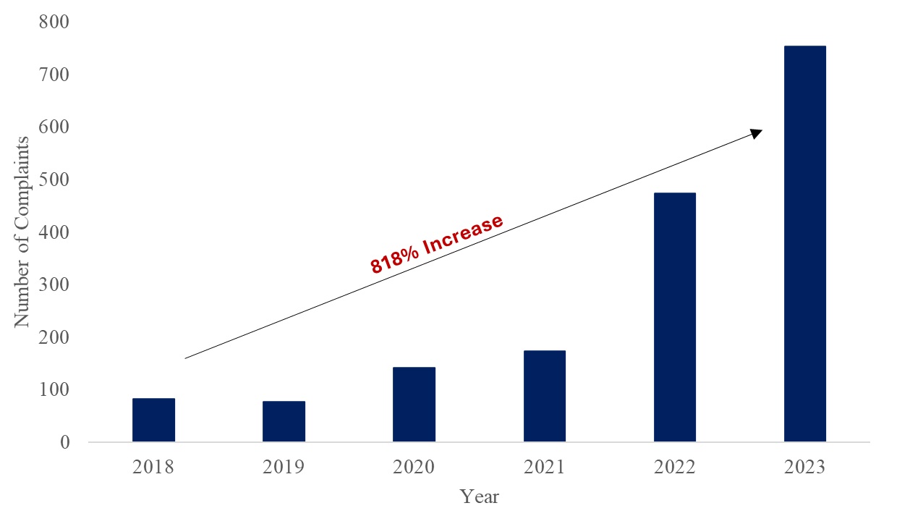
Solar Panel-Related Complaints Submitted by Texans to the OAG
January 1, 2018 to December 31, 2023
Source: Texas Appleseed analysis of solar panel-related complaints accessed through open records requests submitted to the Texas Office of the Attorney General between December 2023 and July 2024. The complaints cover a period from January 1, 2018 to December 31, 2023.

Slide 15
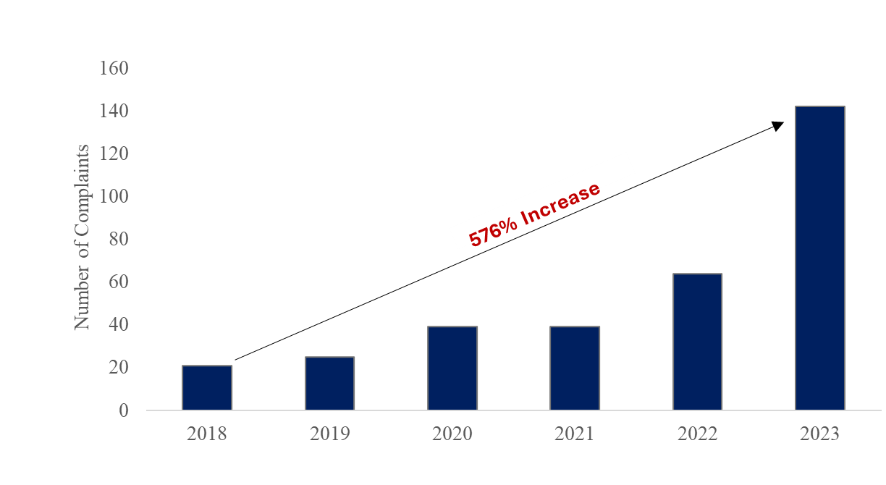
Solar Panel-Related Complaints Submitted by Texans to the TDLR
January 1, 2018 to December 31, 2023
Source: Texas Appleseed analysis of open records request submitted to the Texas Department of Licensing and Regulation, May 2024 for complaints from January 1, 2018 to May 1, 2024.

Slide 16
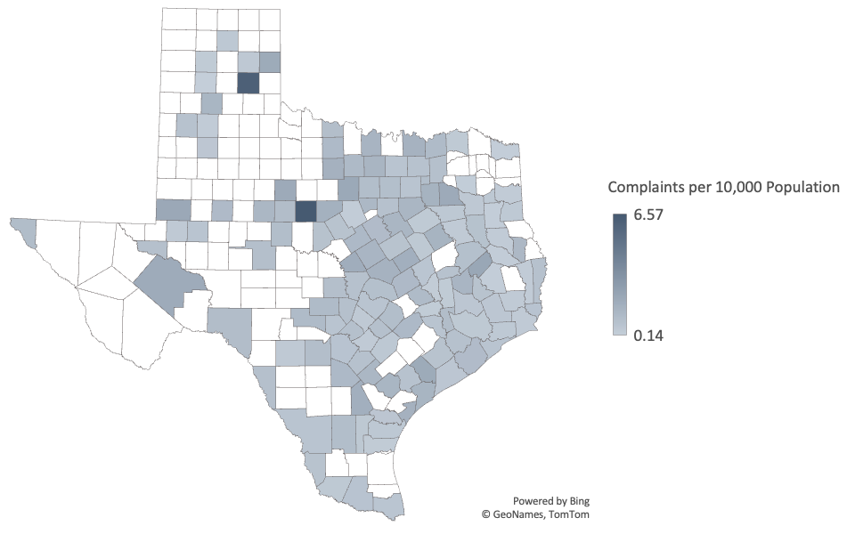
Solar Panel-Related Complaints Submitted to the OAG
Per 10,000 County Population
January 1, 2018 to June 30, 2024
Notes:
The means by which solar panels are being sold today in the US is fundamentally broken; really easy for those sales to not meet the consumer’s expectations

Slide 17
GEOGRAPHY OF COMPLAINTS IN TEXAS
Striking diversity of geography where the complaints originated.
Complaints filed from residents in 141 of 254 Texas counties, which encompasses over 28 million Texans.
The highest number of complaints come from the big population centers, but the rate of complaints is similar across urban and rural counties alike.
Top 5 counties based on the total number of complaints:
Harris, Tarrant, Dallas, Bexar, and El Paso counties
Top 5 counties based on complaints per 10,000 population:
McMullen, Callahan, Donley, Trinity, and Andrews counties

Slide 18
NEW PROTECTIONS FOR TEXANS
SB 1036 (fully effective Nov. 1, 2026):
Create registration requirements solar panel sales
Standardizes contracts
Prohibit deceptive solar sales practices
Issue warnings, cease and desist orders, and impose penalties for violations.​
SB 1697:
Utilities must include a link to a solar energy guide published by the Public Utility Commission in bills for at least 12 months after issued.
Guide adopted in March 2026: https://www.puc.texas.gov/consumer-help/electricity/solar/

Slide 19
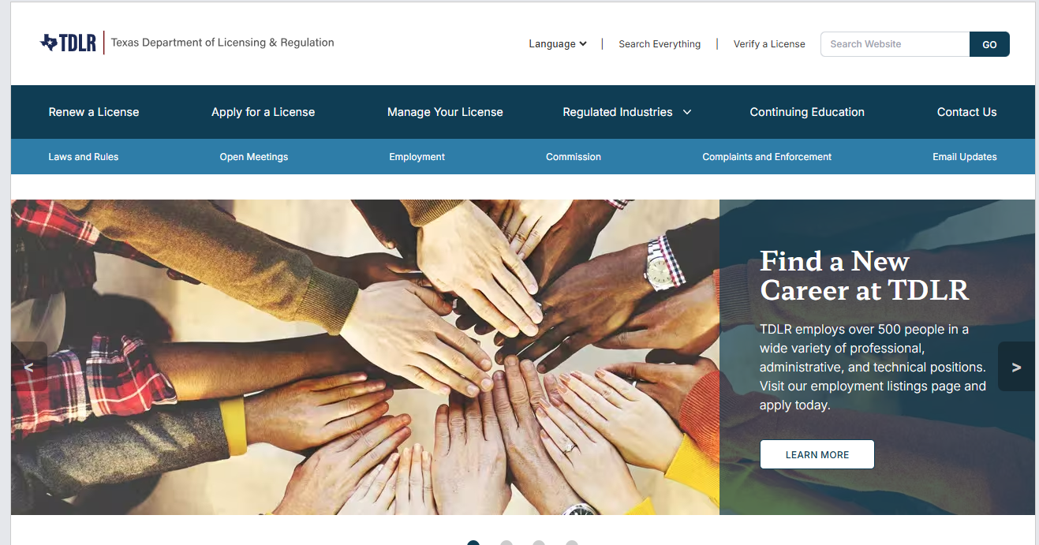
www.tdlr.texas.gov

Slide 20
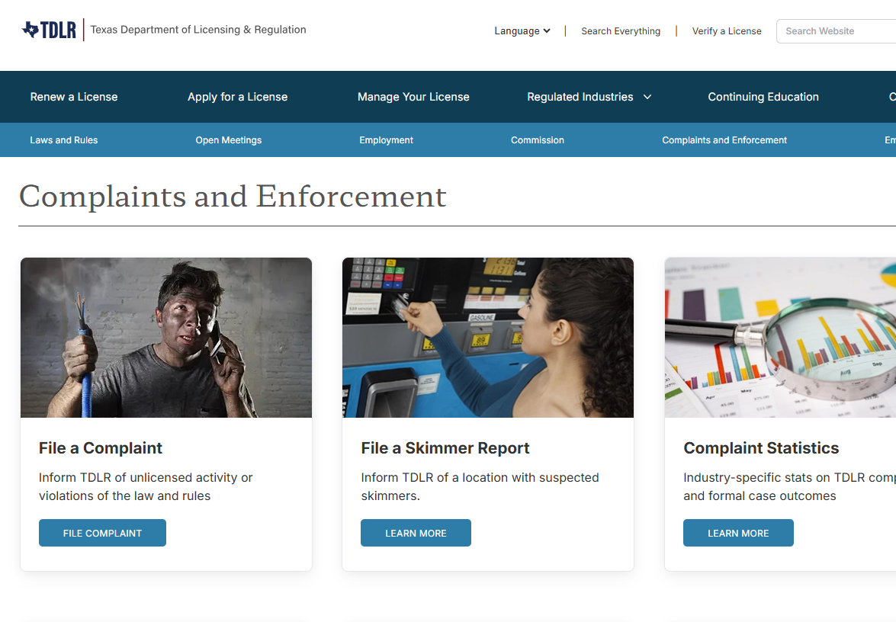

Slide 21
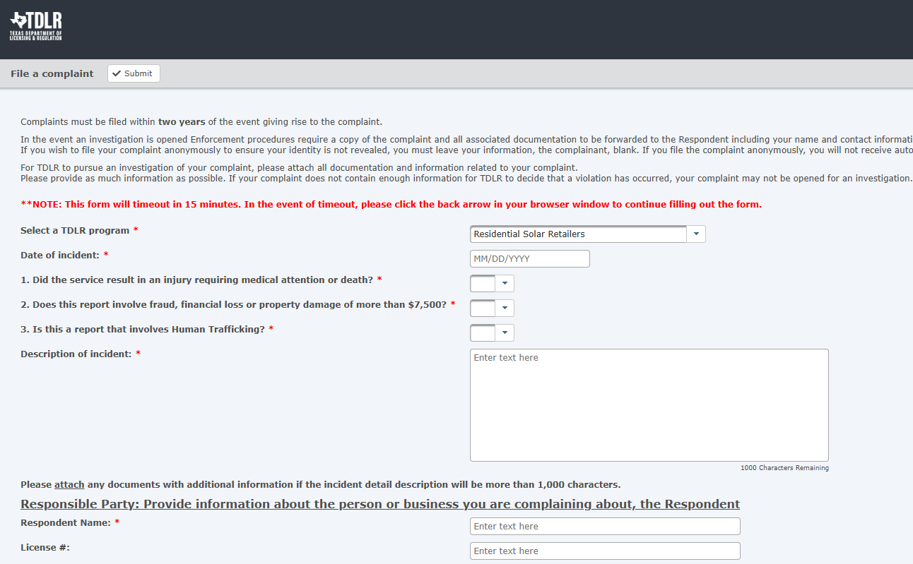

Slide 22
Policy Opportunities:
Adopt Crypto Kiosk Protections

Slide 23
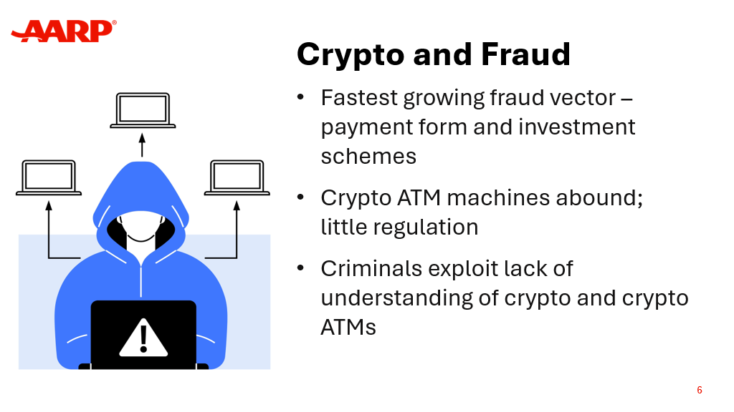

Slide 24
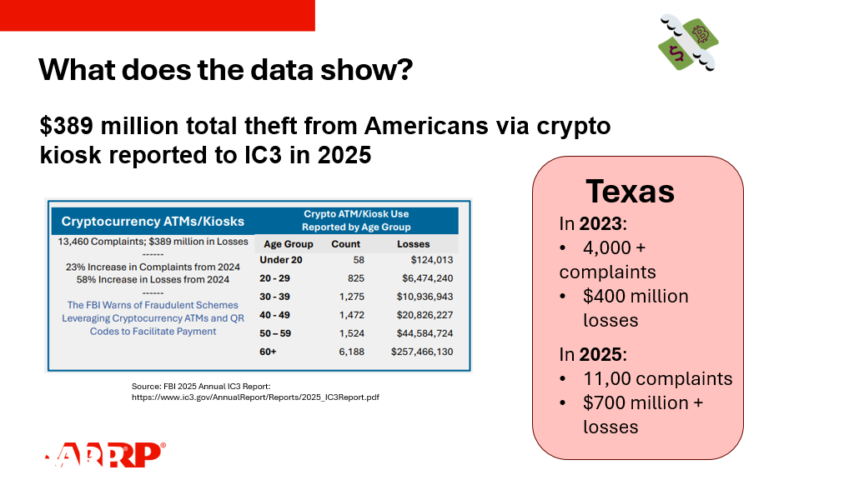

Slide 25
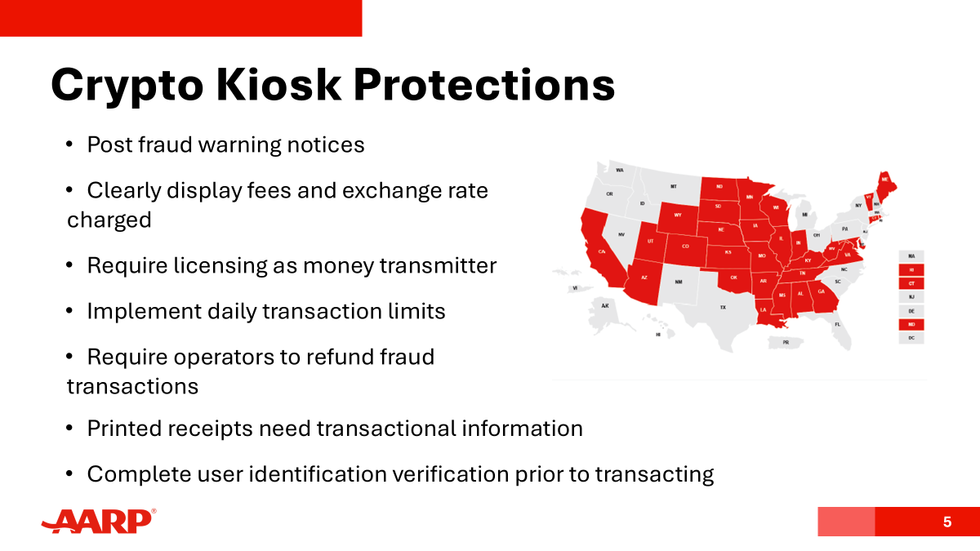

Slide 26
Policy Opportunities:
Online Advertiser & Data Broker Accountability

Slide 27
ONLINE ADVERTISERS AND DATA BROKERS PROFIT FROM AD AND DATA SALES TO SCAMMERS
Studies have found that social media platforms profit from knowingly selling ads to scammers:
Internal documents from Meta expected 2024 earnings of $16 billion from ads for scams and banned goods
15 billion "high risk scam" advertisements shown daily to people on platform
A Texas-based data broker, Epsilon agreed to pay $150 million in 2021 for selling the data of more than 30 million individuals' data to perpetrators of elder fraud schemes.
Another Texas Company, Datamasters, sold a list of 435,245 people with Alzheimer’s disease to anyone with a credit card.
Sources: https://www.reuters.com/investigations/meta-is-earning-fortune-deluge-fraudulent-ads-documents-show-2025-11-06/, https://www.justice.gov/archives/opa/pr/marketing-company-agrees-pay-150-million-facilitating-elder-fraud-schemes, and https://cppa.ca.gov/pdf/datamasters_order_signed.pdf

Slide 28
WHAT CAN WE DO?
Address Scam Ad Sales:
Federal SCAM Act (S. 3774; H.R. 7548)
State-based SCAM Act, modeled after law passed in Nebraska earlier this year (filed as: LB 1118 ).
Address Use of Data for Scam Targeting:
Provide default data protections to make it easier to stop sale of personal data for fraudulent purposes:
  Prohibit sale of sensitive precise geolocation data that can be used to target people for scams and determine likely victims.
  Require all browser to enable individuals to opt out of data sharing.

Slide 29
Policy Opportunities: Additional Resources for FCIC &
Law Enforcement

Slide 30
Opportunities to Get Involved

Slide 31
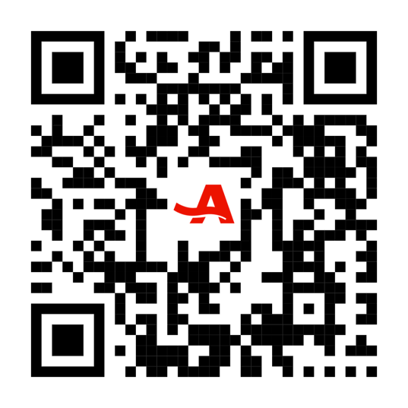
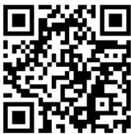
Sign up to follow our work:
AARP.org/txadvocacy
TexasAppleseed.org/Subscribe

Slide 32
Questions?

