Slide 1
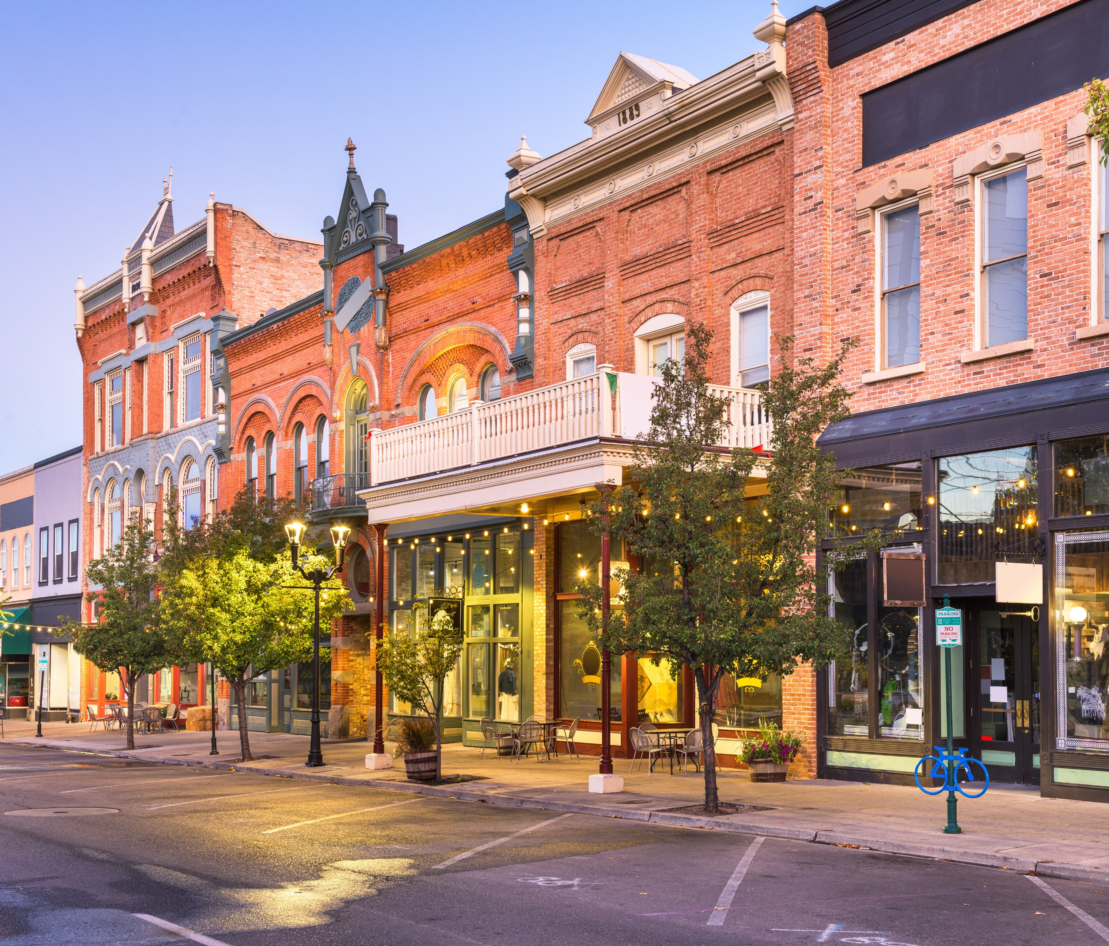

USDA Rural Development Summary of Programs
Together, America Prospers

Slide 2
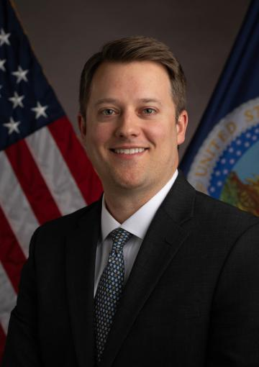
USDA Rural Development Texas Leadership
James Redfield serves as the State Director for Rural Development in Texas. Prior to this role, he managed government and external relations at the Texas Department of Agriculture. Earlier, James was a policy advisor at the U.S. Department of Housing and Urban Development under Secretary Ben Carson, where he worked concurrently for the Office of Policy Development and Research and the Government National Mortgage Association (Ginnie Mae). He also served as a legislative staffer in the U.S. House of Representatives for two former Texas members, focusing on agriculture and financial services policy. A native of Nacogdoches, Texas, James holds a degree in Agribusiness from Texas A&M University.
Notes:
I am focused on improving two primary objectives as state director, revamping our capabilities as a customer forward facing agency and partnering with institutions that can help us target our programs to the rural areas that really need us.

Slide 3
History of USDA Rural Development
The history of RD starts under Franklin Delanor Roosevelt and the New Deal and continues through today.
1935 – President Roosevelt signed Executive Orders establishing the Resettlement Administration & Rural Electrification Administration.
1937 – The Roosevelt Administration transfers the funds, personnel, functions, and properties of the Resettlement Administration to the USDA. Name changes to the Farm Security Administration (FSA).
1947 - USDA changes the name of the FSA to the Farmers Home Administration (FmHA).
Over the years, Acts of Congress have added programs to the agency’s mission.
The Federal Crop Insurance Reform and Department of Agriculture Reorganization Act of 1994 finalized the structure, creating the current Rural Development mission area.
RD falls under Title VI of the Farm Bill. November funding bill extended 2018 Farm Bill at existing funding levels for one year through September 30, 2026.

Slide 4
USDA RD Mission
We are committed to helping improve the economy and quality of life in rural America. Through our programs, we help rural Americans in many ways.
We offer loans, grants and loan guarantees to help create jobs and support economic development and essential services such as housing; health care; first responder services and equipment; and water, electric and communications infrastructure.
We promote economic development by supporting loans to businesses through banks, credit unions and community-managed lending pools. We offer technical assistance and information to help agricultural producers and cooperatives get started and improve the effectiveness of their operations.
We provide technical assistance to help communities undertake community programs.
We help rural residents buy or rent safe, affordable housing and make health and safety repairs to their homes.

Slide 5
Our Priorities
Secretary of Agriculture Brooke Rollins on Rural Prosperity
“America’s rural towns have and always will be the beating heart of our nation…. Families moved west to start a new life in a new land. They came together to build churches, schools, and city halls. They settled fields and forests and weathered hardships beyond what we can comprehend. They risked all they had to open storefronts and stand up Main Streets. They celebrated life’s joys together and cared for those who fell on hard times….
“That is why I truly believe that restoring rural prosperity isn’t simply about bringing back jobs, although that is important. It’s about restoring hope to our communities. It’s about protecting and preserving the quintessential American way of life.”
Role of State Director
It is my duty as State Director to implement the priorities of the administration here in the state of Texas and to well and faithfully serve the people of this state. Through partnerships and collaborations with private capital, the governor’s office, municipalities, and, of course, organizations like yours, we aim to play a part in tackling the many issues facing our rural communities in Texas. Through our programs we can help communities and the state tackle challenges with water, outdated infrastructure, housing, and the viability of businesses in rural America.
Notes:
TARC Priorities/Programs:
Community and Economic Development
Criminal Justice
Emergency Communications
Emergency Preparedness
Financial Transparency and Reports
Municipial Solid Waste
Texas Regional Broadband Program

Slide 6
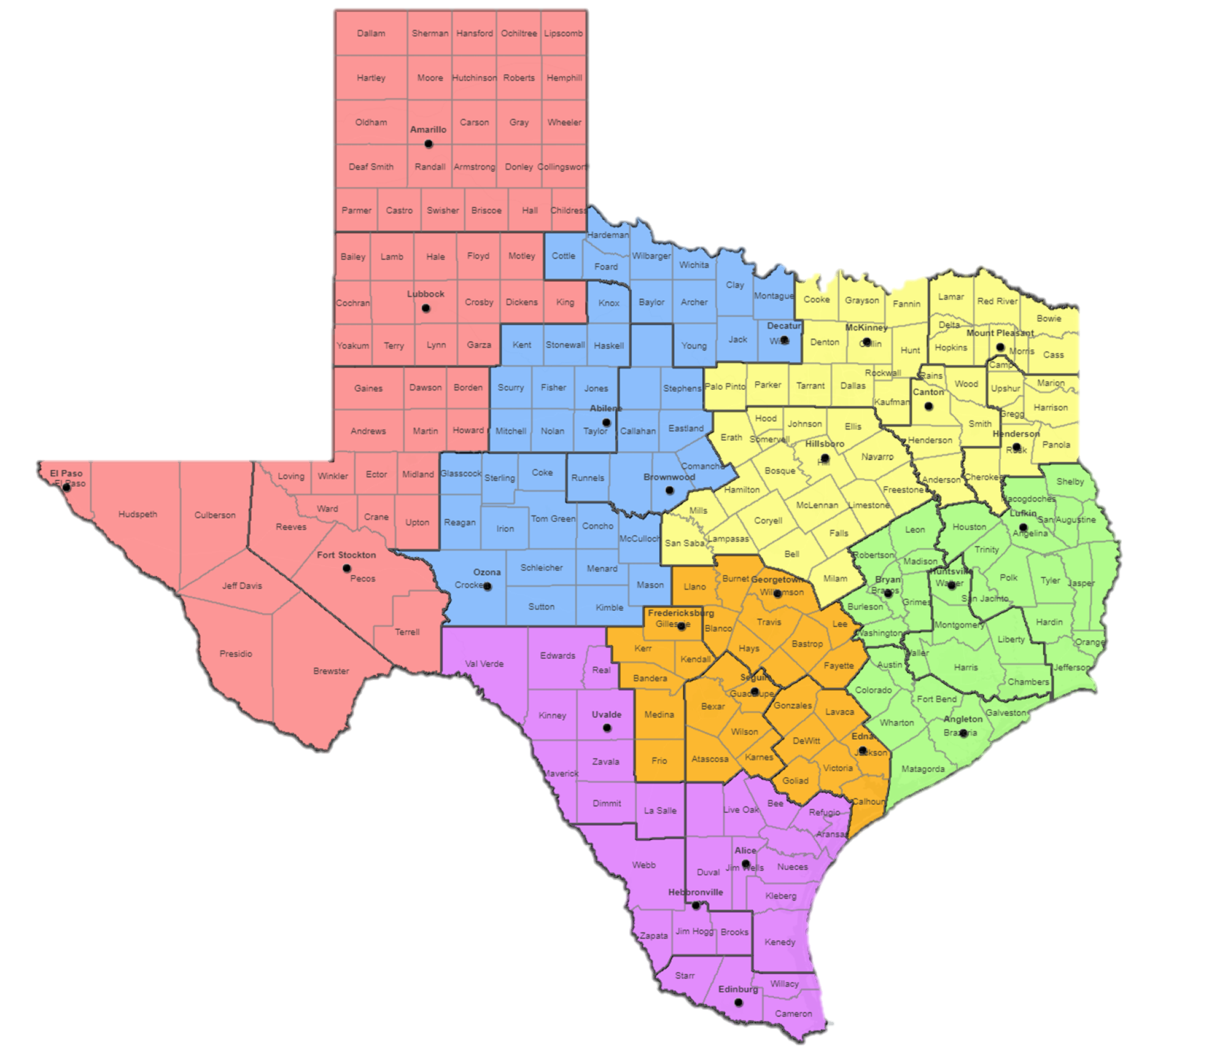
Amarillo
Abilene
Brownwood
Decatur
McKinney
Lubbock
Mt. Pleasant
El Paso
Hillsboro
Henderson
Lufkin
Ft. Stockton
State Office
Huntsville
Georgetown
Fredericksburg
Ozona
Angleton
Uvalde
Alice
Seguin
Edna
Hebbronville
Edinburg

Slide 7
USDA Rural Development Agencies
Rural Business Cooperative Service
Rural Development’s Rural Business-Cooperative Service (RBCS) is an agency that supports rural economic development through a variety of programs and services. It focuses on boosting the viability of rural businesses, promoting cooperatives, and creating job opportunities. RBCS offers financial assistance, technical support, and resources to help rural businesses expand, become more competitive, and promote community development. It aims to strengthen rural America's economic foundation by increasing access to capital, improving infrastructure, and encouraging entrepreneurship.
Rural Housing Service
USDA’s Rural Housing Service offers loans, grants, and loan guarantees for single and multi-family housing and essential community facilities in rural areas. Rural Housing Service also provides technical assistance loans and grants in partnership with non-profit organizations, Indian tribes, and state and federal government agencies.
Rural Utilities Service
USDA's Rural Utilities Service (RUS) provides financing for much needed infrastructure improvements to rural communities. These include water and waste treatment, electric power, telecommunication and broadband services. This investment helps expand economic opportunities, reduce utility costs to consumers, and improve the quality of life for farmers, ranchers, and rural families.
Notes:
Through our three agencies we are able to touch every need that a rural community might need from housing to utilities to business. We are a one stop shop for a fully integrated funding shop to meet all the needs of rural communities.

Slide 8
FY 2026 Funding Outlook
Rural Development received $4.1 billion to support rural development programs across the U.S.
  $1.7 billion for affordable housing rental assistance for low-income families and seniors in rural communities, as requested by the Administration.
  $1 billion for Single-Family Housing direct loans and $25 billion in for the guaranteed Single-Family Housing loans.
  $1.4 billion to prioritize revitalization of aging water and wastewater infrastructure through grants and loans.
  $1.8 billion in grants and loans for rural business and industry programs to promote economic growth.
  $109 million for rural broadband grants and loans aimed at the nation’s most hard-to-reach areas.

Slide 9
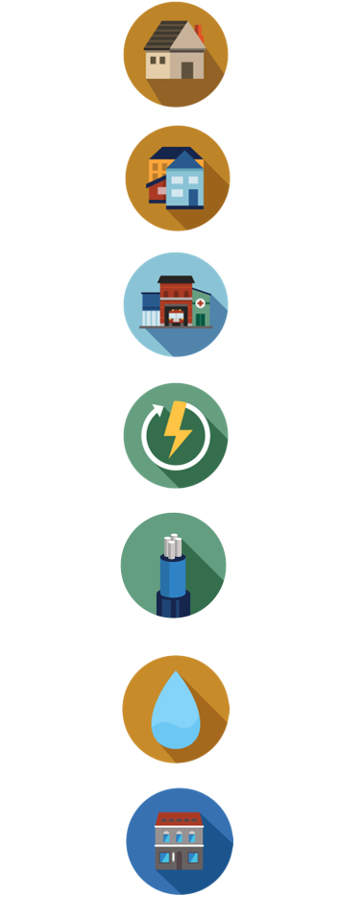
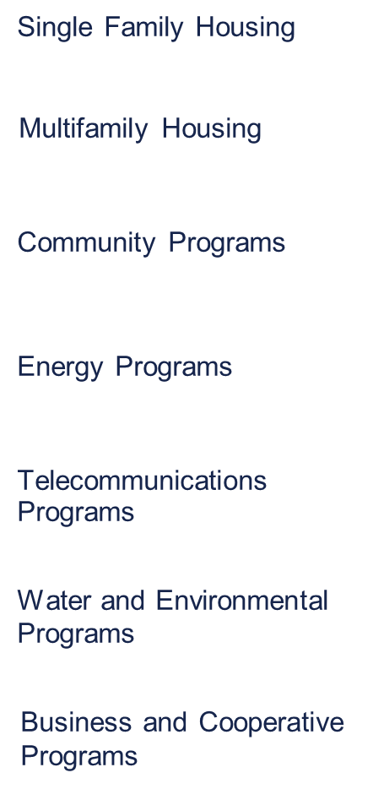
USDA Rural Development Programs
We have more than 70 programs to support rural America.
Rural America’s Partner in Prosperity
USDA Rural Development invests in rural America with loan, grant, and loan guarantee programs because we understand a strong community is rooted in its people. The commitment and resources we bring to rural communities helps drive economic security and prosperity. Our programs expand access to high-speed internet, electric, and transportation infrastructure, and support business
growth, healthcare, education, housing, and other community essentials.

Slide 10
Single Family Housing Programs
Housing Preservation Grants – Closed/Fall
More information can be found here.
This program provides grants to qualified sponsoring organizations to repair or revitalize housing for eligible lower-income people.
Single Family Housing Repair Loans and Grants - Open year-round until funds exhausted
More information can be found here.
This program provides 1-percent-interest loans up to $40,000 to lower-income homeowners to repair, improve, or modernize their homes. Grants up to $10,000.
Mutual Self-Help Housing Technical Assistance Grants - Open year-round until funds exhausted
More information can be found here.
This innovative program provides funding for technical and supervisory assistance to qualified organizations that support rural self-help housing construction.
Single Family Housing Home Loan Guarantees – Open year-round
More information an be found here.
With this program, you work with a Rural Development-approved lender to finance a modest home in an eligible rural area, and then USDA guarantees 90 percent of the loan. No down payment is required.
Single Family Housing Direct Home Loans – Open year-round until funds exhausted
More information can be found here.
With this program, USDA directly finances mortgages for low-and very-low income applicants to buy, build, improve, or repair an eligible rural home as their principal residence.
Individual Water & Wastewater Grants for Colonias - Open year-round until funds exhausted
More information can be found here.
This program provides funding to offset the cost of connecting residential water and waste service lines, pay utility hookup fees, and install plumbing and related fixtures. Designated colonias are unincorporated, low-income, residential subdivisions located within 150 miles of the U.S.-Mexico border in Texas, New Mexico, Arizona, and California.

Slide 11
Community Programs
Community Facilities Direct Loans, Grants and Loan Guarantees – Open year-round
Direct loan and grant information is available here.
Loan Guarantee information is available here.
This program helps finance construction of – or improvements to – essential community facilities such as hospitals, clinics, nursing homes, certain schools, childcare centers, libraries, and town halls, among others. Funds also can be used to purchase necessary equipment and pay for related project expenses.
Rural Community Development Initiative Grants – Closed/Fall
More information is available at here.
This competitive program helps nonprofit housing and community development organizations, lower- income rural communities, and federally recognized Tribes support housing, essential community facilities, and economic development in rural areas.

Slide 12
Rural Utilities Service: Water & Environmental
Circuit Rider Program – Technical Assistance for Rural Water Systems – Open year-round
More information is available here.
This program provides technical assistance to rural water systems experiencing day-to-day operational, financial or managerial issues. Among other things, the Circuit Rider program can help with board training, management, finance, operations, maintenance, leak detection, water treatment, regulatory compliance, facility security, disaster and emergency assistance, loan application, and reporting requirements.
Water and Waste Disposal Loans, Grants, and Loan Guarantees - Open year-round
More information is available here and here.
This program helps private lenders provide affordable financing to qualified borrowers to improve access to clean, reliable water and waste disposal systems for households and businesses in rural areas.
Solid Waste Management Grants – Closed/Fall
More information is available here.
This program reduces or eliminates water pollution by providing funding to eligible organizations that provide technical assistance or training to improve the planning and management of solid waste sites.
Emergency Community Water Assistance Grants - Open year-round
More information is available here.
This program helps eligible communities prepare – or recover from – an emergency that threatens the availability of safe, reliable drinking water. Grants can be used for maintenance, to build waterline extensions, repair breaks or leaks in existing distribution lines, and to build intake or treatment facilities.
Revolving Funds for Financing Water and Wastewater Projects – Closed/Summer
More information is available here.
This program helps qualified nonprofits create revolving loan funds that provide financing to extend and improve water and waste disposal systems in rural areas.

Slide 13
Rural Utilities Service: Electric
Distributed Generation Energy Project Financing – Open year-round
More information is available here.
This program offers loans and loan guarantees to eligible developers of distributed energy projects that provide wholesale or retail electricity to existing USDA RD Electric Program borrowers, or to rural communities serviced by other utilities. Distributed generation projects – including those using renewable resources – provide crucial, additional power supply options for rural communities.
Rural Energy Savings Program - Open year-round
More information is available here.
This program provides loans to rural utilities and other companies that offer energy efficiency loans to qualified consumers. Funds can be used to implement energy efficiency measures that decrease energy use or costs for rural families and small businesses.
Electric Infrastructure Loans and Loan Guarantees – Open year-round
More information is available here.
This program helps rural communities access affordable, high-quality electric service. Loans and loan guarantees are used to finance the construction of electric distribution, transmission, and generation facilities.
Energy Efficiency and Conservation Loans - Open year-round
More information is available here.
This program provides pass-through funding for energy efficiency and conservation projects for residential, commercial, and industrial consumers. Funds can be used by eligible utilities – including existing Rural Utilities Service Electric Program borrowers – to develop and deliver new, diverse energy service products in their service territories.

Slide 14
Rural Utilities Service: Telecommunications
Community Connect Grants - Closed
More information is available here.
This program offers financial assistance to eligible applicants to provide broadband service in economically-challenged rural areas where service does not exist.
Telecommunications Infrastructure Loans and Loan Guarantees – Open year-round
More information is available here.
This program provides funds to build, maintain, improve, or expand telephone and broadband service in rural areas.
Distance Learning and Telemedicine Grants – Closed/Spring
More information is available here.
This competitive program helps rural communities use advanced telecommunications technology to connect to each other – and the world – overcoming the effects of remoteness and low population density.
Rural Broadband Loans, Loan and Grant Combinations, and Loan Guarantees - Closed
More information is available here.
This program offers loans, loan and grant combinations, and loan guarantees to eligible applicants for the construction, improvement, or purchase of facilities and equipment needed to provide service at the broadband lending speed (the minimum bandwidth requirement) in eligible rural areas.

Slide 15
Business and Cooperative Programs
Business and Industry Loan Guarantees – Open year-round
More information is available here.
This program offers loan guarantees to lenders for their loans to rural businesses. Funds can be used for business conversions, expansion, repair, modernization, or development. Up to $25 million.
Rural Business Development Grants – Closed
More information is available here.
These grants funds public economic development activities to help small and emerging private businesses and nonprofits in rural communities start or expand.
Value-Added Producer Grants – Currently open, closes on April 15th
More information is available here.
The VAPG helps independent agricultural producers begin processing and marketing activities that add value to their products. $200,000 for working capital and $50,000 for planning grants.
Rural Business Investment Program – Open year-round
More Information is available here.
This program provides Rural Business Investment Company (RBIC) licenses to newly-formed developmental capital organizations to help meet equity capital investment needs in rural communities.
Biorefinery, Renewable Chemical, and Biobased Product Manufacturing Assistance Program – Open year-round
More information is available here.
This program provides loan guarantees up to $250 million to develop, build, or retrofit facilities to support new and emerging technologies, and produce advanced biofuels, renewable chemicals, and biobased products.
Agriculture Innovation Center Program – TBD/Delayed
More information is available here.
The AICP awards technical assistance grants to eligible agriculture innovation centers to help develop and market value-added agricultural products.

Slide 16
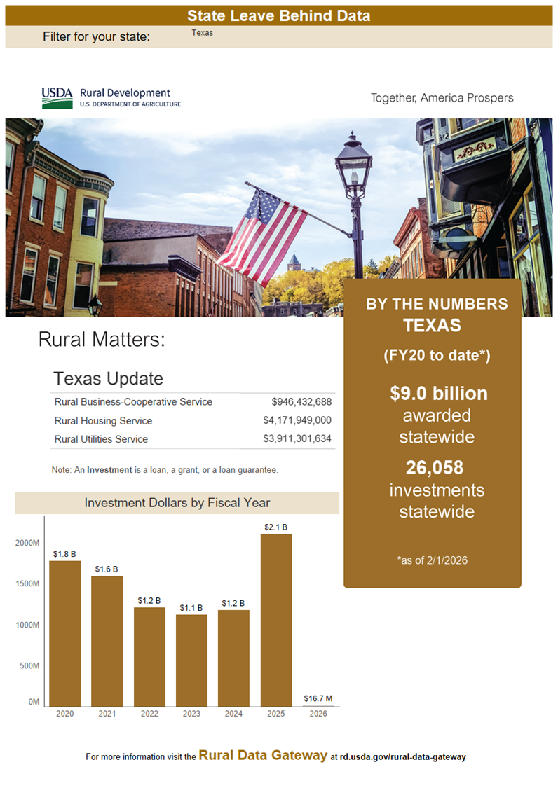

Slide 17
Key Contacts
John Powell – Acting Single Family Housing Director
John.Powell@USDA.gov
Cell: (325) 201-9828
James Redfield – State Director
James.Redfield@USDA.gov
Cell: (254) 935-8957
Micheal Self– Business Programs Director
Micheal.Self@USDA.gov
Cell: (254) 742-9779
Matthew Armato – Deputy State Director
Matthew.Armato@USDA.gov
Cell: (202) 748-1717
Micheal Canales – Community Programs Director
Micheal.Canales@USDA.gov
Cell: (254) 913-3102
https://www.rd.usda.gov/

