Slide 1
9-1-1 Program Finance Overview
January/February 2026 Lorrain Meek

Slide 2
9-1-1 Program: Finance
Agenda
CSEC Teams
Resources:
Program Policy Statements
Walk-through Videos
CPA Payment Search
CPA Transparency: State Revenue and Spending
Program Income
Funding Requests (FRs)
Quarterly Financial Reports (QFRs)

Slide 3
CSEC Team

Slide 4





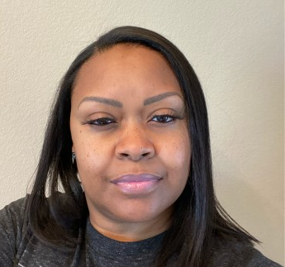
9-1-1 Program: Finance
CSEC Teams
Finance:
Lorrain Meek
Chief Financial Officer
512-968-8226
lorrainm@csec.texas.gov
Elsa Paynes
Accountant
512-968-2597
elsap@csec.texas.gov
Pamela Parks
Accountant
512-968-2035
pamelap@csec.texas.gov
Program
Heather Barnes
Director of Programs
512-969-0740
heatherb@csec.texas.gov
Becky Cooley
9-1-1 Program Manager
512-975-9176
beckyc@csec.texas.gov
Kimber Snoddy
9-1-1 Program Manager
512-969-0914
kimbers@csec.texas.gov

Slide 5
Resources

Slide 6
9-1-1 Program: Finance
Resources: Program Policy Statements
PPS-001 Regional Planning Commission Advance Quarterly Funding
PPS-003 Post Year-End Expenditure Reporting and Close-outs
PPS-005 Funding Request
PPS-006 Quarterly Financial Information Reporting and Disbursements
Exhibit A: Additional Instructions
Exhibit B: Grant Management Systems Access
Exhibit C: COG/RPC License Form
PPS-009 Program Income

Slide 7
9-1-1 Program: Finance
Resources: Walk-through Videos
How-To Videos on Utilizing Salesforce - YouTube
Funding Requests (FRs)
Create & Submit Funding Request
COG Review & Approve Funding Request
Quarterly Financial Reports (QFRs)
Enter & Submit QFR
COG Review & Approve QFR

Slide 8
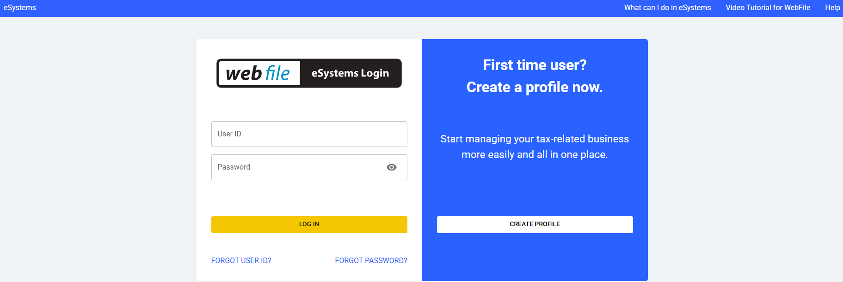
9-1-1 Program: Finance
Resources: CPA Payment Search
Texas Comptroller of Public Accounts > Under Business Center > Look It Up > State Payments Issued
A profile MUST be created to utilize this system
Comptroller eSystems | Security Portal Login

Slide 9
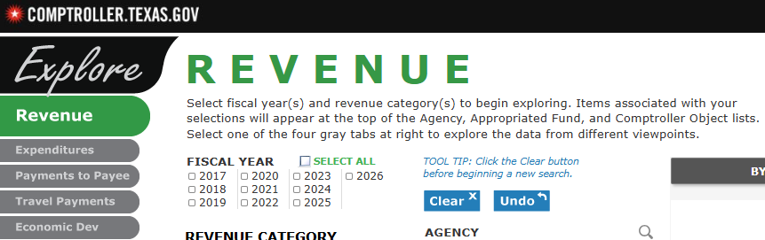
9-1-1 Program: Finance
Resources: CPA Transparency: State Revenue and Spending
Texas Comptroller of Public Accounts > Under TRANSPARENCY in the top menu bar > Revenue and Spending > State Revenue and Expenditure Dashboard

Slide 10
Program Income

Slide 11
9-1-1 Program: Finance
Program Income
PPS-009 Program Income
What is Program Income
Fees for services performed;
The use or rental of real or personal property acquired with grant funds;
Royalties and license fees for copyrighted materials, patents, and inventions developed by the grantee;
The sale of commodities or items fabricated under the RPC’s contract with the Commission;
Payments of principal and interest on loans made with grant funds; and,
Interest earned in excess of $250 on grants from purely state sources
REPORT ALL PROGRAM INCOME INTEREST

Slide 12
Funding Requests (FRs)

Slide 13
9-1-1 Program: Finance
Funding Requests (FRs)
PPS-005 Funding Request
www.csec.texas.gov > Documents Libraries > 9-1-1 PROGRAM > Program Policy Statements
LEGAL BASIS:
Article IX of the General Appropriations Act states in part:
A state agency shall distribute grants on a reimbursement or as needed basis unless otherwise provided by statute or otherwise determined by the grantor agency to be necessary for the purposes of the grant.
Health and Safety Code Section(s) 771.078(c)(7) states:
Contracts under this section must provide for a means for the commission to give an advance on a quarterly distribution under the contract to a regional planning commission that has a financial emergency.

Slide 14
9-1-1 Program: Finance
Funding Requests (FRs)
WHY submit a funding request?
Four reasons
Current Year: Expenses > quarterly advance/reimbursement
Post-Current Year: Payment of invoice, against an encumbrance
Any Period: Equipment reimbursement
Any Period: Project reimbursement (NG911)

Slide 15
9-1-1 Program: Finance
Funding Requests (FRs)
WHEN to submit a funding request?
Any Time
Minimum: Prior-to or in accordance with each Quarterly Financial Report,
including Addendums
Regional Planning Commissions (RPCs) can submit funding requests when they receive an invoice to which any of the four reasons on the prior slide apply.

Slide 16
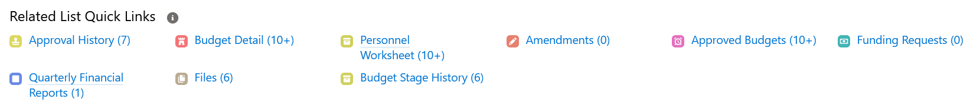
9-1-1 Program: Finance
Funding Requests (FRs)
HOW to submit a funding request?
Navigate to Funding Request by:
Accounts > RPC Name > Strategic Plan > Stage 2b > Budget Stages
Select New on the right-side of the page
Fields:
Budget: Stage 2b selected
Year: 1 or 2
Finance Approver: Salesforce will auto-fill the appropriate user

Slide 17
9-1-1 Program: Finance
Funding Requests (FRs)
WHAT to submit in a funding request?
Budget Type: (1) Admin
(2) Program
(3) Equipment
Invoice(s) which support the request. ONLY complete invoices*
If additional information is needed, CSEC staff will ask.
Submission is limited to 10 lines (vendor)
*Equipment invoices MUST indicate PSAP. Noted on invoice or attached document.

Slide 18
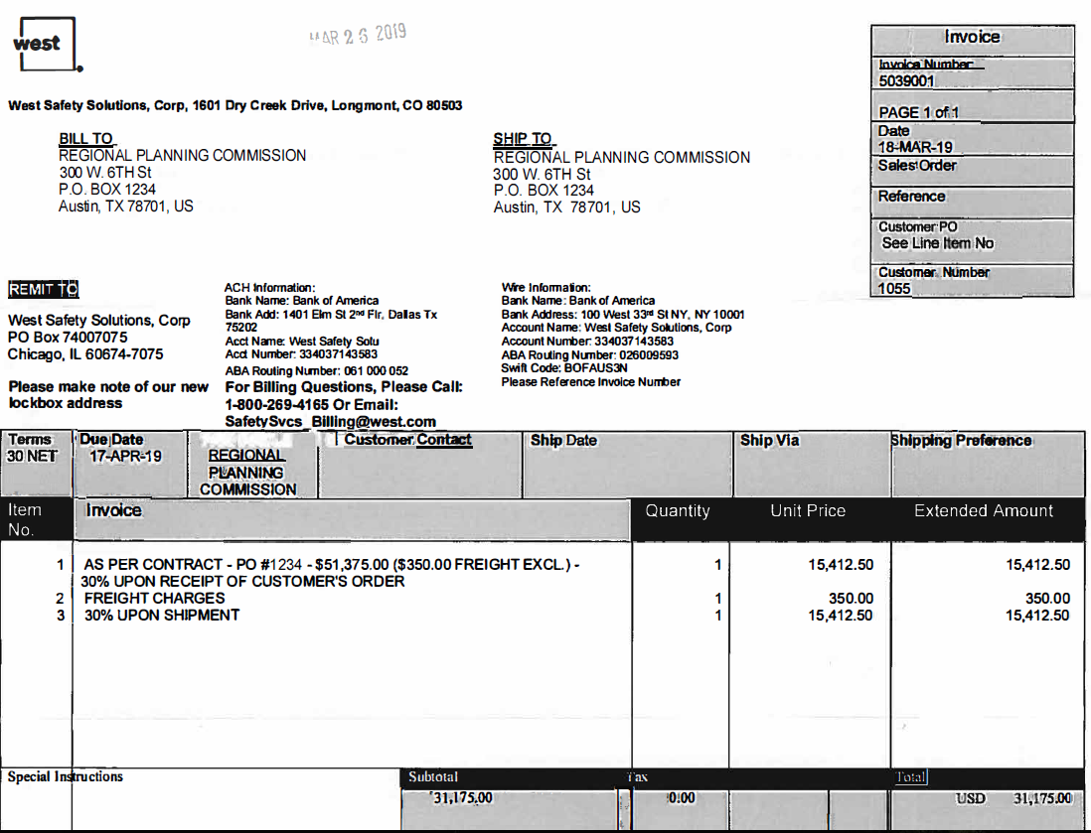
9-1-1 Program: Finance
Funding Requests (FRs)
What: CPE Refresh
Who: All PSAPs

Slide 19
Quarterly Financial Report (QFR)

Slide 20
9-1-1 Program: Finance
Quarterly Funding Request (QFRs)
Program Policy Statements (PPS) 006: Quarterly Financial Information Reporting and Disbursements
www.csec.texas.gov > Documents Libraries > 9-1-1 PROGRAM > Program Policy Statements
LEGAL BASIS:
General Appropriations Act, Article IX
Health and Safety Code Section 771.078(c)
Commission Rule 251.12,Commission and Regional Planning Commission Contracts for 9-1-1 Service

Slide 21
9-1-1 Program: Finance
Quarterly Funding Request (QFRs)
Article IX of the General Appropriations Act states in part:
Funds appropriated by this Act for grants of money to be made by state agencies, including agencies of the legislative branch, are appropriated for the statutory purposes as the grantor may specify. A state agency shall distribute grants on a reimbursement or as needed basis unless otherwise provided by statute or otherwise determined by the grantor agency to be necessary for the purposes of the grant.
Health and Safety Code Section 771.078(c) (and Commission Rule 251.12) states in part that the biennial contracts with Regional Planning Commissions (RPCs) must provide for:
(1) the reporting of financial information regarding administrative expenses by regional planning commissions in accordance with generally accepted accounting principles;. . .
(5) the quarterly disbursements of money due under the contract, except as provided by Subdivision (6);
(6) the Commission to withhold disbursement to a regional planning commission that does not follow a standard imposed by the contract, a Commission rule, or a statute; and
(7) a means for the Commission to give an advance on a quarterly distribution under the contract to a regional planning commission that has a financial emergency.

Slide 22
9-1-1 Program: Finance
Quarterly Funding Request (QFRs)
WHEN to submit Quarterly Financial Reports
Quarterly. Currently, these are due the 25th after the quarter-end
The full calendar can be seen at:
www.csec.texas.gov > Documents Libraries > 9-1-1 PROGRAM > RPC Resources > Calendar
HOW to submit a financial report?
CSEC Finance will release the quarterly report, at least 5 days prior to the due date.
Navigate to Quarterly Financial Reports by:
Accounts > RPC Name > Strategic Plan > Stage 2b > Budget Stages

Slide 23
9-1-1 Program: Finance
Quarterly Funding Request (QFRs)
WHAT to submit on the Quarterly Financial Reports
Expenses-to-date as of the quarter end.
The QFR will be pre-populated with the expenses reported in the prior quarter.
Update the Program Income section on the Details page

Slide 24

Questions? Comments?

