Slide 1


Supporting Older Adults with DD & Caregivers
Presenter: Evan Marczynski
OVERVIEW
What is TCDD?
Addressing Needs and Barriers
Project and Resource Spotlight
How to Connect with TCDD

Slide 2
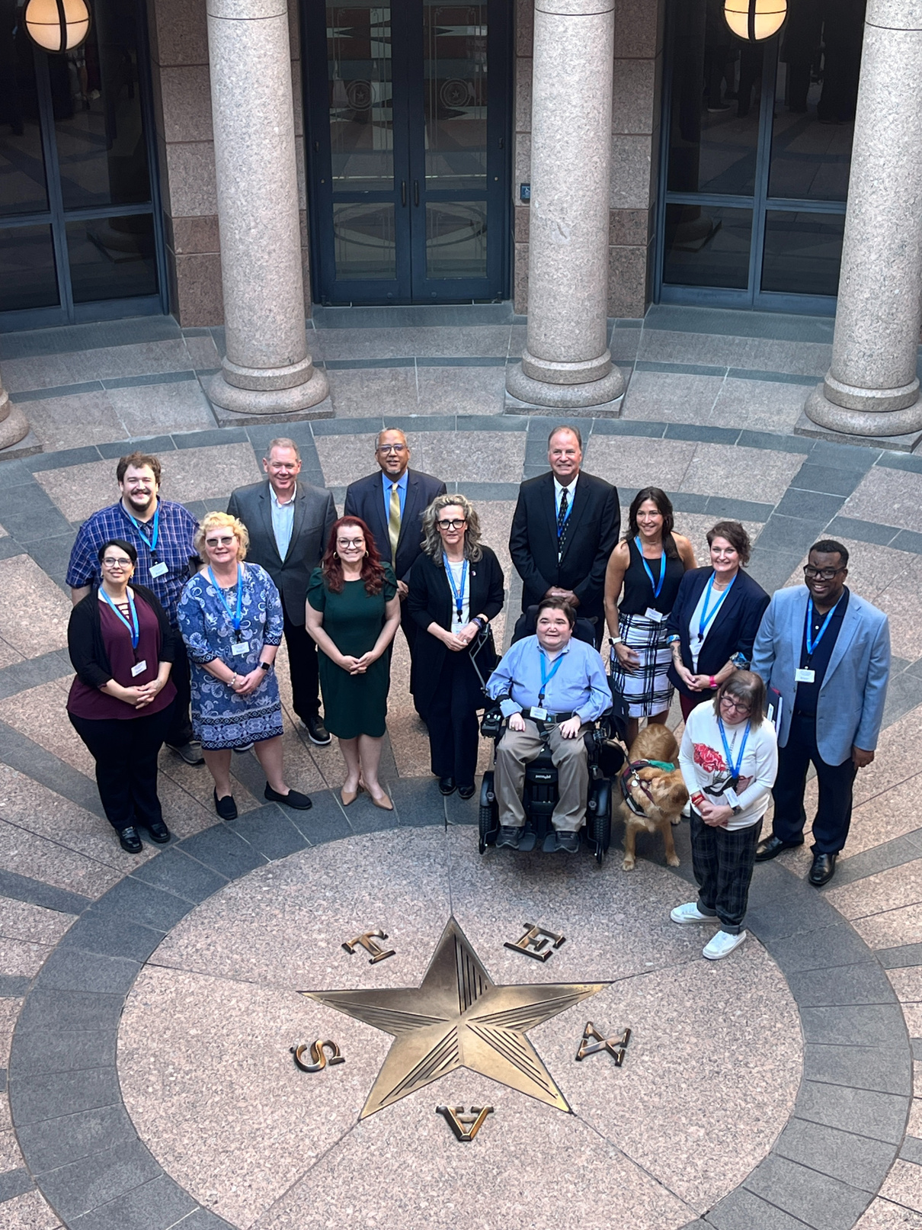

What is TCDD?
Led by a Council that includes Texans with DD, family members of Texans with DD, and agency representatives.
State agency fully funded by the federal government through the Developmental Disabilities Assistance and Bill of Rights Act (DD Act).

Slide 3
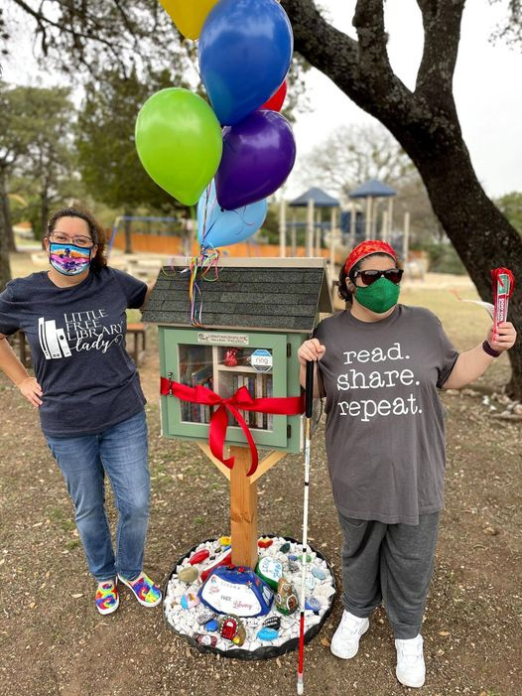

What is TCDD?
Supporting people with
DD in making their own decisions on how to live, work, and engage in their communities.
Funding innovative grant projects across Texas to develop best practices and increase capacity for services and support.

Slide 4
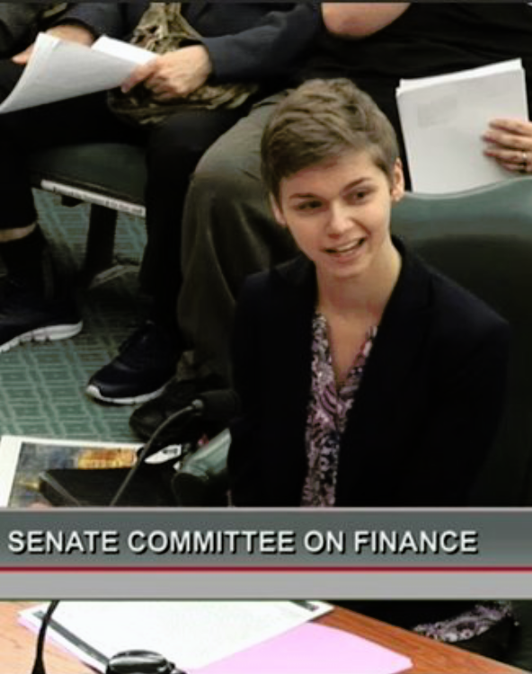
What is TCDD?
Serving as a nonpartisan resource to help Texas lawmakers understand how policy decisions impact the disability community.
Coordinating leadership training programs to enhance the skills and confidence of future disability leaders.

Slide 5
Addressing Needs & Barriers
TCDD Initiatives to Support Older Adults with DD and Caregivers
Building a statewide virtual training network for health providers and caregivers of older adults with DD.
Creating mental health resources to help older adults with DD handle grief and loss.
Developing training for people with DD who may need to care for older family members.

Slide 6
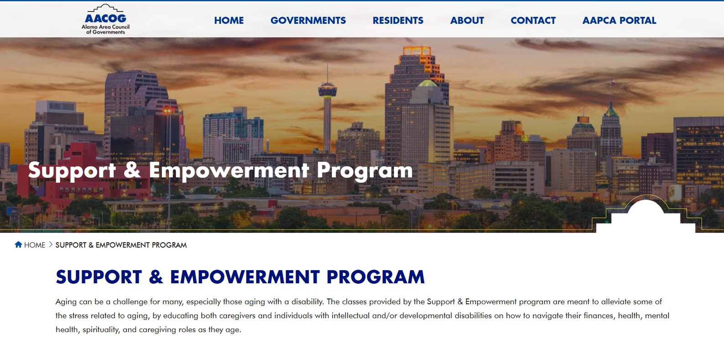
Project Spotlight
Alamo Area Council of Governments holistically addressed the health and well-being of older adults with DD and caregivers.
Provided classes and educational resources to meet wide-ranging nutrition, fitness, and wellness needs.

Slide 7
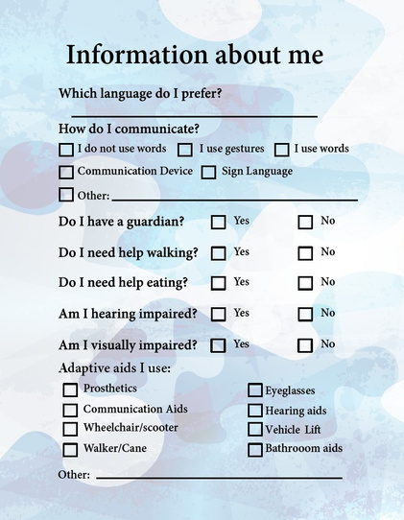

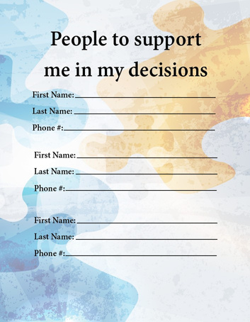
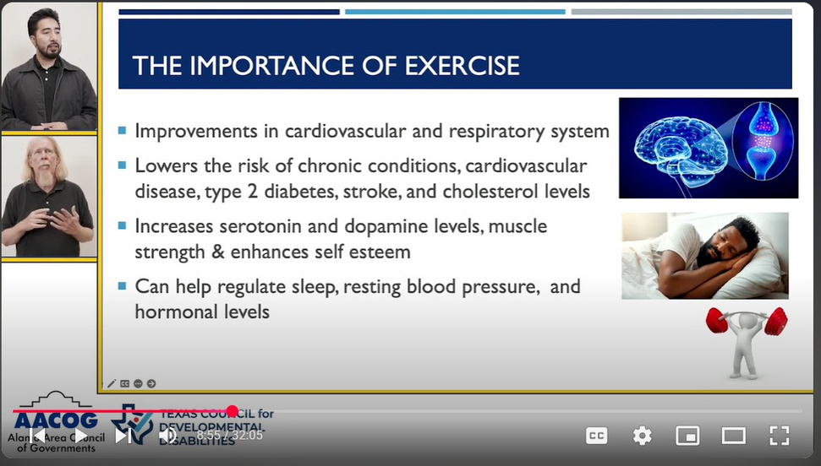
Health Passport
Downloadable booklet to support older adults with DD in advocating
for their own health care needs
and preferences.
Informational Videos
Online video series that covers how
to manage money, develop healthy habits, understand legal rights,
and more.

Slide 8
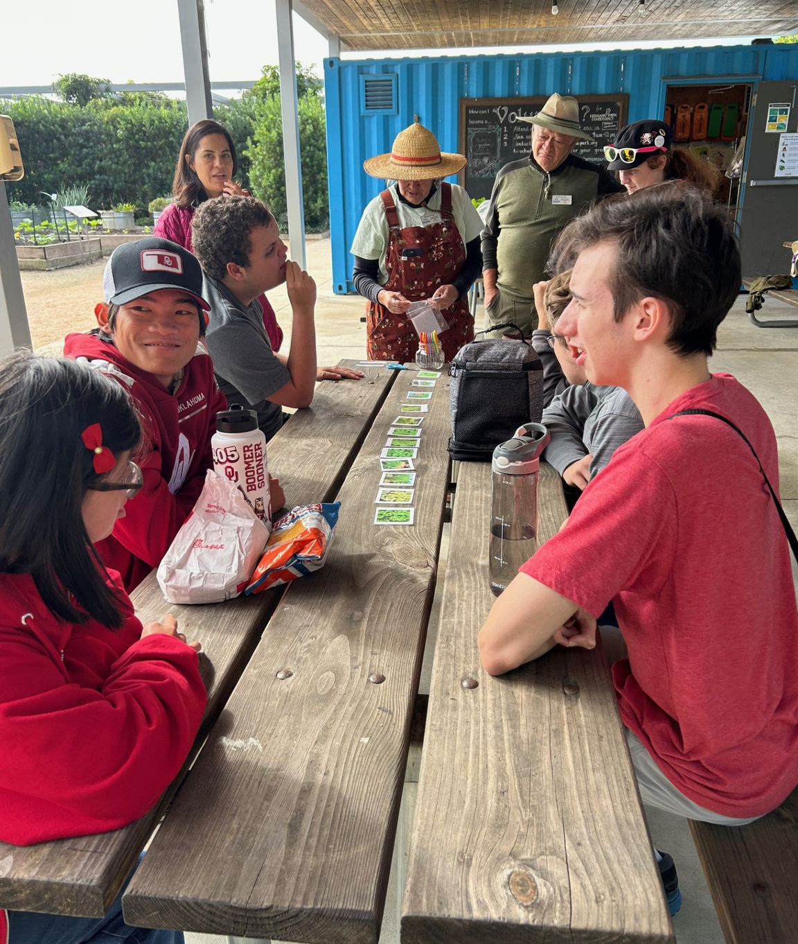
How to Partner with TCDD
Connect with a Disability Community Coordinator in your part of Texas.
Apply for grant funding through our Request for Applications process.

Slide 9


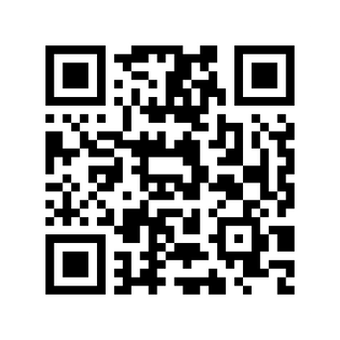




Connect with Us
tcdd@tcdd.texas.gov
tcdd.texas.gov
Scan to
join our
email list
@txcdd
@txcdd
@txcdd
Our work is supported by a grant from the U.S. Administration for Community Living (ACL), Department of Health and Human Services (HHS), Washington, D.C. 20201 with a 100% federal funding award totaling $6,161,072. Council efforts are those of the grantee and do not necessarily represent the official views of nor are endorsed by ACL, HHS, or the U.S. government.

