Slide 1

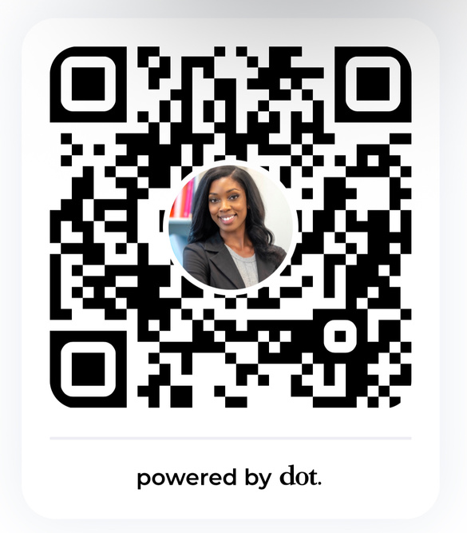
AgriLife Extension | TCDD
Initiative
Disability Community Coordinators
Morgan Foster, DrPH

Slide 2
AGENDA
  How can we serve as connectors for you?
  How can you all serve as connectors for us?
  Opportunities for cross-collaboration to reach more older adults with disabilities

Slide 3


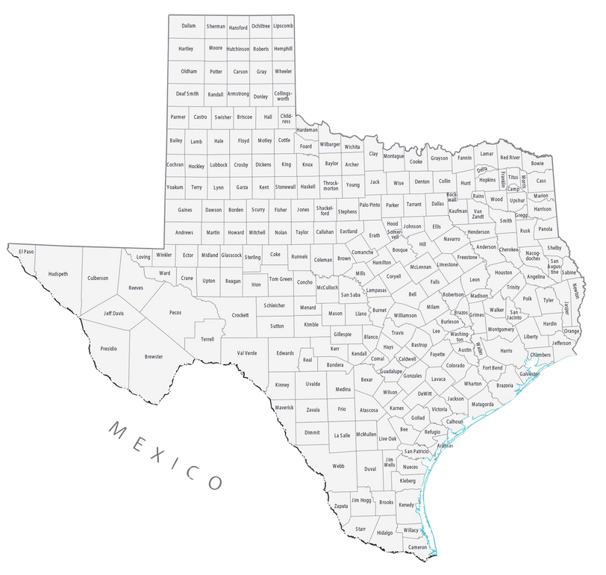


AgriLife Extension & TCDD

Slide 4

Disability
Community
Coordinators

Slide 5
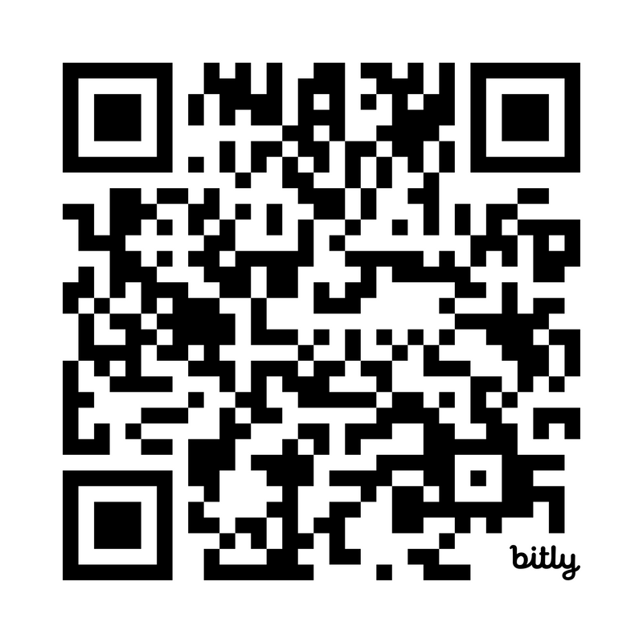

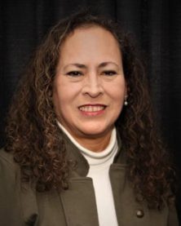
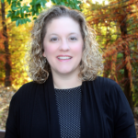
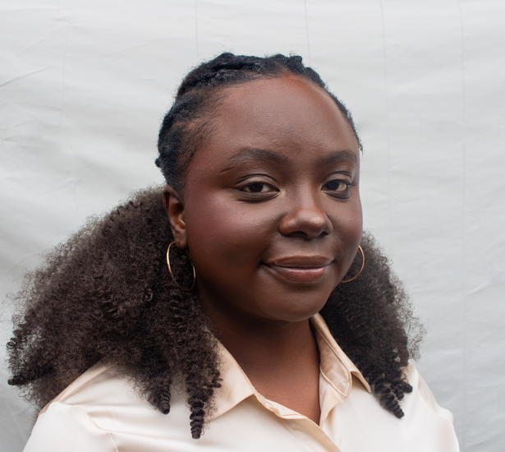

morgan.foster@ag.tamu.edu
Dr. Morgan Foster
alexandra.venegas@ag.tamu.edu
COASTAL, WEST
Alexandra Venegas
rosa.guel@ag.tamu.edu
CENTRAL
Rosa Guel
erin.fogarty@ag.tamu.edu
SOUTH
Erin Fogarty
olu.motoni@ag.tamu.edu
Contact Our
Team!
NORTH
Olu Motoni
EAST

Slide 6
Project Impact Highlights
8,000+
participants served through educational trainings, outreach, webinars, and community engagement.
500+
Aging and IDD service providers, caregivers, and self-advocates have received educational information and resources through our virtual webinar series.
100+
Educational trainings on disability-related topics such as mental wellness, accessible healthcare, workplace preparation, youth programs, and others.
Disability
Community
Coordinators
1000+
Extension professionals trained on recommendations for accessible Extension programming
2,000 +
Contacts
500+
Community partners

Slide 7
Key Program Areas
  Resources for individuals with IDD, family members, and professionals.
  Educational trainings and technical assistance on disability-related topics and accessible programming guidelines.
  Collaborations with disability partners to make meaningful connections with individuals with IDD and families in the community.
Health & Wellness
Gardening
Trainings
Employment
Outreach
Resources

Slide 8

DCCs as Connectors
  Deep connections to local communities through county Extension agents and community partners
  Statewide Expansion of outreach and education
  Ability to collect information and provide data-driven and evidence-based strategies
  Support federal and state aging initiatives

Slide 9
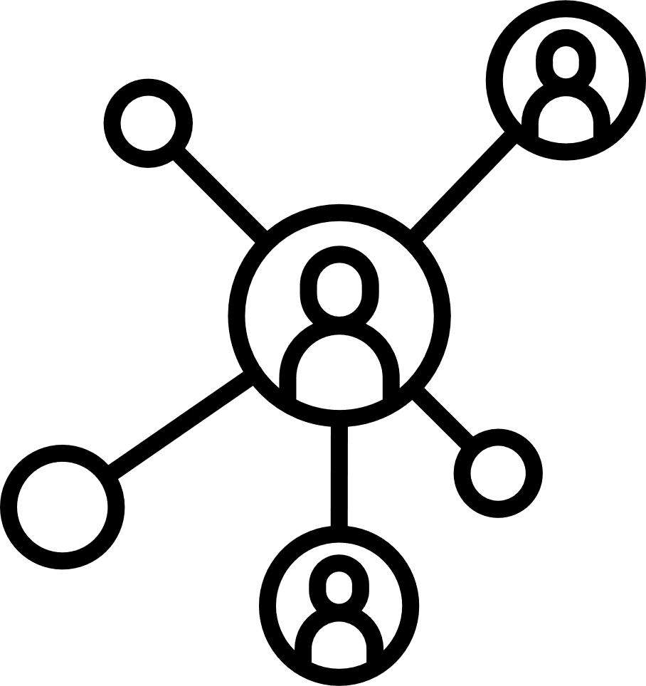
TARC as Connectors
  Connection to local communities.
  Provide feedback on programmatic efforts.
  Share resources and data on aging services.
  Help avoid duplication of efforts.

Slide 10
Cross-collaboration
  Co-host workshops and trainings.
  Share outreach and marketing efforts.
  Create referral pathways for older adults and caregivers.
  Collect and share data to show impact.

Slide 11


