Slide 1
Aging Texas Well (ATW) Strategic Plan
Texas’ Multisector Plan on Aging (MPA)

Slide 2
Agenda
Learn about the benefits of an MPA
Discuss the Aging Texas Well Strategic Plan
Understand Key Differences in Aging Plans
Share Methods for Stakeholder Engagement
Highlight Key Domains for 2028-2029 ATW Plan

Slide 3
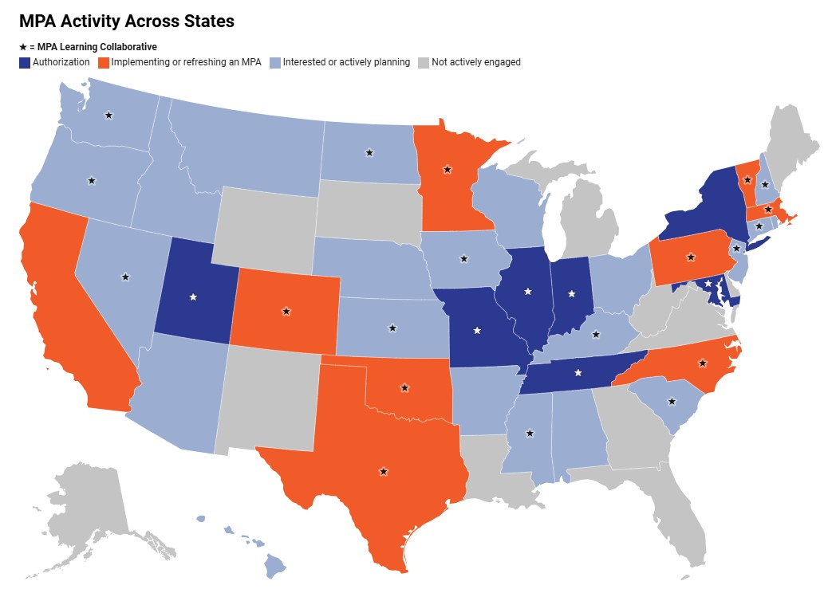
Multisector Plans on Aging
Multisector Plans on Aging (MPAs) are state-led, cross-agency, multi-year planning documents that convene a broad range of public and private stakeholders to collaboratively address the current and future needs of the aging population, including those with disabilities.

Slide 4
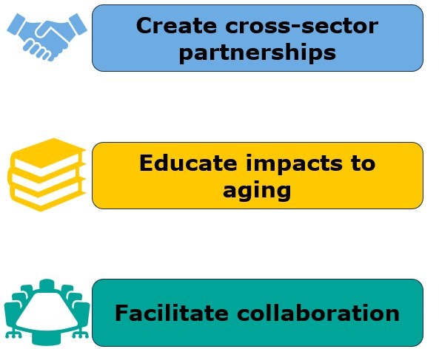
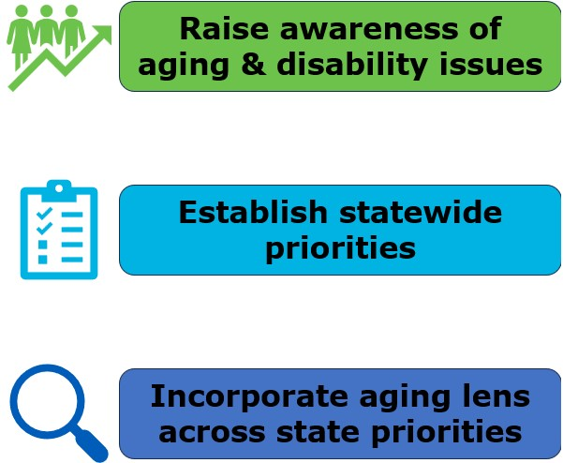
Benefits of an MPA
Notes:
Create partnerships across sectors that bring aging experts to the forefront and ensure evidence-based/data driven planning
Educate sectors how their work impacts older adults (even if not specifically focused on aging or disability)​
Facilitate collaboration between policymakers and broad stakeholders​
Raise awareness about how aging and disability-related policy impacts people at all stages of life​
Establish statewide priorities to respond to unanticipated and urgent events​
Incorporate an aging and disabilities lens across state priorities beyond traditional health care and community services

Slide 5

Aging Texas Well
The Aging Texas Well (ATW) initiative helps Texans prepare for all aspects of aging at the individual, community and state level. Formalized in 2005 by Executive Order R.P. 42, ATW identifies policy issues, guides state readiness, and promotes increase community preparedness.

Slide 6
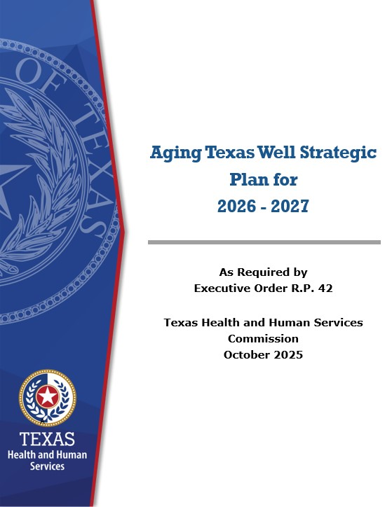
Aging Texas Well Strategic Plan Overview
The ATW Strategic Plan is Texas’ MPA. The ATW Strategic Plan is:
Led by the HHSC.
Separate from the State Plan on Aging (SPoA).
Separate but informed by the Statewide Interagency Aging Services Coordinating Council (SIASCC) Strategic Plan
Developed through cross-sector coordination and planning.

Slide 7
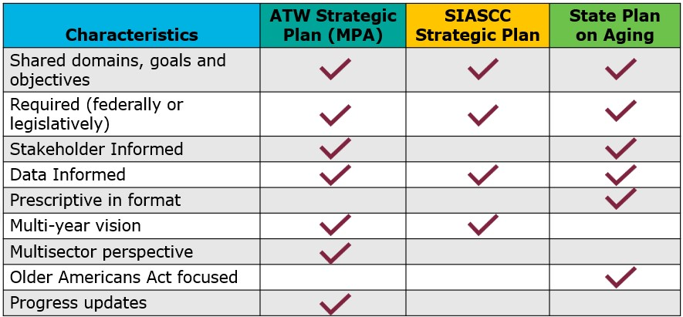
Comparison of Aging Plans

Slide 8
Sectors Informing the ATW Strategic Plan
AGING TEXAS WELL STRATEGIC PLAN
A biennial multisector plan issued by the Texas Health and Human Services Commission (HHSC). Launched under Executive Order R.P. 42 in 2005.
HHSC
Internal Stakeholders
SIASCC
Commitee Members both
Internal and External
STATE AGENCIES
External Stakeholders
OTHER SECTORS
External Stakeholders
Adult Mental Health
Office of Guardianship Services
The Office of the Governor
Office of the Attorney General
Employee Retirement System
Texas Comptroller of Pubic Accounts
Alzheimer’s Association
Inform Texas
Family Health Services
Office of Mental Health Coordination
Texas Department of Family and Protective Services
Barshop Institute for Longevity and Aging Studies
Texas Department of Transportation
Texas Commission on Environmental Quality
American Association of Retired Persons
Texas AgriLife Extension
Medicaid and CHIP Services
Office of Veteran Services Coordination
Texas Department of State Health Services
Texas Aging and Longevity Consortium
Texas Commission on Law Enforcement
Teachers Retirement System
American Heart Association
LeadingAge
Office of Aging and Disability Resource Centers
Quality Monitoring Program
Department of Agriculture’s State Office of Rural Health
Texas Department of Housing and Community Affairs
Center for Community Health and Aging
Broadband Workgroup/Coalition
Texas Association of Regional Councils
Office of Aging Services Coordination*
State Long-Term Care Ombudsman
Texas Veterans Commission
Texas Workforce Commission
Texas Guardianship Association
Texas Silver Haired Legislature
Office of Area Agencies on Aging
Office of Disability Services Coordination

Slide 9





2028-2029 ATW Strategic Plan - Domains
Access to services
Healthy Aging
Promoting healthy aging suppports older adults in living longer, more active, and fulfilling lives.
Access to essential services empowers older adults to maintain their health, independence, and quality of life as they age.
Age-Friendly
Caregiver support
Creating age-friendly communities ensures that older adults can thrive in environments that support their needs, preferences, and abilities.
Supporting caregivers directly enhances the well-being, safety, and stability of older adults.

Slide 10



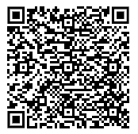
Brainstorming on ATW Domains
I like
I wish
I wonder
What’s good, motivating, exciting, or otherwise positive?
What was bad, frustrating, or otherwise, negative?
What ideas do you have?
What has potential?
Activity Link

Slide 11
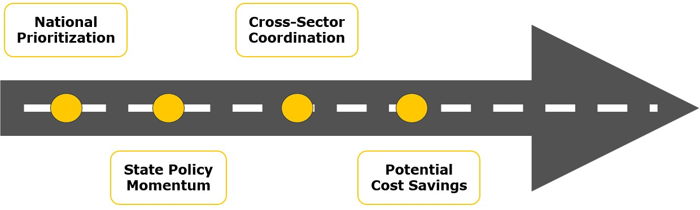
Why an MPA is Needed?

Slide 12
Thank You!
Sara Damiano – Sara.Damiano@hhs.Texas.gov
Stephanie Taylor –Stephanie.Taylor@hhs.Texas.gov

