Slide 1
Texas Water Development Board
Financial Assistance Programs
Presented to:
Texas Association of Regional Councils
Community & Economic Development Staff Association Training & Meeting
February 5, 2025

Slide 2
Topics
Funding Process
Water Supply Planning - SWIFT Program
Flood Planning - FMA & FIF Programs
State Programs
Federal Programs
    DWSRF
    CWSRF
Program Requirements
Q&A & Closing

Slide 3
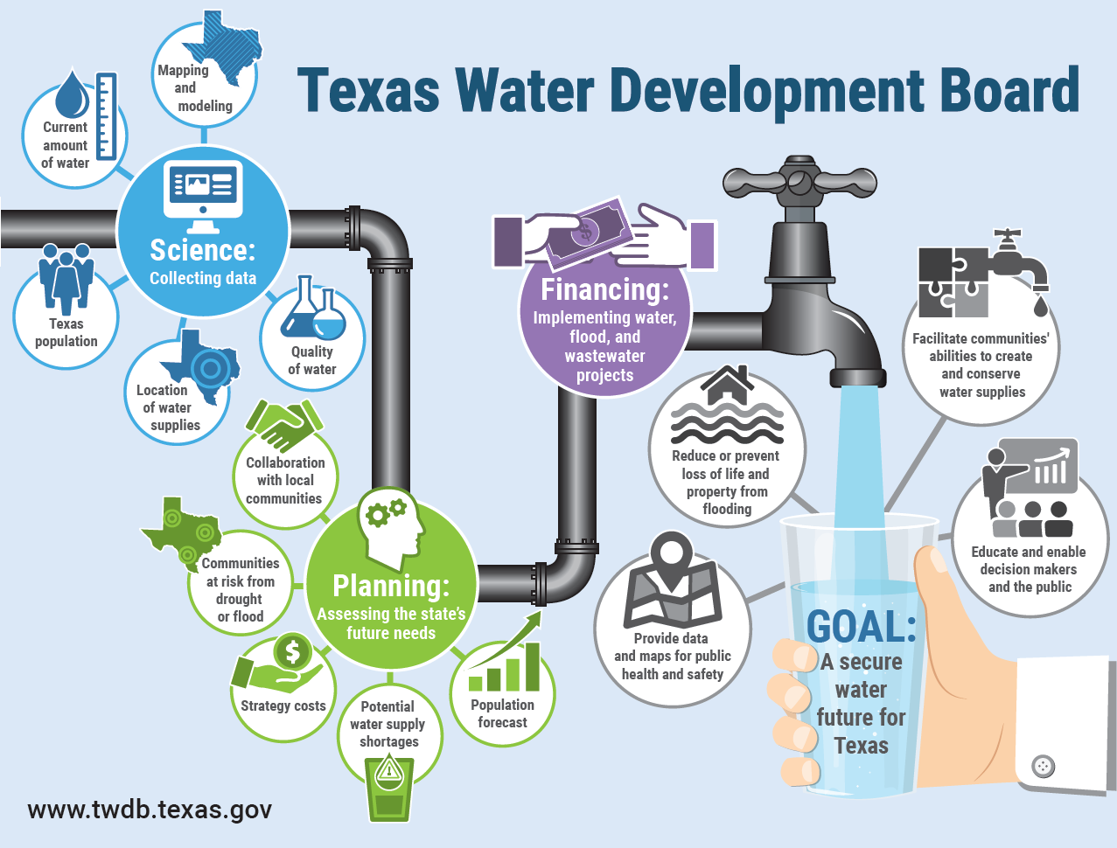
Notes:
TWDB Homepage: https://www.twdb.texas.gov/index.asp

Slide 4

In General, This is How It Works…
Bond Proceeds
Borrower Bonds
Borrowers Repay Programs
Financial
Assistance
Programs
Borrower Bonds
TWDB
(as Borrower/Issuer)
Sells Bonds
in Open-Market
TWDB
(as Lender)
Buys Bonds
Borrower Bonds
Program Repays Bondholders
GR, Grants
Appropriations, SWIFT $
Notes:
Bond flow chart: https://www.twdb.texas.gov/financial/doc/closing/flowchart-bonds.pdf
Closing a commitment: https://www.twdb.texas.gov/financial/closing_commitment.asp

Slide 5
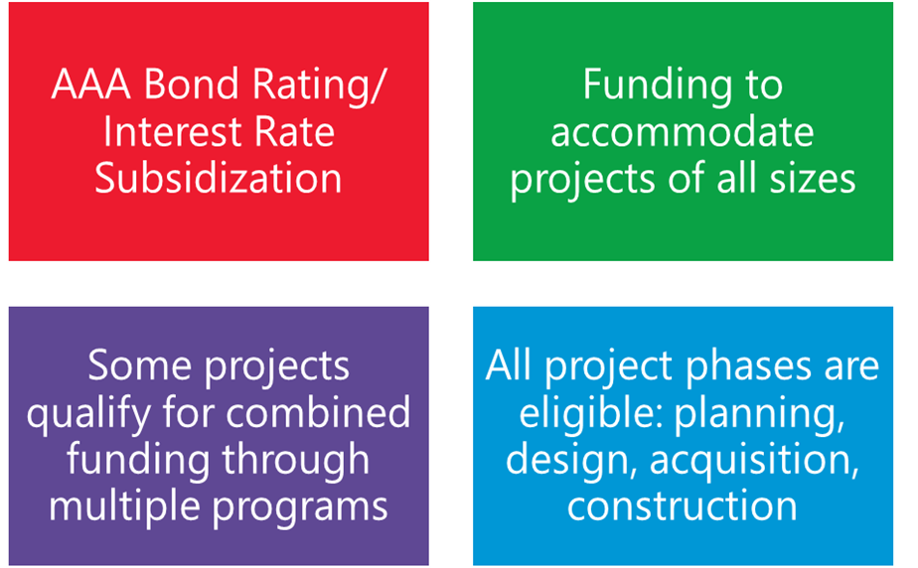
Funding Program Key Points
Notes:
Financial Assistance: https://www.twdb.texas.gov/financial/index.asp

Slide 6
Examples of Eligible Projects
Water Supply
Correct Water System Deficiencies
Upgrade or Replace Water Systems
Purchase Capacity, Other Systems, or Consolidate Systems
Current and Future Water Needs
Water Transmission & Distribution
Conservation Projects, Meters
Potable and Non potable Reuse
Water and Wastewater Treatment
Wastewater Collection and Distribution, Recycling, Reuse, Purple Pipe
Stormwater Control
Nonpoint Source Pollution Control
Flood Control, Drainage Infrastructure, Warning Systems
Notes:
Financial Assistance Programs Index: https://www.twdb.texas.gov/financial/index.asp
Review the individual program list for project eligibility details.

Slide 7
Funding Application Detail
Notes:
Application process: https://www.twdb.texas.gov/financial/applications/index.asp

Slide 8
Outlays and Escrows
Disbursements
Outlays: Entities must provide evidence of costs incurred on projects.
Escrow Releases: Recipients account where TWDB funds are deposited at closing but can only be released with TWDB approval.
Disbursement Methods
Federal programs with principal forgiveness: released based on outlays provided.
Program funds can be released either with outlays or completion of project milestones.
Notes:
Outlays: https://www.twdb.texas.gov/financial/outlay/index.asp
Email: outlays@twdb.texas.gov

Slide 9


Popular Financial Assistance Programs
State Fiscal Year 2025
State Water Implementation Fund for Texas (SWIFT)
Clean Water State Revolving Fund (CWSRF) Federal
Drinking Water State Revolving Fund (DWSRF) Federal
Texas Water Development Fund (DFund)
Flood Infrastructure Fund (FIF)
Notes:
Financial Assistance Programs: https://www.twdb.texas.gov/financial/index.asp

Slide 10

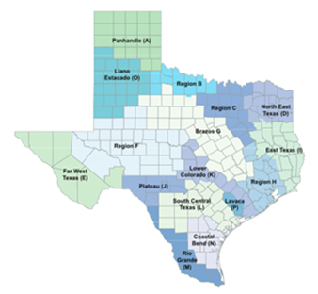
Water Planning
Current State Water Plan 2022. The state water plan is prepared and adopted every five years. Published next 2027.
SWIFT Funding Requirement – Recommended water management strategy projects with a capital cost in the most recent adopted state water plan.
Notes:
Water Planning: https://www.twdb.texas.gov/waterplanning/index.asp

Slide 11


Programs | Eligible Applicants: | Security Instruments: | Typical Pledges Include: | Length of Loans:
State Water Implementation Fund for Texas (SWIFT) | Political Subdivisions Water Supply Corporations Project must be in adopted State / Regional Water Plan | Bonds Master Agreement | System Revenue Contract Revenue Ad Valorem Tax Tax and Revenue Pledge | 20 to 30 years 34 years for Board Participation
Current State Water Plan 2022. The state water plan is prepared and adopted every five years. Published next 2027.
Recommended water management strategies listed in Regional and State Water Plans with an associated capital cost.
Projects include conservation and reuse, desalinating groundwater and seawater, building new pipelines, developing reservoirs and well fields, purchasing water rights, and other plan strategies.
Interactive State Water Plan: 2022.texasstatewaterplan.org
Abridged Application due February 3, 2025.
Notes:
SWIFT: https://www.twdb.texas.gov/financial/programs/SWIFT/index.asp
Interactive State Water Plan: https://2022.texasstatewaterplan.org/
Email: SWIFT@twdb.texas.gov.

Slide 12

Flood Planning in Texas
The 2019 Texas Legislature greatly expanded the TWDB's role in flood planning and financing.
Inaugural 2024 Texas State Flood Plan adopted on August 15, 2024.
Brings together the findings of the 15 river-basin-based regional flood plans and makes legislative and floodplain management recommendations to guide state, regional, and local flood control policy.
Notes:
In 2019, the Texas Legislature passed two Senate Bills that were later approved by voters directing the creation of the first-ever state flood plan for Texas and the Flood Infrastructure Fund.
The 15 Regional Flood Planning Group Plans were approved by the TWDB on July 14, 2023.
The TWDB adopted Texas' inaugural State Flood Plan on August 15, 2024 and it was delivered to the Legislature by the September 1, 2024 deadline.
The regional and state flood planning processes recur in five-year cycles.
The state flood plan brings together the findings of the 15 river-basin-based regional flood plans and makes legislative and floodplain management recommendations to guide state, regional, and local flood control policy.
Flood Planning: https://www.twdb.texas.gov/flood/index.asp
Texas Flood: https://www.texasflood.org/
Email: flood@twdb.texas.gov

Slide 13
TWDB Flood Programs
FEMA Flood Mitigation Assistance (FMA) Grant Program
TWDB Flood Infrastructure Fund
FEMA FMA Swift Current
Federal funding for projects that reduce or eliminate the risk of flood damage to structures insured under the NFIP
Support the local match for federal award
Requires Federal Flood Disaster Declaration. Federal funding for projects in communities under federal disaster declaration.
Support already-vetted flood mitigation projects
Purpose: Assist Texas communities by providing federal and state funds for cost-effective flood mitigation measures to reduce or eliminate the long-term risk of flood damage.
Notes:
FEMA FMA
The Flood Mitigation Assistance (FMA) grant program under FEMA provides federal funding to help states and communities pay for cost effective ways to reduce or eliminate the long-term risk of flood damage to repetitive loss and severe repetitive loss structures that are insured under the National Flood Insurance Program (NFIP). The TWDB administers the FMA grant program for the State of Texas on behalf of FEMA.
The FY 2024 FMA grant cycle Notice of Funding Opportunity (NOFO) is anticipated to be posted on grants.gov in the near future. The application cycle will open shortly after that with $600 million available nationwide. TWDB encourages all communities interested in applying to email TWDB staff at floodgrant@twdb.texas.gov.
FEMA FMA Swift Current
is a relatively new FMA program that provides grant funding to support individual property mitigation for states and communities affected by a presidentially declared disaster.
Texas has had two presidentially declared disasters in 2024. As such, FEMA has allocated $40M of FMA Swift Current funding to Texas for the spring storms, DR-4781-TX and another $40M for Hurricane Beryl, DR-4798-TX. TWDB will be working with affected communities to develop grant applications responsive to the available funding.
The agency recently allocated funds from the Flood Infrastructure Fund (FIF) to support community local match requirements
TWDB FIF
The FIF program assists in the financing of drainage, flood mitigation, and flood control projects
Supports the local match for projects that have received federal funding
Supports already vetted flood mitigation projects.
FIF@twdb.texas.gov

Slide 14
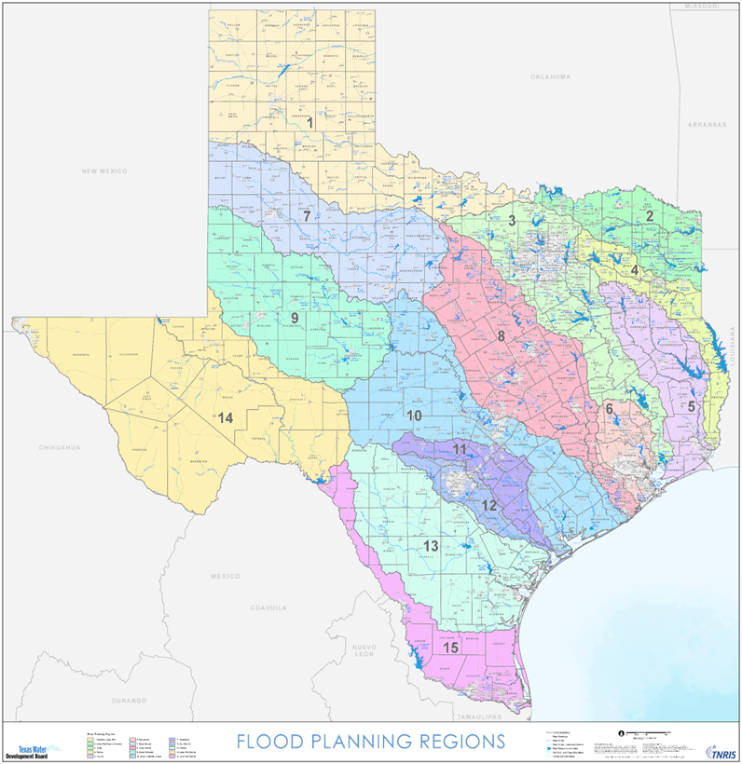
Programs | Eligible Applicants: | Security Instruments: | Typical Pledges Include: | Length of Loans:
Flood Infrastructure Fund (FIF) | Political Subdivisions Nonprofit Water Supply Corporations Project must be in adopted State Flood Plan | Bonds Loan Agreement | System Revenue Contract Revenue Ad Valorem Tax Tax and Revenue Pledge | Varies
Must be recommended as Flood Management Evaluations (FME), Flood Mitigation Projects (FMP), or Flood Management Strategies (FMS) in a Regional and State Flood Plan.
Up to 30-year repayment period for construction projects.
Up to 10-year repayment period for planning, acquisition, and/or design projects.
0% interest loans and grants available.
Eligible activities: planning, construction, nature-based solutions, warning systems, and gages.
The next funding cycle is State Fiscal Year 2026-2027.
Notes:
FIF: https://www.twdb.texas.gov/financial/programs/FIF/index.asp
Email: FIF@twdb.texas.gov

Slide 15
Texas Water Fund Distribution
Proposition 6 – Voter Approved November 7, 2023
Notes:
Texas Water Fund: https://www.twdb.texas.gov/financial/programs/twf/index.asp

Slide 16
Programs | Eligible Applicants: | Security Instruments: | Typical Pledges Include: | Length of Loans:
Texas Water Development Fund (DFUND) | Political Subdivisions Nonprofit Water Supply Corporations | Bonds Loan Agreement | System Revenue Contract Revenue Ad Valorem Tax Tax and Revenue Pledge | 20 to 30 years
The program enables the TWDB to fund projects with multiple purposes for drinking water, wastewater, and flood control in one commitment.
100% low-interest loan available annually.
Long-term fixed interest rates based on the TWDB’s cost of funds.
No maximum funding limits. TWDB will sell bonds as needed.
Application Submission – Opens Summer and closes December 31, 2025.
Notes:
DFund: https://www.twdb.texas.gov/financial/programs/TWDF/index.asp

Slide 17
Programs | Eligible Applicants: | Security Instruments: | Typical Pledges Include: | Length of Loans:
Clean Water State Revolving Fund (CWSRF) | Political Subdivisions Water Supply Corporations Designated Water Management Agencies Authorized Tribal Organizations Private Entities (Nonpoint Source Projects Only) | Bonds Loan Agreement | System Revenue Contract Revenue Ad Valorem Tax Tax and Revenue Pledge | 20 to 30 years
Federal Program to address wastewater, stormwater, and reuse such as wastewater treatment facilities, wastewater recycling and reuse facilities, non potable reuse, wastewater collection systems, stormwater control, nonpoint source pollution control projects.
Loan Principal Forgiveness (grants) for disadvantaged communities, small/rural disadvantaged, very small systems, green, and urgent need.
1.75% loan origination fee
SFY25 - $481,832,070
$70M - maximum financing per project
Project Information Form (PIF) due March 7, 2025
Notes:
CWSRF: https://www.twdb.texas.gov/financial/programs/CWSRF/index.asp
Email: cwsrf@twdb.texas.gov

Slide 18
Clean Water State Revolving Fund Project Categories
Treatment and/or Collection (POTW) (Section §212) - Construction or rehabilitation of a Wastewater Treatment Plant (WWTP); expansion of the hydraulic capacity at a WWTP; expansion of the solids treatment and handling portion of a WWTP; or construction of facilities, including linework, to enable reuse of reclaimed wastewater or stormwater for irrigation or other purposes.
Nonpoint Source Pollution Control (NPS) (§ 319): NPS pollution control projects control sources of water pollution that do not enter water from a point source, including pollution generally resulting from land runoff, precipitation, atmospheric deposition, drainage, seepage, or hydrologic modification. This may also involve stormwater projects.
Estuary Management (§ 320): Estuary management includes conservation and/or management projects that impact a national estuary.
Notes:
CWSRF: https://www.twdb.texas.gov/financial/programs/CWSRF/index.asp
Email: cwsrf@twdb.texas.gov

Slide 19
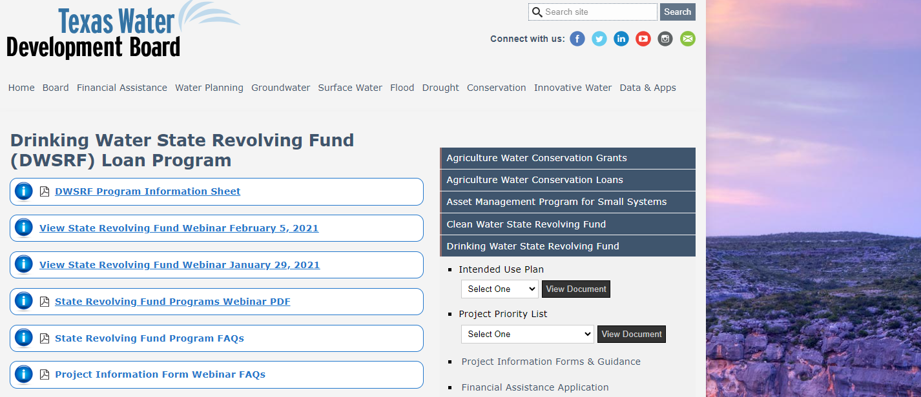
SRF Intended Use Plans
User-friendly interface with ability to select IUPs and PPLs via drop-down window for SFYs
1
Notes:
CWSRF: https://www.twdb.texas.gov/financial/programs/CWSRF/index.asp
Email: cwsrf@twdb.texas.gov

Slide 20
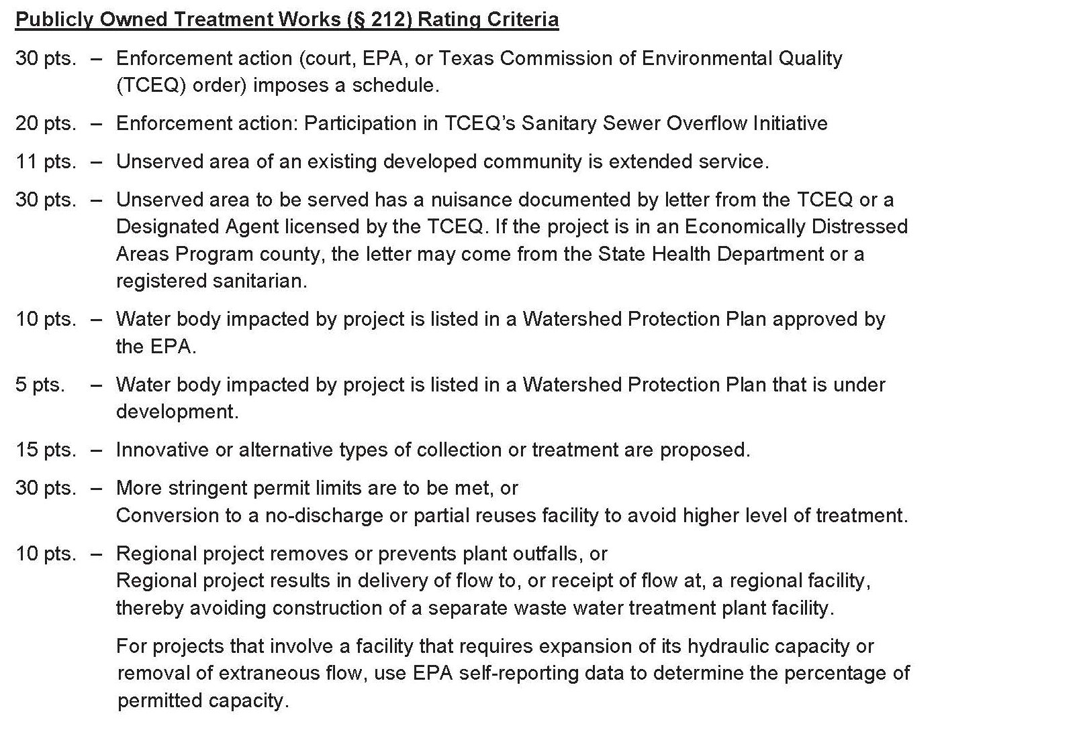
CWSRF IUP Appendix C - Rating Criteria
Notes:
CWSRF: https://www.twdb.texas.gov/financial/programs/CWSRF/index.asp
Email: cwsrf@twdb.texas.gov

Slide 21
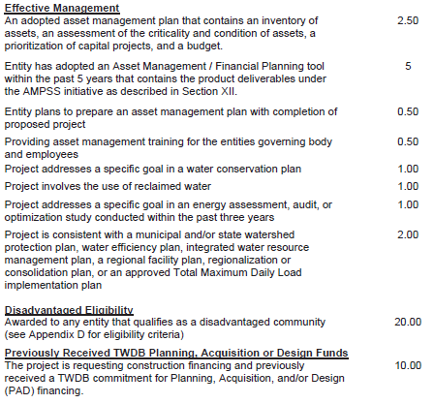
CWSRF IUP Appendix C - Rating Criteria Continued
Notes:
CWSRF: https://www.twdb.texas.gov/financial/programs/CWSRF/index.asp
Email: cwsrf@twdb.texas.gov

Slide 22
Programs | Eligible Applicants: | Security Instruments: | Typical Pledges Include: | Length of Loans:
Drinking Water State Revolving Fund (DWSRF) | Political Subdivisions Public and Privately Owned Water Systems Nonprofit Water Supply Corporations Nonprofit, Non-Community Public Water Systems | Bonds Loan Agreement | System Revenue Contract Revenue Ad Valorem Tax Tax and Revenue Pledge | 20 to 30 years
Federal Program to address water infrastructure needs, correct water system deficiencies, upgrade or replace water systems, consolidate systems, purchase capacity, purchase other systems, green projects.
Loan Principal Forgiveness (grants) for disadvantaged communities, small/rural disadvantaged, very small systems, green, and urgent need.
2.00% loan origination fee
SFY25 - $444,395,440
$59M - maximum financing per project
Project Information Form (PIF) due March 7, 2025
Notes:
DWSRF: https://www.twdb.texas.gov/financial/programs/DWSRF/index.asp
Email: dwsrf@twdb.texas.gov

Slide 23
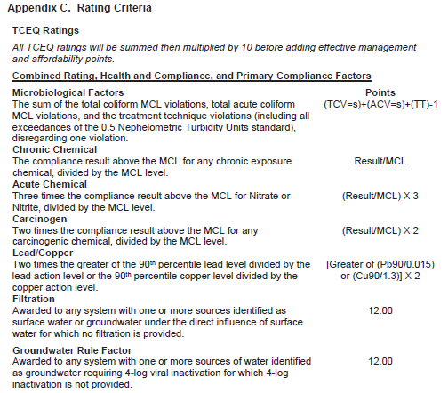
DWSRF IUP Appendix C – TCEQ Rating Criteria
Notes:
DWSRF: https://www.twdb.texas.gov/financial/programs/DWSRF/index.asp
Email: dwsrf@twdb.texas.gov

Slide 24
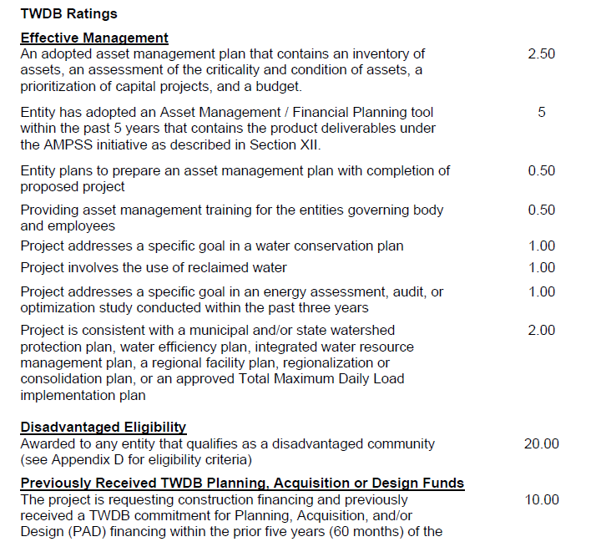
DWSRF IUP Appendix C – TWDB Rating Criteria
Notes:
DWSRF: https://www.twdb.texas.gov/financial/programs/DWSRF/index.asp
Email: dwsrf@twdb.texas.gov
Good afternoon, everyone, like Scott mentioned, I'm Heather O'Keefe and I’m a Program Specialist in Program Administration. I'm going to briefly cover our agency's rating criteria and ways to improve scoring on your PIFs.
We perform our own review of the PIFs. Scoring is based on effective management, whether an entity qualifies as a disadvantaged community and if the entity has a previously funded project where they received a commitment for PAD and now they are coming back in for construction funds.
Under Effective Management….
We look to see if an entity provided an asset management plan, if not, then are they going to prepare an AMP as part of their proposed project. We also look at whether AMP training was administered and review all supporting documentation.
We look to see if the proposed project addresses specific goals in a water conservation plan or drought contingency plan and whether the entity has provided the necessary supporting documentation.
We also look at whether the proposed project involves the use of reclaimed water where it would mitigate the need for additional potable water supply.
We also look at whether the project addresses a specific goal in an energy assessment or audit.
And whether a project is consistent with a state/regional or other water plan and review all necessary supporting documentation.
We also review an entity's disadvantaged community worksheet.
We look at the source of the socioeconomic data the entity is using, is it census data or a valid TWDB approved survey. We generally do not accept other agency surveys. For example, we don’t accept Community Block Grant survey forms b/c they only capture a household income range and not the specific household income.
We will review the boundary designations, Annual Median Household Income (AMHI) data and water/sewer rates. Basically, has the entity provided all the required information in the worksheet?
We also QC our review for any inconsistencies, such as, an entity has a qualifying AMHI, but they don’t qualify as disadvantaged. Often that’s because the entity has not met the other part of the affordability criteria related to the Household Cost Factor. HCF considers income, unemployment rates, and population trends.
For previously funded projects, we confirm in our database whether the project did receive a commitment and isn’t just in the Application phase.
NEXT SLIDE....

Slide 25
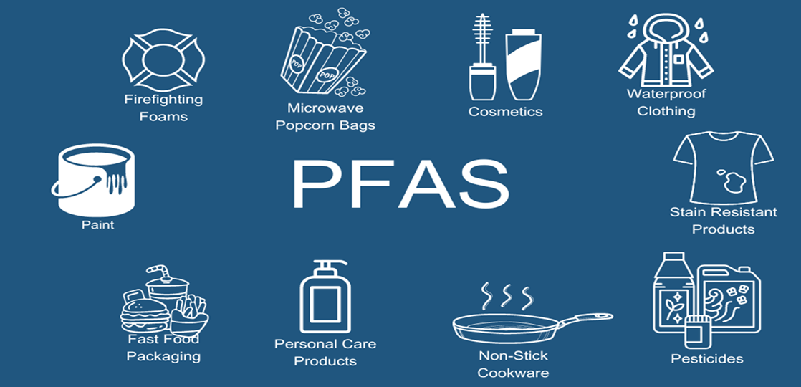
Programs | Eligible Applicants: | Security Instruments: | Typical Pledges Include: | Length of Loans:
Emerging Contaminants (EC) for both DWSRF and CWSRF | Political Subdivisions Water Supply Corporations Designated Water Management Agencies Authorized Tribal Organizations State Agencies Private Entities (Nonpoint Source Projects Only) | N/A | N/A | N/A
The Infrastructure Investment and Jobs Act (IIJA) appropriated funds through the base SRF program.
CWSRF-EC or DWSRF-EC, it must be eligible under the base CWSRF or DWSRF programs AND specifically reduce exposure to perfluoroalkyl and polyfluoroalkyl substances (PFAS) and/or other emerging contaminants.
All project funding will be in the form of 100% principal forgiveness (similar to grants)
CWSRF-EC SFY25 $9,817,000
DWSRF-EC SFY25 $60,914,000
Project Information Form (PIF) due April 4, 2025
Notes:
Emerging Contaminates: https://www.twdb.texas.gov/financial/programs/ec/index.asp
EPA: EPA’s Contaminant Candidate Lists
EC Projects are 100% principal forgiveness

Slide 26
CWSRF-EC/DWSRF-EC Project Information Forms
Must submit via email, as PDF with attachments (no online application option).
Only project components integral to the emerging contaminant purpose of the project are eligible for funding.
Identifying sources of the EC or monitoring for EC’s is generally not eligible for funding.
Highly recommended to provide lab data showing presence of EC’s with PIF submittal.
Rating criteria as listed in Appendix C of the Intended Use Plans. In general:
  Highest points for existing EC’s identified and project is for construction to treat/remove EC’s
  PFAS are higher priority than other EC’s
  Providing first time service or system consolidation
  Disadvantaged community (slightly different criteria than regular CWSRF/DWSRF programs)
  Rural community
  System size
Notes:
Emerging Contaminates: https://www.twdb.texas.gov/financial/programs/ec/index.asp
First point is a big one, there could be times when the entire project submitted is NOT 100% covered by the EC program, so the Applicant will need to have an additional funding source. Example, to build a new treatment facility, only the components being added to the facility due to the presence of EC’s are covered by this program.

Slide 27
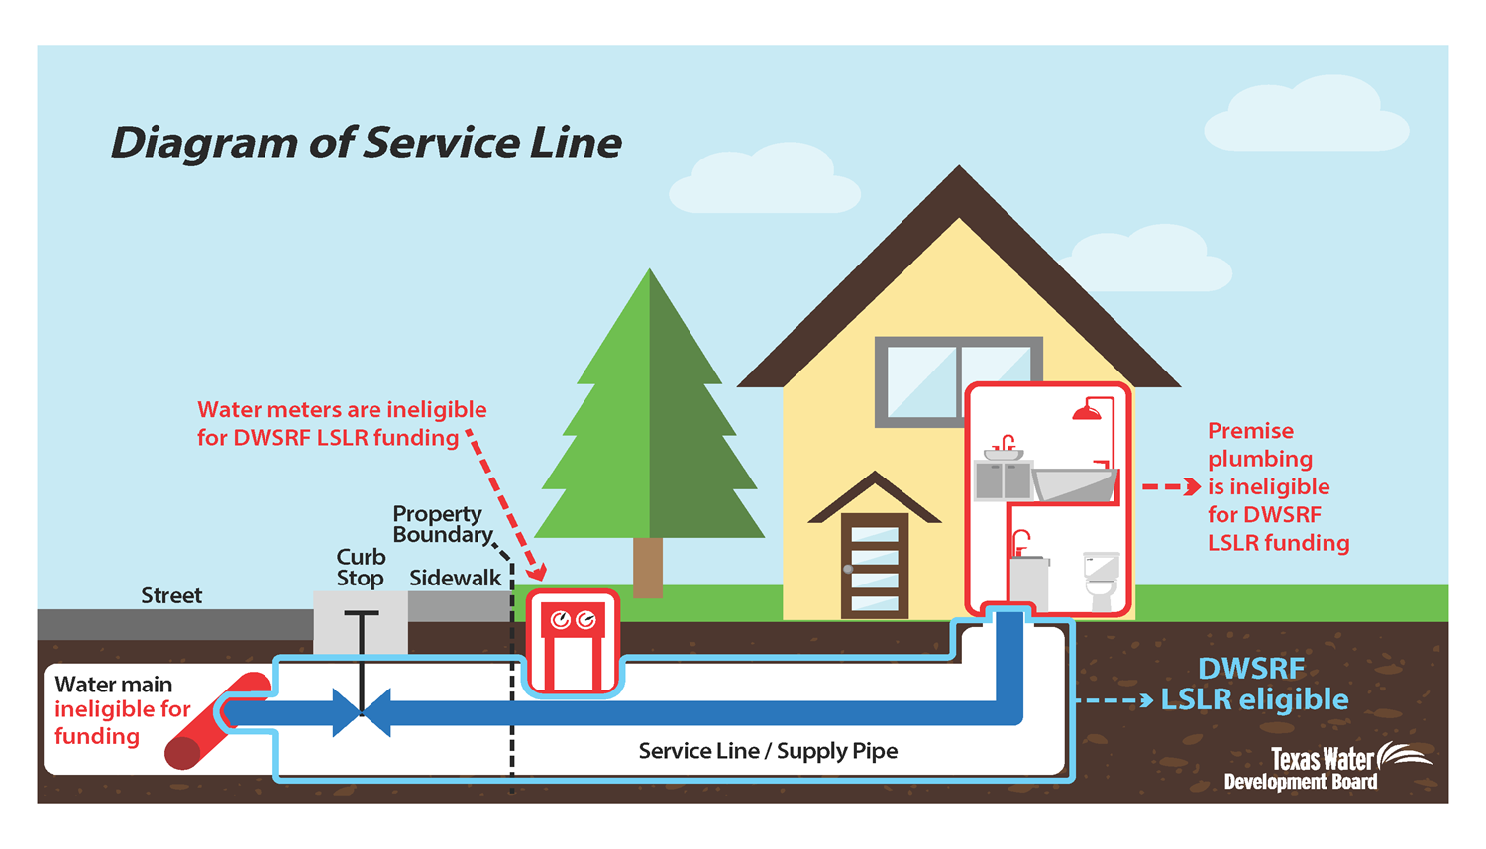
Programs | Eligible Applicants: | Security Instruments: | Typical Pledges Include: | Length of Loans:
Lead Service Line Replacement (LSLR) Program | Political Subdivisions Public and Privately Owned Water Systems Nonprofit Water Supply Corporations Nonprofit, Non-Community Public Water Systems State agencies | Bonds Loan Agreement | System Revenue Contract Revenue Ad Valorem Tax Tax and Revenue Pledge | 15 years (Inventory-Only) 30 years (Non-Inventory, Replacement)
The Infrastructure Investment and Jobs Act (IIJA) appropriated funds through the base DWSRF for Lead Service Line Replacement (LSLR) projects and associated activities directly connected to the identification, planning, design, and replacement of lead service lines.
2.00% loan origination fee
SFY25 $27,528,500
All funding awarded at ratio of:
  49% Loan
  51% Principal Forgiveness
Project Information Form (PIF) due April 4, 2025
Notes:
LSLR: https://www.twdb.texas.gov/financial/programs/Lead-SLR/index.asp

Slide 28
DWSRF-LSLR Project Information Form
Must submit via email, as PDF with attachments (no online application option)
Project funding is 51% Principal Forgiveness and 49% Loan
Replacement must be for complete lead service line (no partial replacements, no other water system improvements).
Rating criteria as listed in Appendix C of the Intended Use Plans. In general:
  Highest points for identified lead service lines or updating inventory to identify unknowns
  Must be below 150% of the State Annual Median Household Income (AMHI) (Note: this is different than the DWSRF program)
  System size
Notes:
LSLR: https://www.twdb.texas.gov/financial/programs/Lead-SLR/index.asp

Slide 29
Water Utility Technical Assistance Program
Benefits Water or Wastewater Systems
  Up to $150,000 worth of services dependent upon the needs of the system.
  All water and wastewater systems in Texas are eligible for this program, if they desire to seek funding from TWDB in the future.
  Pre-qualified contractors to assist.
  Next application solicitation deadline pending.
Final products of the program include:
  Approvable Water Conservation Plans.
  Successful submission of PIFs/Abridged Applications.
  Successful submission of Financial Assistance Applications for invited entities.
  Summary reports with recommendations for financial management controls and operating processes.
  Completed rate study.
  Training regarding Disadvantaged Business Enterprises requirements including submission of documentation for federal reporting purposes.
  NOTE: If system is not ready to submit PIF/Apps, the contractor will prepare these documents as much as possible, so system is prepared to submit when ready.
Notes:
WUTAP: https://www.twdb.texas.gov/financial/programs/WUTAP/index.asp

Slide 30
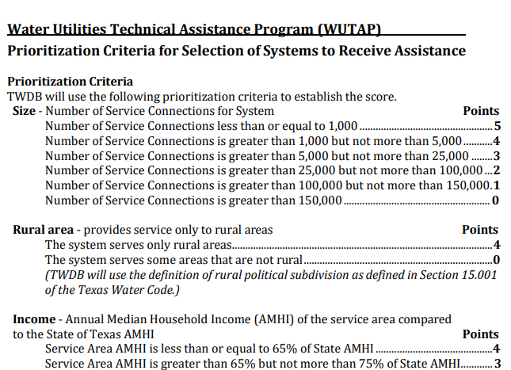
WUTAP Prioritization Criteria
Notes:
WUTAP: https://www.twdb.texas.gov/financial/programs/WUTAP/index.asp

Slide 31
Program Requirements
Federal
Loan origination fee
Projects must be listed in the current SRF Intended Use Plan
Davis-Bacon wage rate requirements
American Iron and Steel (AIS) requirements
Build America Buy America (BABA) requirements
National Environmental Policy Act (NEPA)-type environmental review
For equivalency projects only:
Disadvantaged Business Enterprise program
Additional steps when procuring architecture and engineering services
State
Water supply projects must be consistent with the current state water plan
U.S. Iron and Steel requirements
State-level environmental review
All
Adoption of a water conservation and drought contingency plan (for entities receiving assistance greater than $500,000)
Notes:
Financial Assistance Programs Index: https://www.twdb.texas.gov/financial/index.asp

Slide 32
Disadvantaged Business Enterprise
The Disadvantaged Business Enterprises (DBE) Program is an outreach, education, and goal-oriented program designed to increase the participation of DBEs in procurements funded by EPA assistance agreements. All solicitations, both publicly advertised and via direct contact, must address:
  Fair Share Goals - combined construction and non-construction procurement
    MBE Potential = 24.16%
    WBE Potential = 17.38%
  Good Faith Efforts -
    Ensure DBEs are made aware of contracting opportunities.
    Posting solicitations for bids or proposals for a minimum of 30 calendar days before the bid or proposal closing date.
    Consider in the contracting process whether firms competing for large contracts could subcontract with DBEs.
    Encourage contracting with a consortium of DBEs when a contract is large.
    Use the services and assistance of the Small Business Administration (SBE) and the Minority Business Development Agency of the Department of Commerce.
    If the prime contractor awards subcontracts, require the prime contractor to take the above steps.
Notes:
Disadvantaged Business Enterprise (DBE) Program: https://www.twdb.texas.gov/financial/programs/DBE/index.asp
Email: DBE@twdb.texas.gov

Slide 33
Helpful Tips
Financial
  Is the entity prepared for bond issuance?
  Independent Financial Audit up to date?
    At the time of formal application submittal, a current audit is required for the application to be deemed administratively complete.
  Current registration with SAM (System for Award Management, https://sam.gov)
Ability to Take on Debt
  Credit analysis will be completed.
  Loan repayment pledge?
  Are water, wastewater rates, and charges sustainable? Will they need to be raised?
Self-Reports to the TWDB up-to-date?
  Water Use Survey
  Water Loss Audit
  Water Conservation and Drought Contingency Plan
  Water Conservation Plan Annual Reports
Talk early and often with TWDB staff – we are happy to provide guidance and support.
Notes:
TWDB: https://www.twdb.texas.gov/index.asp

Slide 34
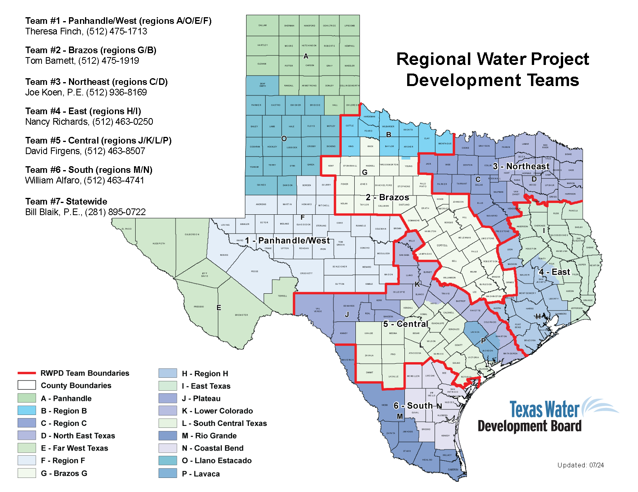
TWDB Contacts
General Email
Financial_Assistance@twdb.texas.gov
Financial Assistance Outreach
Scott Galaway
737-226-3381
scott.galaway@twdb.texas.gov
Enriqueta "Keta" Caballero
512-435-9071
enriqueta.caballero@twdb.texas.gov
Drinking Water SRF Coordinator
dwsrf@twdb.texas.gov
Clean Water SRF Coordinator
cwsrf@twdb.texas.gov
Notes:
RWPD Teams: https://www.twdb.texas.gov/contact/office/wsi.asp
EC questions can be routed to DWSRF or CWSRF mailbox
LSLR questions can be routed to DWSRF mailbox

Slide 35
Resource Links
* TWDB Financial Assistance Programs Index
https://www.twdb.texas.gov/financial/index.asp
* TWDB Funding Application FAQ
https://www.twdb.texas.gov/financial/applications/faq.asp
* TWDB Financial Assistance Applications
https://www.twdb.texas.gov/financial/applications/index.asp
* TWDB Financial Assistance Program Guidance Manuals and Forms Library
https://www.twdb.texas.gov/financial/instructions/index.asp
* Clean Water State Revolving Fund Program
www.twdb.texas.gov/financial/programs/CWSRF/index.asp
* Drinking Water State Revolving Fund Program
www.twdb.texas.gov/financial/programs/DWSRF/index.asp
* Texas Water Fund
https://www.twdb.texas.gov/financial/programs/twf/index.asp
Notes:
TWDB: https://www.twdb.texas.gov/index.asp

Slide 36
Resource Links
* Interactive State Water Plan
https://2022.texasstatewaterplan.org/statewide
* Regional Water Planning
www.twdb.texas.gov/waterplanning/index.asp
* Flood Programs
https://www.twdb.texas.gov/flood/index.asp
* Water Use Survey
https://www.twdb.texas.gov/waterplanning/waterusesurvey/index.asp
* Water Loss Audit Reporting
https://www.twdb.texas.gov/conservation/municipal/waterloss/index.asp
* Conservation Plan Reporting
https://www.twdb.texas.gov/conservation/municipal/plans/ARs.asp
* TWDB Newsletter
https://www.twdb.texas.gov/newsmedia/signup.asp
Notes:
TWDB: https://www.twdb.texas.gov/index.asp

Slide 37
For more information
Visit
https://www.twdb.texas.gov/financial/index.asp
Or email:
financial_assistance@twdb.texas.gov
Notes:
TWDB: https://www.twdb.texas.gov/index.asp

