Slide 1


Texas silver-haired legislature
TSHL 21st Session
Elections Process Update
Special Presentation for the
Texas Association of Regional Councils

Slide 2

What is tshl?
In 1985, the Texas Legislature authorized and embedded a Texas Silver-Haired Legislature into the Texas legislative process by passing Senate Concurrent Resolution No. 37 (S.C.R. No. 37) which stated that:
Texans, aged 60 and older, were the fastest growing segment of the population increasing 32% between 1970 and 1980;
Many older Texans wanted a better understanding of the legislative process and state policy development through participation.
Recognized that problem solving is best achieved by involving those most closely related to the problems.

Slide 3
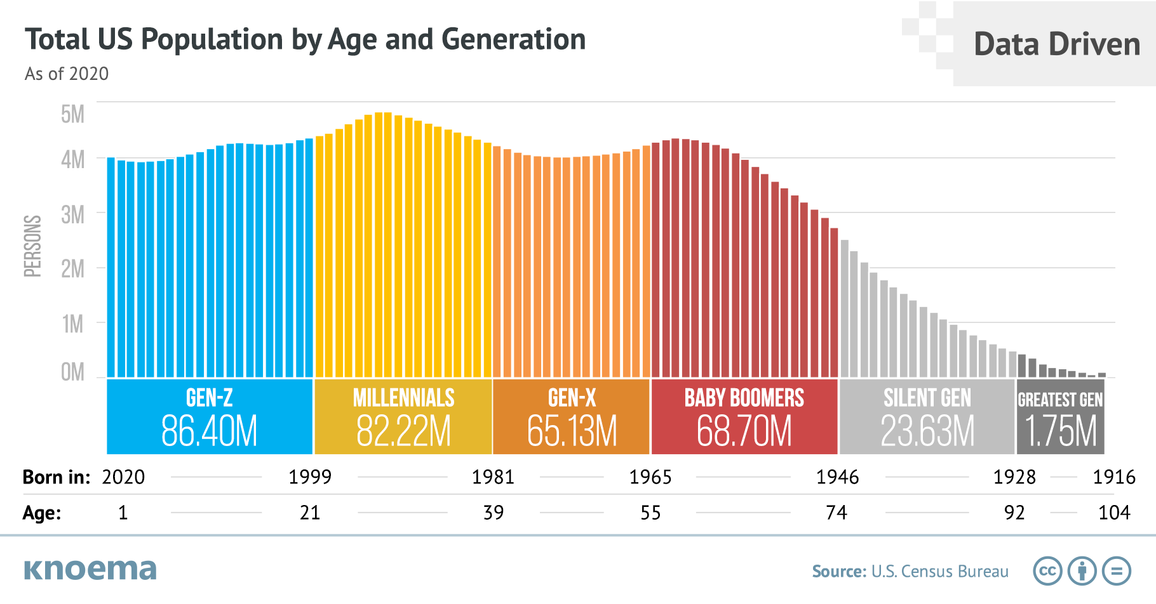

Slide 4
WHY A TSHL?
“We authorized the Silver-Haired Legislature because they (Aging Texans) didn’t have a voice in the Legislature…”
“TSHL is unique in the Legislature, I don’t know of anything else like TSHL, there may be, but I’m not aware of it…”
Speaker Gibson D. “Gib” Lewis
Former Speaker of the Texas House of Representatives
1983-1993, 68th-72nd Legislative Sessions

Slide 5
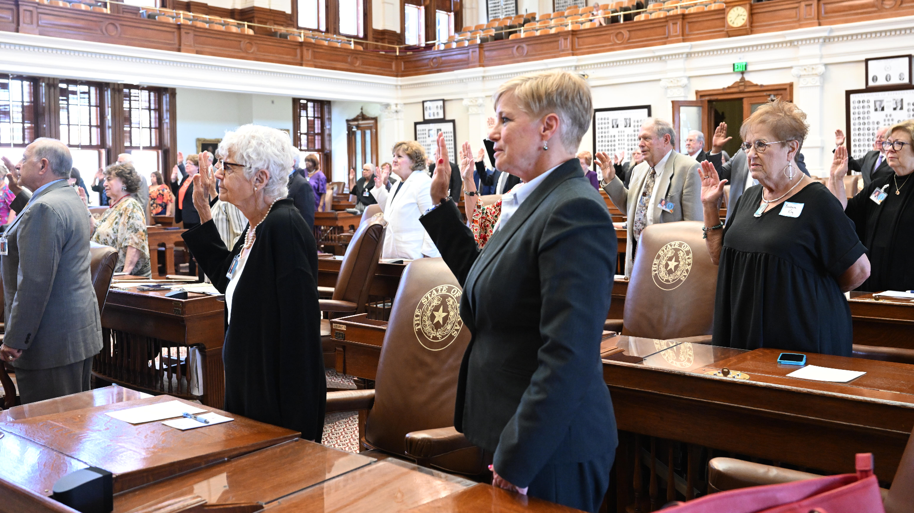
Since 1985, more than 750 Texans
Aged 60 and over have served as
Texas Silver-Haired Legislators
advocating for over 900 issues and
influencing over 275 bills of
concern to aging Texans

Slide 6
S.C.R. No. 37 Mandate
A Silver-Haired Legislature is:
  A non-partisan model legislative session.
  Elected by their peers (aged 60+) for two-year terms.
  To initiate and debate policy alternatives that deal with the problems affecting them (aging Texans).
  Effectively used to inform aging persons about the legislative process.
  A forum to discuss policy issues on aging and recommend solutions to those problems.

Slide 7
s.c.r. No. 37 Resolved
That the Texas Legislature support the development of a biennial Silver-Haired Legislature in Texas.
That the Texas Legislature allow its chamber and meeting rooms, and other assistance to be used by the Silver-Haired Legislature at a time that does not interfere with any regular, called, or interim legislative activities of the Texas Legislature

Slide 8
Tshl responsibilities under s.c.r. No. 37
At the close of each Silver-Haired Legislative Session, recommendations formulated by the Silver-Haired Legislature must be submitted to the:
  Governor of the State of Texas
  The Texas Legislature (Lt. Governor, Speaker of the House, and Legislators)
  The Directors of the Area Agencies on Aging (AAA) regions

Slide 9
changes to the
21st Tshl session
21ST TSHL Biennial Session restructuring:
Adopted a TSHL Biennial Calendar establishing fixed dates for the biennial sessions and the following interim sessions contained within:
  Legislator Development Session Capitol, Austin (Combined Orientation & Training Sessions)
  Legislative Session Capitol, Austin (Legislators adopt resolutions for TSHL Legislative Report)
  Advocacy Session Capitol, Austin (New session to provide hands-on education and experience to TSHL legislators by meeting with Texas Legislators and staff and attending and testifying in committee meetings during the Texas Legislative session)

Slide 10
changes to the
21st Tshl session
Revised the TSHL legislator election process by assigning the TSHL Elections & Credentials Chair with handling new and incumbent, candidate communications, filings, election cancellations, certifications, processes, and procedures.
Adoption of Silver Legislature Districts (SLD) that share the same geographic boundaries and region numbers with AAA Regions. A SLD boundary will be amended if the corresponding AAA Region boundary is amended.

Slide 11
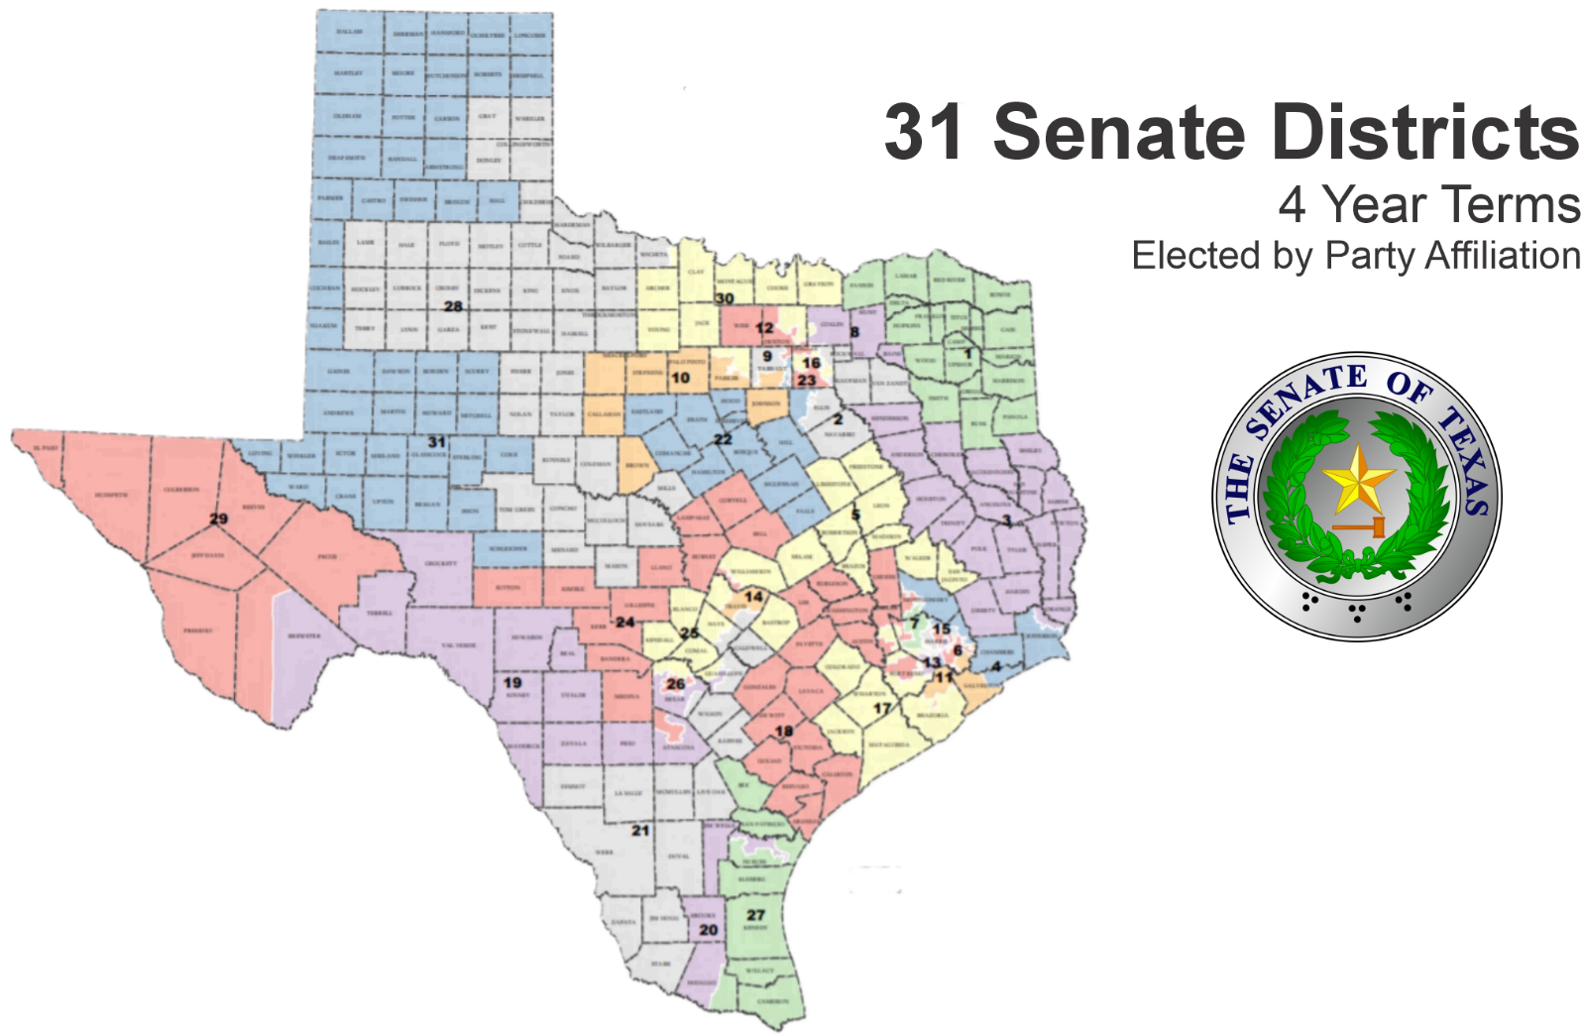

Slide 12
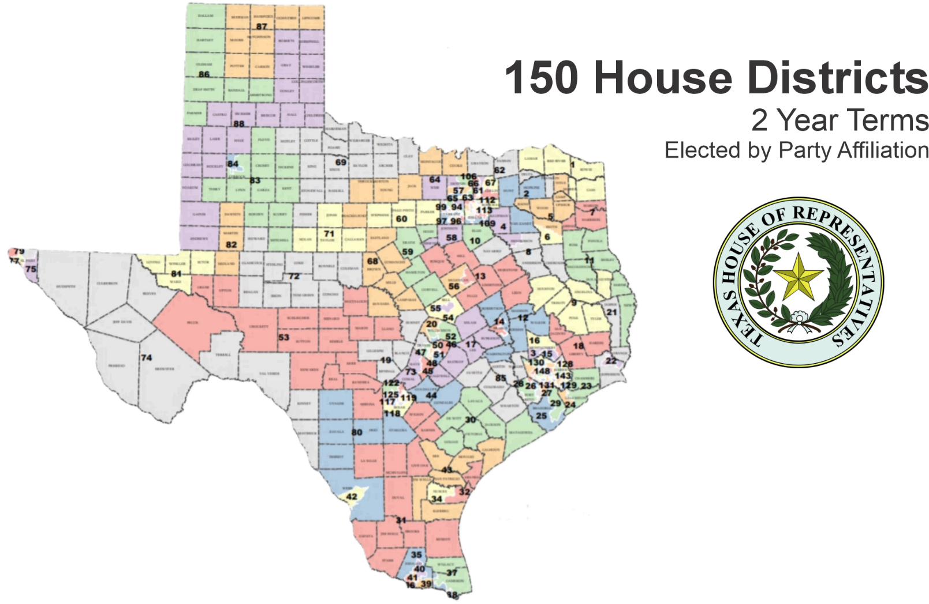

Slide 13
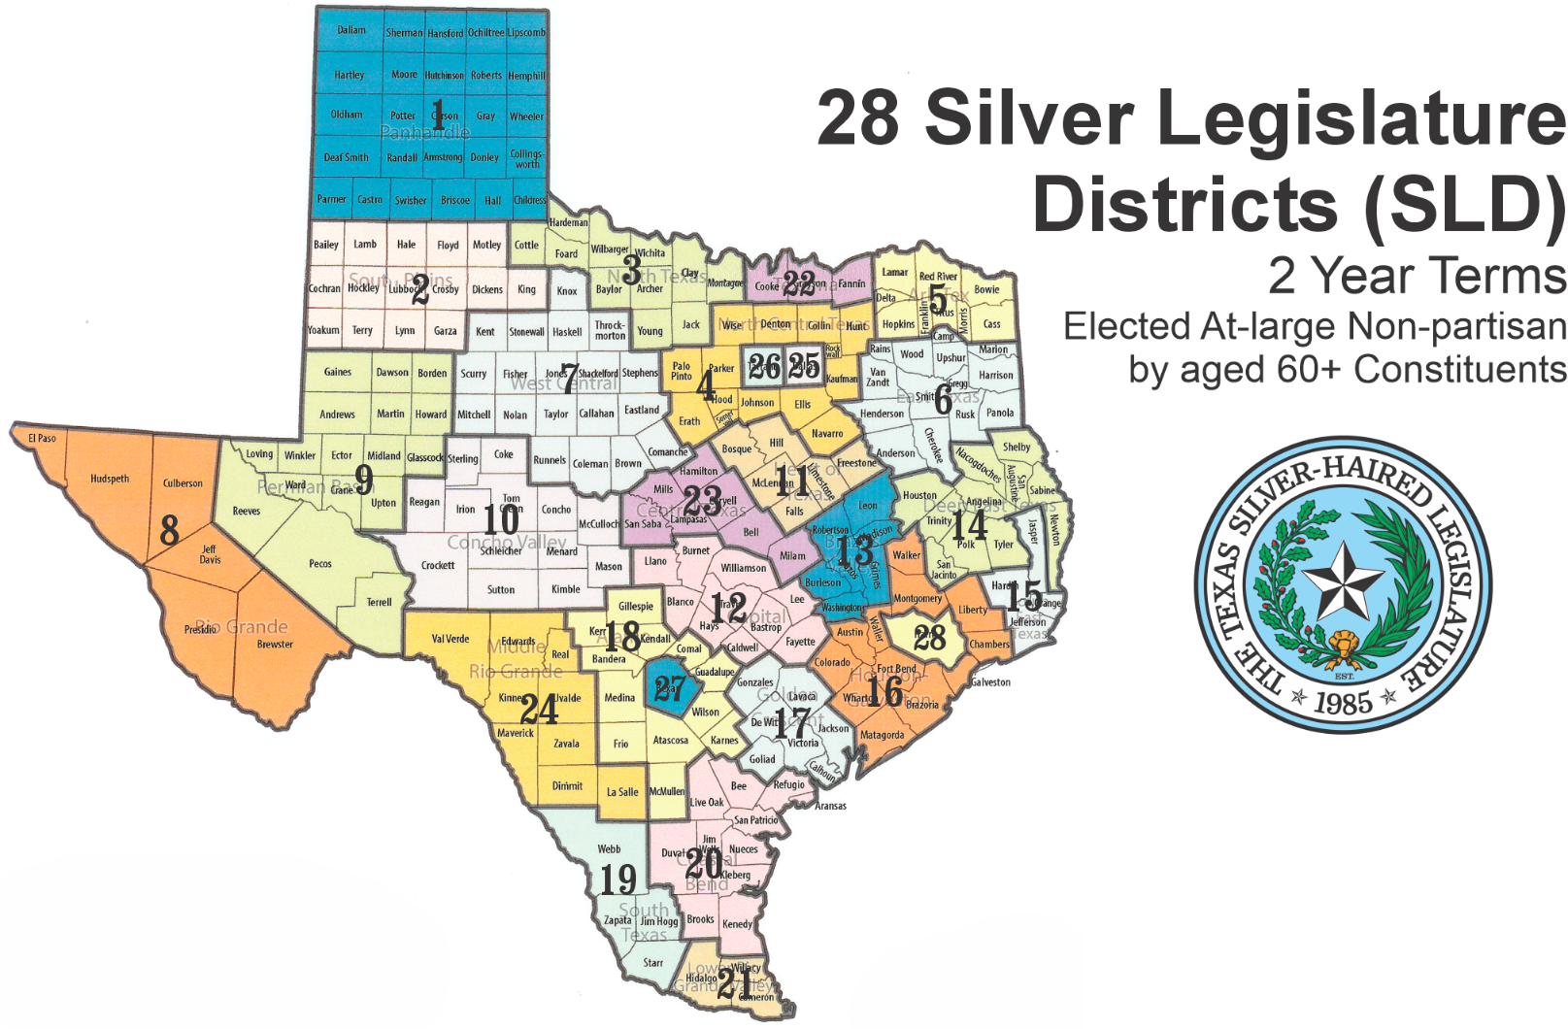

Slide 14
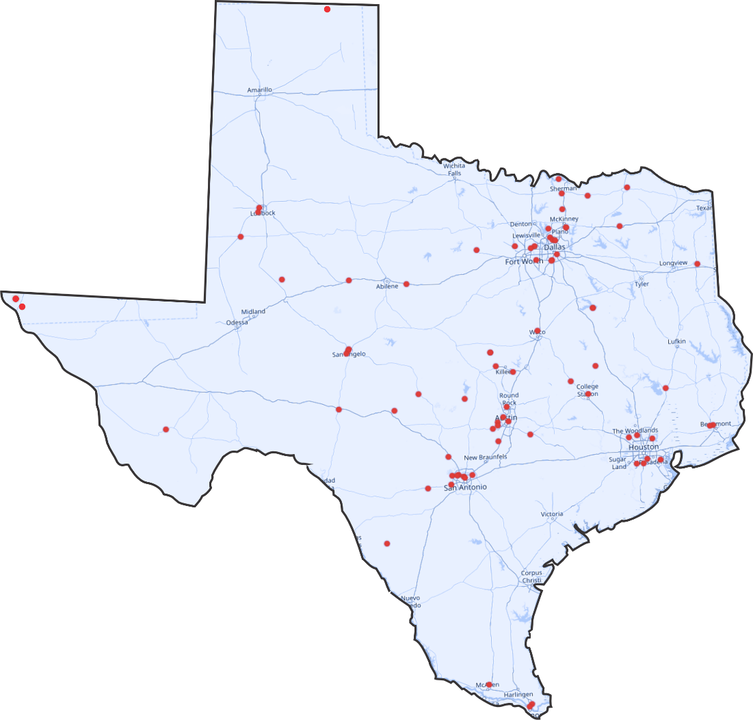
123
TSHL Legislators
Advocating Across Texas

Slide 15
What TSHL does nOt do…
Texas Silver Legislators
do not VOTE ON legislatION!
Tshl IS THE PREDICATE research for legislation AND RECOMMENDATIONS to the Texas legislature, FOR WHICH WE advocate and educate.
Under the Texas constitution, ONLY THE constitutional Legislature CAN MAKE LAW.

Slide 16
TSHL Election timeline
ODD-NUMBERED YEARS
New TSHL Biennial Session begins Jul 1st odd-numbered years
Legislator Development Session 2nd* week of July in odd-number years for one week.
EVEN-NUMBERED YEARS
Legislative Session 2nd* week in May of even-numbered years for one week.
TSHL Legislative Report published by the 90th day before the new Texas Legislature convenes.
TSHL Election Cycle begins Dec 15th for the next TSHL Session beginning Jul 1st of odd-numbered years
Interim Elections filings for current TSHL Session ends Dec 31st.

Slide 17
TSHL Election timeline
ODD-NUMBERED YEARS
Candidate Filing begins for the next TSHL Session (Jul 1st of odd-numbered years)
  TSHL State Officer candidate filing begins
  TEXAS LEGISLATURE CONVENES 2nd Tuesday in January of odd-numbered years for 140* days.
Advocacy Session in the Capitol 2nd week of April in odd-numbered years & elect Officers for next session.
  TSHL Election Day (Last Friday of April of odd-numbered years)
  SINE DIE – TEXAS LEGISLATURE
Sine Die – Texas Silver-Haired Legislature (30th day of June odd-numbered years)

Slide 18
TSHL responsibilities for elections
Thanks to each of you and your predecessors for the successful advocacy partnership, candidate recruitment, and election work you have done over the past 40 years!
Elections & Credentials Chair will:
Provide Form “Notice to File for Candidacy” to AAA Directors for posting and distributing.
Handle all SLD new and incumbent, candidate communications, filings, election cancellations, certifications, processes, and procedures.
Communicate to the AAA Director(s) any new legislator(s) elected in a General or Interim SLD election(s).
Support Director and the AESC in conducting balloted elections if and when needed.
Notify the AAA Director(s) of any:
  Transfers from one SLD to another
  Reallocation of vacant seat(s) from a lending SLD to a borrowing SLD

Slide 19
aaa responsibilities for elections
Posting and distributing Form “Notice to File for Candidacy” to your COGs, Senior Centers, websites, etc.
Recruit candidates to represent your regions. Your recommendations are highly valued.
Host and support TSHL-AAA Town Hall meeting(s) in your region.
Arrange meetings with you, your staff, and TSHL Legislator during the 2nd half of odd-numbered years to share and discuss issues that need advocacy or follow-up from the TxLeg Session.
Conduct balloted elections if and when needed with the support of the AESC

Slide 20

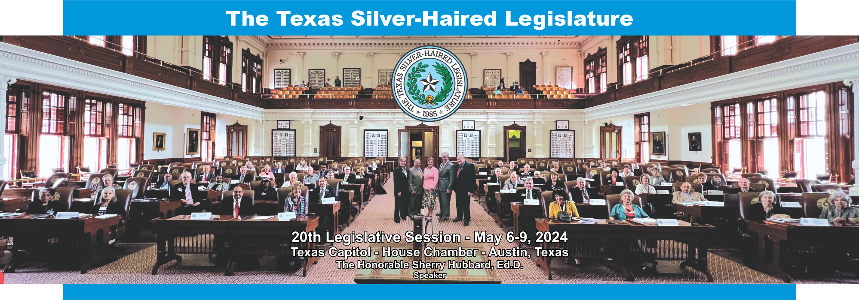
Thank You Directors for Your
Partnership in Advocacy!

Slide 21

TEXAS SILVER-HAIRED LEGISLATURE
“Advocating for
Older Texans”
Since 1985

Slide 22
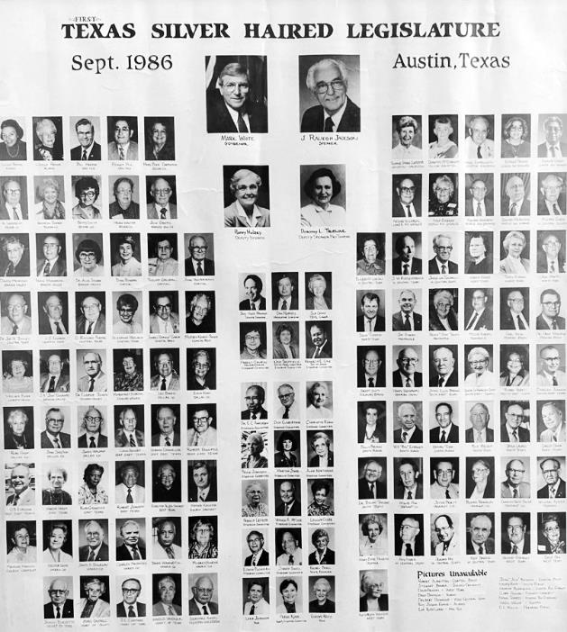
Thank You
For your time!
QUESTIONS?

