Slide 2
TEXAS DEPARTMENT
OF AGRICULTURE
2025 -2026 CDV

Slide 3
Two Phase Application Process
Overall Success!
Areas for Improvement:
Communication for Regional Priorities
Communication of USC Goals
Expectations for Professional Services

Slide 4
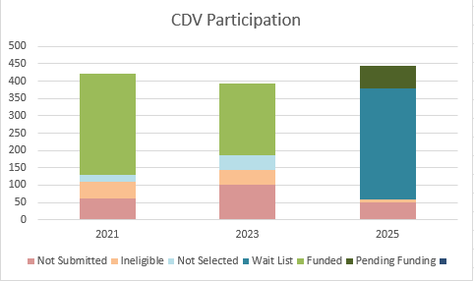
Two Phase Application Process

Slide 5
TEXAS DEPARTMENT
OF AGRICULTURE
2025 CDM (DRP)

Slide 6
Downtown Revitalization
Community Application due April 3
Funding:
Grant Amount: $1 million
Match Amount: $20,000 minimum
($50,000 for maximum points)
HUD National Objective
Elimination of slum and blight conditions
Benefit to low- to moderate-income (LMI) persons
Downtown District
Pedestrian-centered economic activity
Map required for Community Application

Slide 7
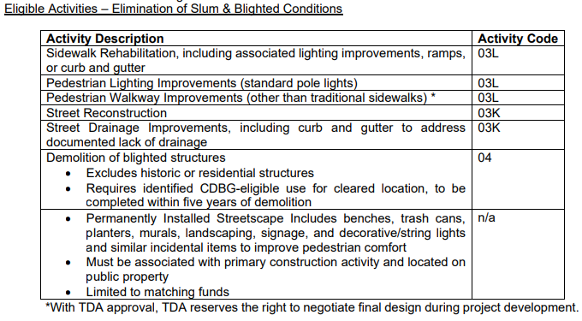
Downtown Revitalization

Slide 8
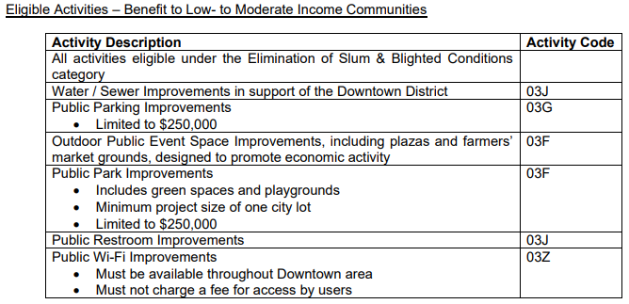
Downtown Revitalization

Slide 9
TEXAS DEPARTMENT
OF AGRICULTURE
2025 CEDAF

Slide 10
Community Development Fund
Rider 12
LAR 2026-27 recommended deletion
Funding would restore 2 FTEs for TDA to provide technical assistance

Slide 11
Community Development Fund
2024 CEDAF
Dissemination of Program Information
Grant Kick-Off Meeting
Fair Housing and other Outreach Events

Slide 12
CDBGApps@TexasAgriculture.gov
https://www.nhaustin.com/training-and-certifications/course-outline/id/1000401014/c/adobe-indesign-cc-part-1

