Slide 1


Slide 2
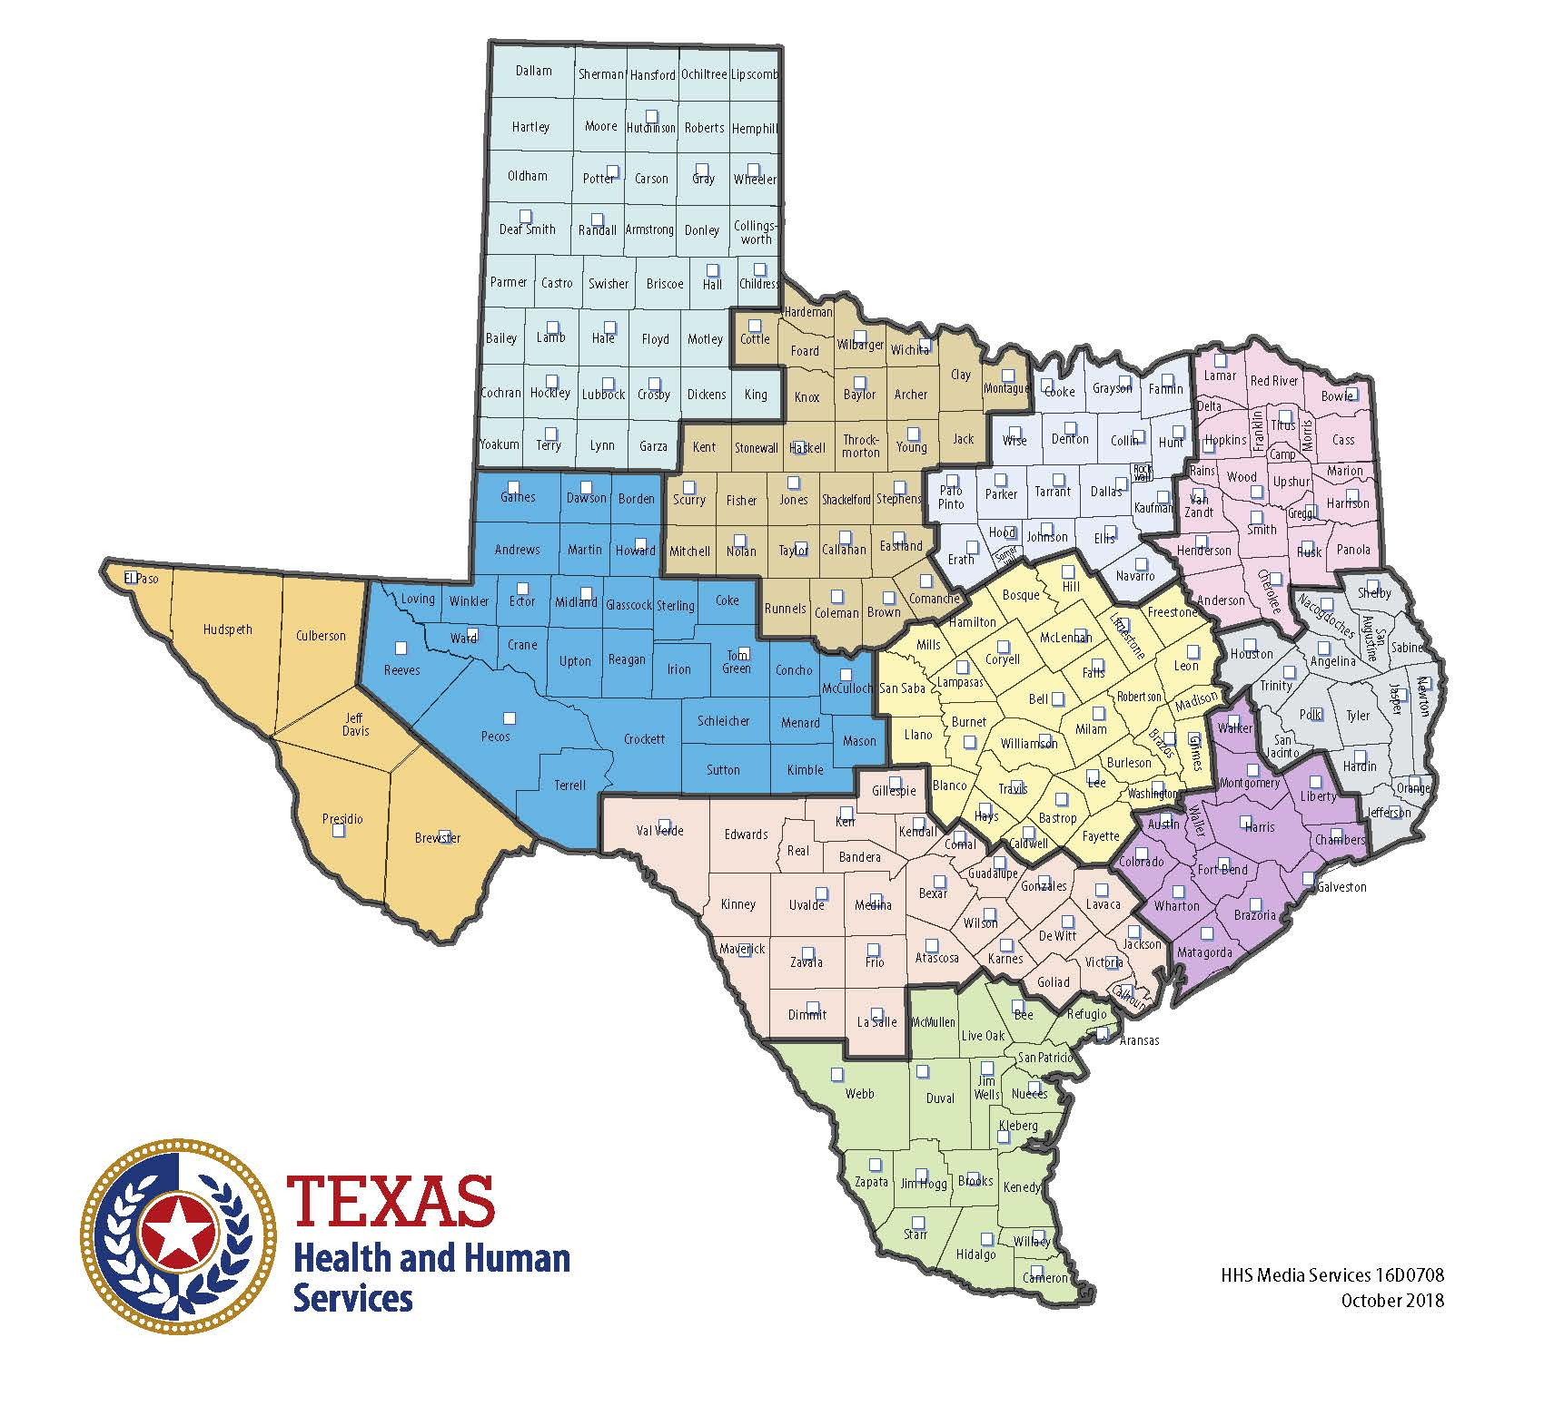
Notes:
11 HHSC Regions

Slide 3
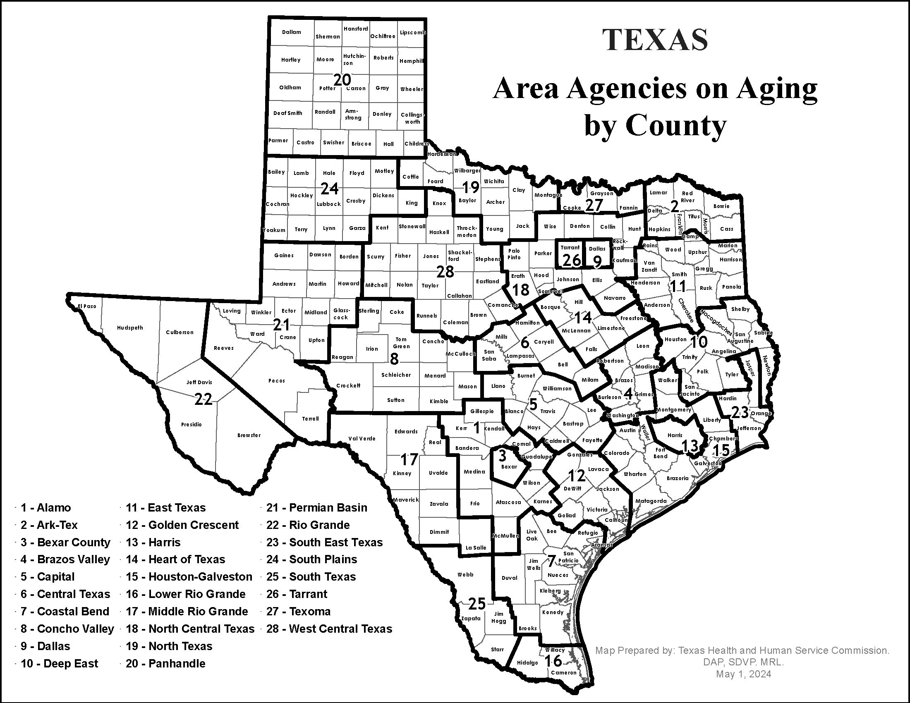
Notes:
28 Area Agencies on Aging

Slide 4
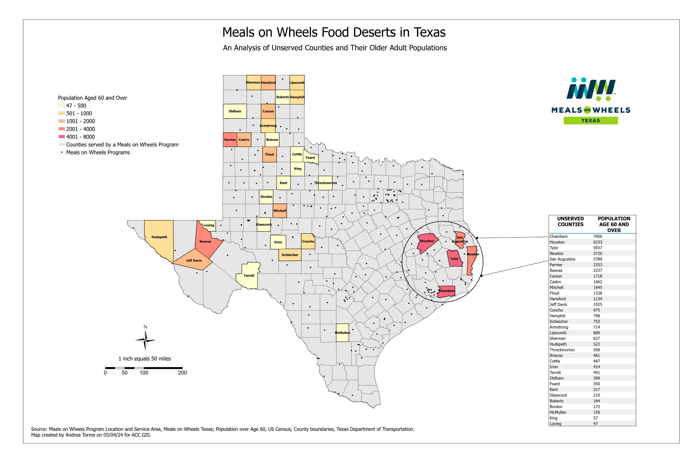
Notes:
Meals on Wheels Programs

Slide 5

We know that if you’ve seen one Meals on Wheels program, you’ve seen ONE Meals on Wheels program!

Slide 6
Meals Programs have different formations
Stand-alone 501(c)(3)s
Department of local or county government
Ministry of a local church or religious institution
For-profit companies

Slide 7
All programs do things differently
Home-delivered meals ONLY
01
Home-delivered meals and congregate services
02
Home-delivered meals, congregate services and other services for older adults
03

Slide 8

What other services do MOW programs offer?
Case management
Housing
Transportation
Pet programs
Home repair
Adult Day Care
Provide heath care services and referrals

Slide 9
Some Meals on Wheels programs are part of larger organizations
Amigos Del Valle (ADV)
Meals on Wheels
Housing
Transportation
Visiting Nurse Association (VNA)
Hospice
Meals on Wheels
Pediatric Hospice
Supportive Palliative Care
Interfaith Ministries of Greater Houston (IMGH)
Meals on Wheels
Refugee Services
Interfaith Relations and Community Partnerships
Volunteer Houston & Serve Houston
Adult Hospice

Slide 10
Funding
Private funding
Individual donations
Corporate gifts
Events
Grants
Major gifts
Planned giving/bequests
Government funding/contracts
Local – City and County Support
State (via Area Agencies on Aging or Health and Human Services Commission) through Title XX, Title III and Title XIX

Slide 11
Meals on Wheels Texas
is a 501(c)(3) association of home-delivered and congregate meal programs established to ensure every older person and individual with a disability in Texas is well nourished and has the social supports they need to age in place with dignity.

Slide 12
Advocacy
Education
Connection
We provide a unified voice for nutrition providers to improve the lives of older Texans and Texans with disabilities.
Notes:
The association provides education, advocacy and connection to create a unified voice for nutrition providers that improves the lives of older Texans and individuals with disabilities.

Slide 13
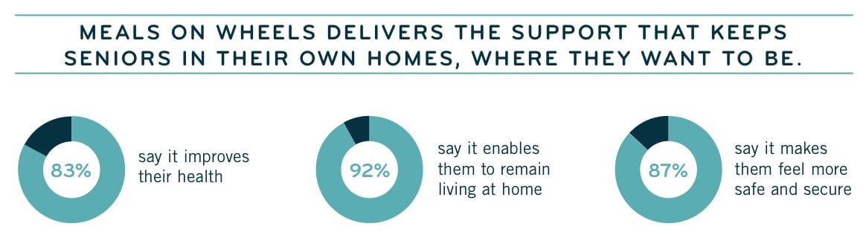

Slide 14
Texas Program Statistics
There are more than 300 home-delivered meal providers in Texas.
Estimates are that Meals on Wheels organizations in Texas employ more than 10,000 dedicated Texans and have more than 100,000 committed volunteers. Every day, they deliver meals to approximately 100,000 frail Texans. By 2050 there will be more than 16.4 million Texans over the age of 50. – Texas Health and Human Services
Our surveys indicate that the average age of the people helped by Meals on Wheels programs in Texas is 77; more than half live alone; 70 percent are women; more than 50 percent live at or below the federal poverty line, some on as little as $733 or less per month; and so many of those we help are veterans and their spouses, widows, or widowers. MOW Programs provided more than 4,000 health and safety interventions in 2023.
Funding comes from a range of sources including individuals, corporations, foundations, and various levels of government. All MOW Programs leverage local philanthropy funds to help cover the fully allocated cost of meals, that is not covered by our government partners, as well as to provide even more individuals with meals and care. From 2020 to 2024, food prices in the U.S. have risen cumulatively by approximately 23% - US Bureau of Labor Statistics

Slide 15


89TH TEXAS LEGISLATIVE SESSION
MEALS ON WHEELS IMPACT REPORT
GOALS
ENABLING HOMEBOUND NEIGHBORS TO AGE IN PLACE
Prioritize support for home-delivered meals that also provide senior well-checks and fight social isolation.
INCREASE TX DEPT OF AG GRANT TEXANS FEEDING TEXANS GRANT BY $10 MILLION
The TFT-HDM provides grants to local programs to help support them for all the meals they serve that are not funded by State or Federal dollars.
INCREASE HHSC MEAL REIMBURSEMENT TO $7/MEAL
Include a $0.54 per meal common rate increase - or $7 per meal - in your LAR for the upcoming biennium in allocated funding for home-delivered meals. This overall increase will total $10.5 million in general revenue in the budget each year of the biennium.

Slide 16
Questions, Comments and Thoughts!

