Slide 1
Utilizing Community Health Workers to Serve Hispanic/Latino Older Adults and Other Vulnerable Populations through Culturally Appropriate Strategies
Notes:
(Monica) 10-minute introduction

Slide 2
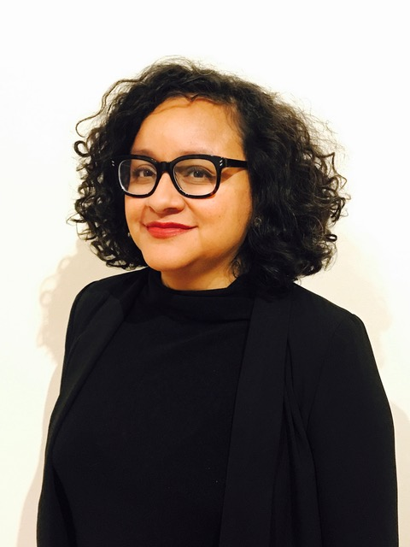
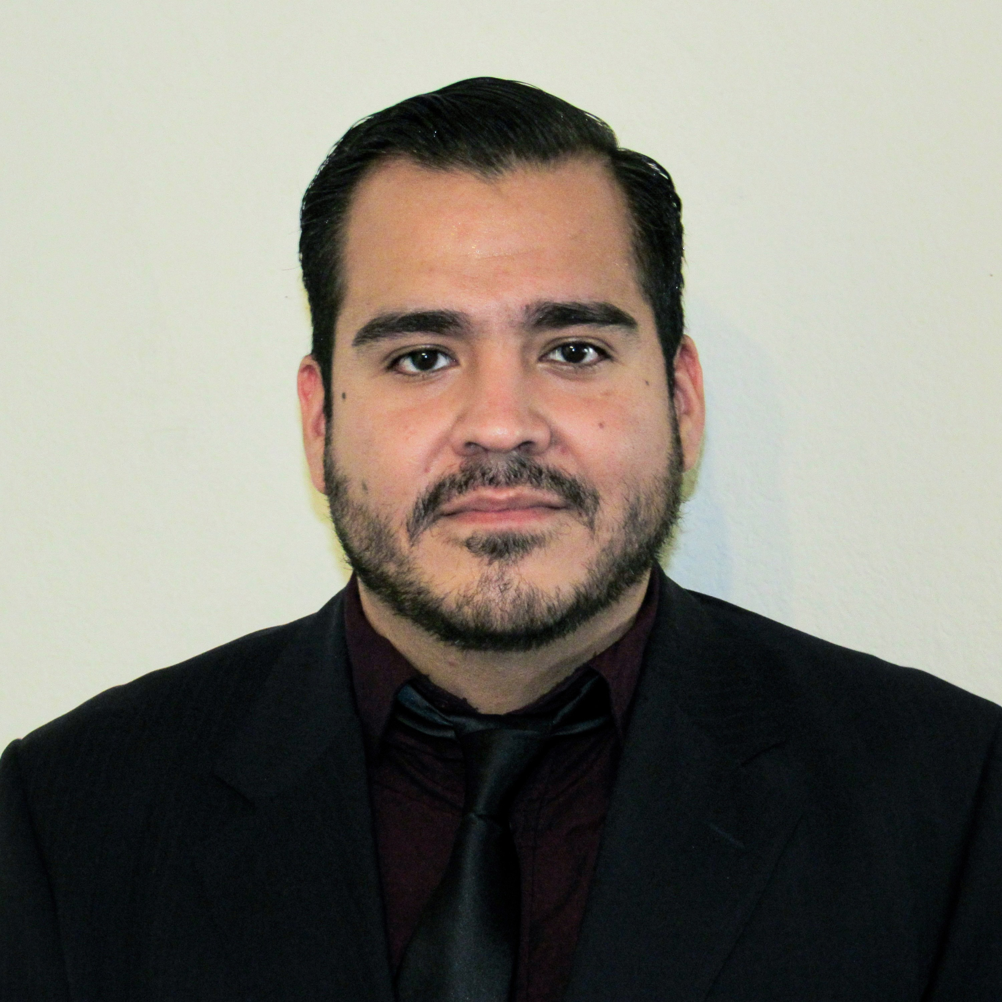
MHP Salud Presenters:
Monica Garcia, MA
Program Director
mogarcia@mhpsalud.org
Jose Luis Rucobo, CCHW/CHWI
Curriculum & Workforce Engagement Specialist
Notes:
Jose: feel free to update your credentials

Slide 3
Who is MHP Salud?
MHP Salud is a national non-profit organization that has implemented CHW programs in underserved Latino communities for 39 years. We also promote the CHW professional nationally as a culturally appropriate strategy to improve health through national training and technical assistance opportunities.
MHP Salud is a HRSA funded National Training and Technical Assistance Partner (NTTAP), providing training and technical assistance to FQHCs and other organizations looking to build or enhance Community Health Worker (CHW) programs.
MHP Salud is also an ACL funded Minority Technical Assistance Resource Center (TARC) focusing on strengthening aging services for Hispanic/Latino communities.
www.mhpsalud.org

Slide 4
Session Objectives: Utilizing Community Health Workers as essential resources that improve the lives of older Hispanic/Latino adults.
1. Define
Define Community Health Worker (CHW) and understand CHW roles and competencies.
2. Provide
Provide examples of how CHWs provide culturally appropriate services to Hispanic/Latino older adults.
3. Identify
Identify ways your organization can benefit from a CHW program.

Slide 5
Overview of Aging Services Program
Minority Aging Technical Assistance Resource Center (TARC)
Resources
TTA
Virtual Learning
Culturally and Linguistically Appropriate material
Blogs
Newsletters
Resources
*COVID-19 resources
Focus on peers/CHWs
Monthly TA Calls
Incoming TTA Requests
Future opportunities
Webinars
Learning Collaboratives
Pre-recorded sessions
*COVID-19 specific virtual learning
Notes:
Jose

Slide 6
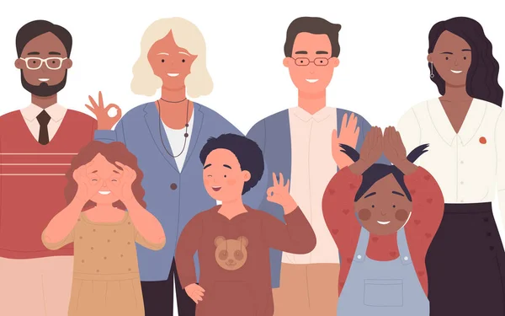
Dinamica!
Notes:
How Long is a Minute? Have People stand up for this one.
Have participants close their eyes and ask them to open them when they think a full minute has passed after you say “Start”.Take the time with a stopwatch (silent, no alarm), and silently raise a hand when the minute has passed. Wait until everybody has opened their eyes, explain that you raised your hand at the one-minute time, and ask participants to discuss the experience. Does everyone experience time the same way? You can repeat the activity and change the time to two minutes.
Option 2:
Chain of requests (4-25 participants)The participants will organize themselves in a circle or a line. Each participant will share with the group something they need or would want to have right now. (Ex. Cup of coffee, nap, money etc.) The next person in line must repeat the needs of everyone that went before them. (Ex. My name is Suzy and I need a nap, John needs Coffee, Brandon needs money, etc.). To finish the activity the first person to go must then repeat everyone’s orders.

Slide 7
Community Health Workers (CHW): Understanding their Roles and Competencies
Notes:
Monica

Slide 8
U.S. Census Bureau, Population Estimates and Projections of older Americans
2020 PROFILE OF OLDER AMERICANS
Between 2019 and 2040, the white (not Hispanic) population age 65 and older is projected to increase by 29% compared to 115% for racial and ethnic minority populations: Hispanic (161%), African American (not Hispanic) (80%), American Indian and Alaska Native (not Hispanic) (67%), and Asian American (not Hispanic) (102%)
Note: Increments in years are uneven. Lighter bars (2040 and 2060) indicate projections.Source: U.S. Census Bureau, Population Estimates and Projections
Notes:
15-min (intro to topic CHW-roles and skills)
Between 2019 and 2040 white older adults are projected to increase by 29% where other racial and ethnic minority groups are expected to increase by 115%. If we look at Hispanic older adults, that number is 161%.
These numbers show that we need to be prepared to serve diverse older adults and ensure that our programs are reflective of our changing communities.

Slide 9
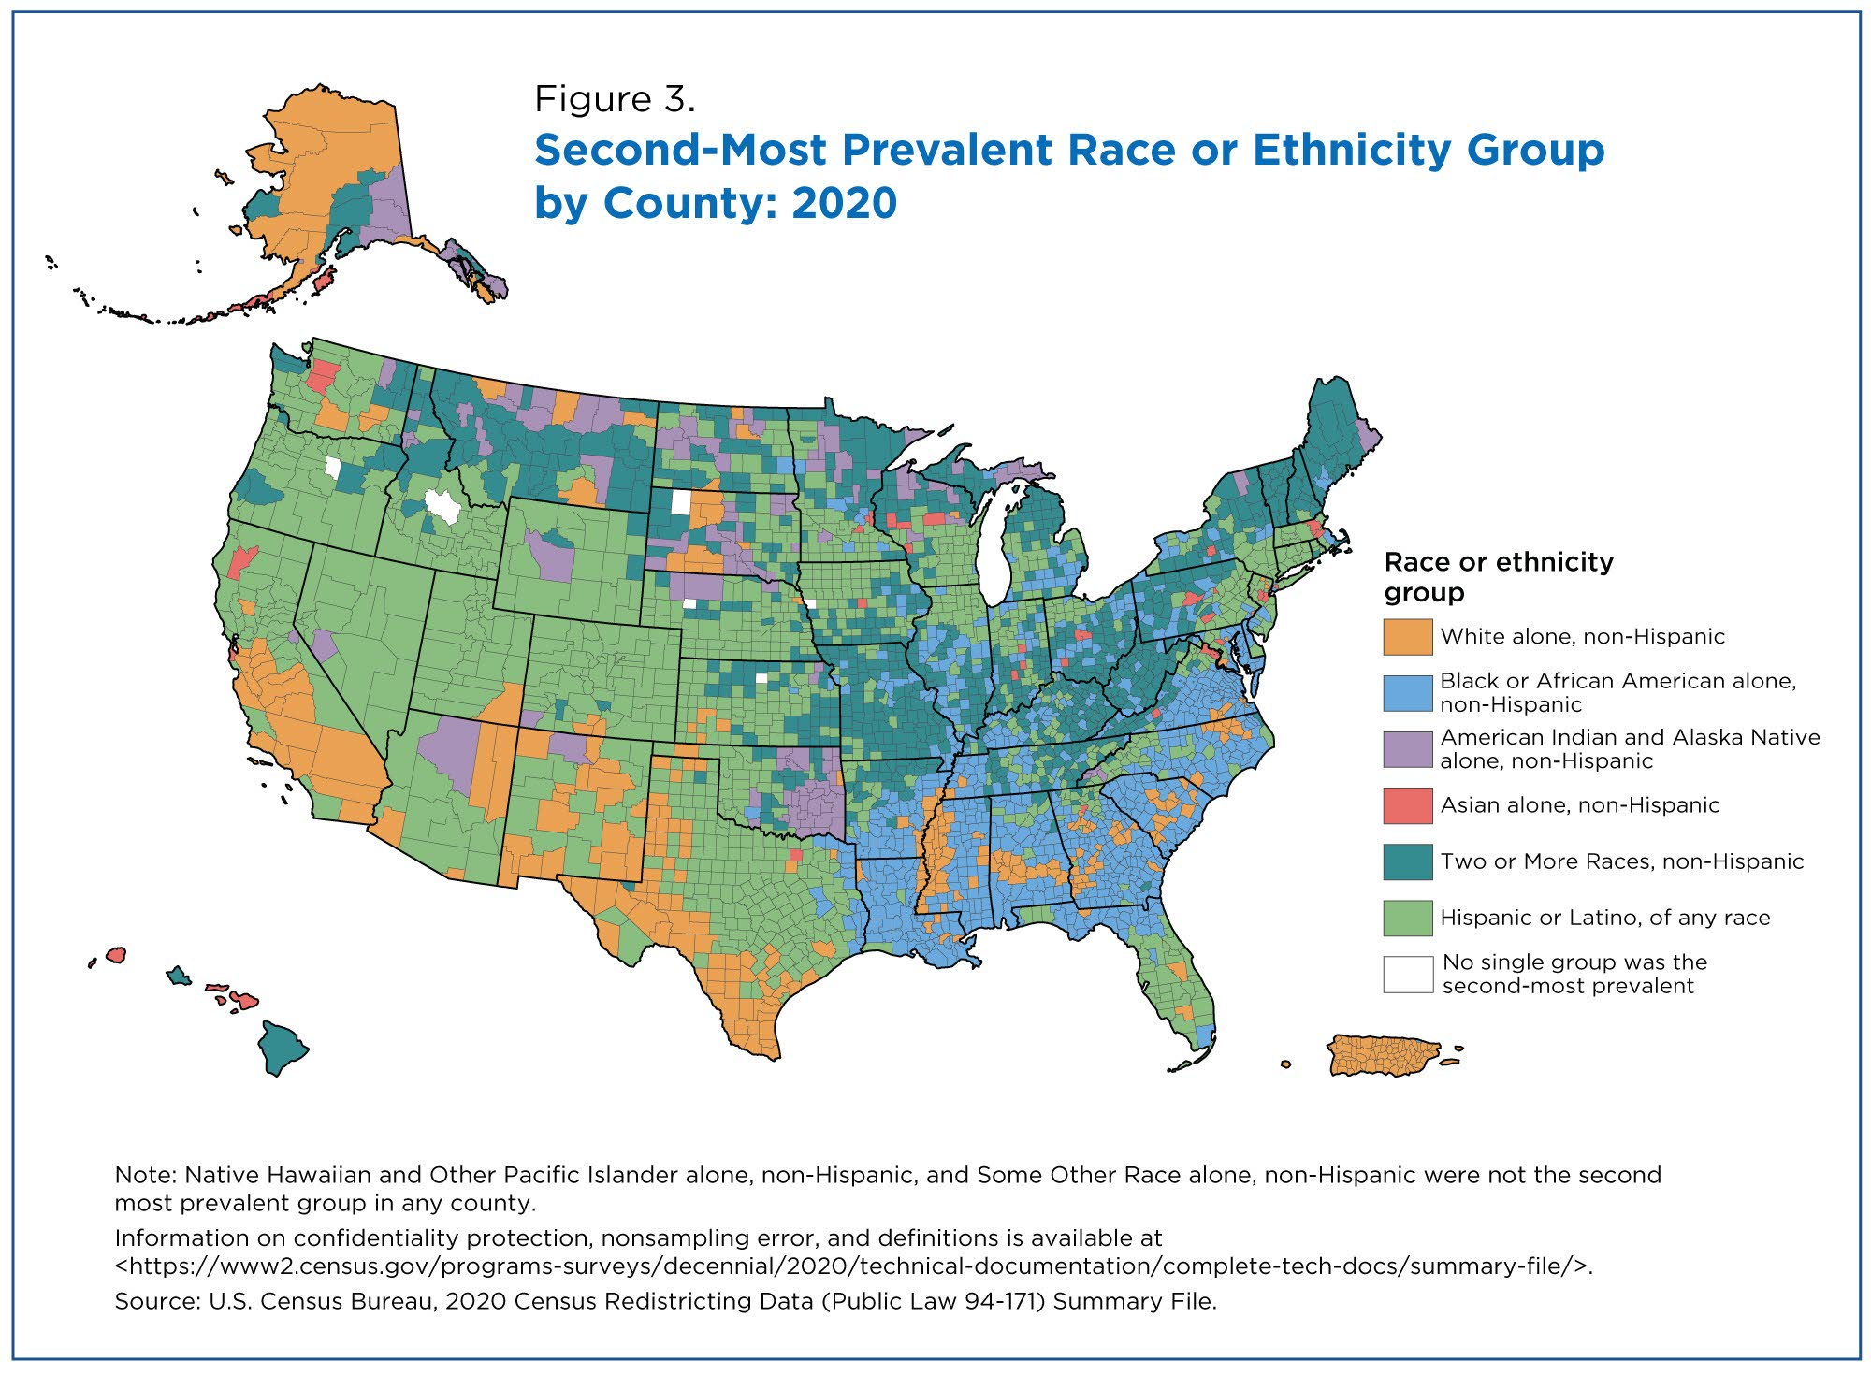
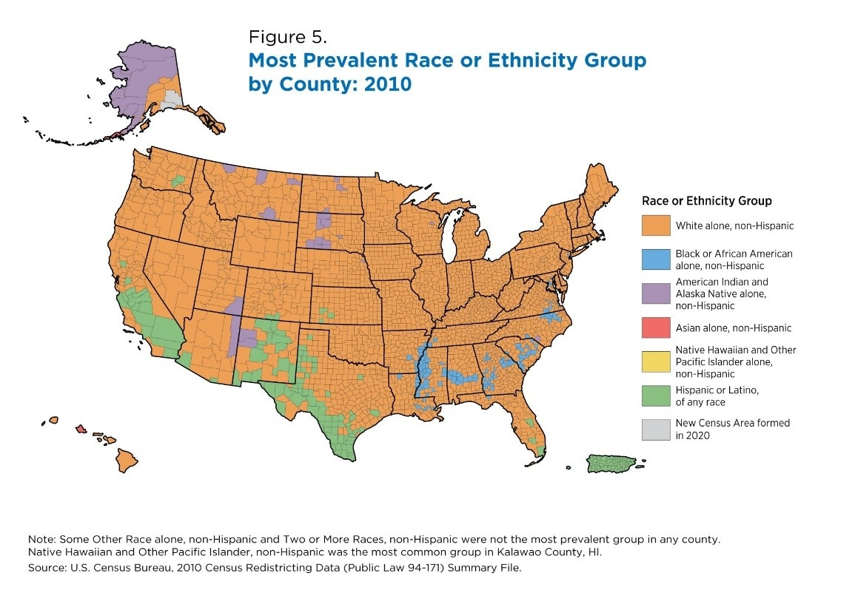
Older Hispanic/Latinx Adults in the US
The Hispanic/Latinx Population is diverse!
1 in 5 older adults will be Hispanic by 2060.¹
In 2017, 27% of Hispanics lived in multigenerational households.²
In 2017, 38% of older Hispanic Americans had one or more disabilities. ¹
The poverty rate in 2017 for Hispanic Americans age 65 and over was 17.4%, which is higher than the rate for all older Americans at 9.2%.¹
In 2018, 57% of the Hispanic American population age 65 and over had finished high school as compared to 87% of all older persons. ¹
In 2013, 47% of Latinos aged 65 and older reported they mainly speak Spanish.²
Profile of Hispanic Americans Age 65 and Over: 2018, Administration for Community Living, U.S. Department of Health and Human Services
Pew Research Center
Notes:
Hispanic someone from Spanish-speaking country, Latino is someone from Latin America (some fit in both, but some do not), Latinx is a gender-neutral term gaining popularity among academics and young adults, but it is not yet a term widely accepted by most Hispanic/Latinos… so it is important to not that some people use these terms interchangeably but there are unique differences and each individual within these larger groups is very unique with unique cultural norms and beliefs… so we cannot overgeneralize our services too much.
Hispanics/Latinos are a diverse group! There are over 20 Spanish-speaking countries in the world. Among the 50.5 million Hispanics counted in the 2010 census, 31.8 million were Mexican-origin Hispanics, 4.6 million Puerto Rican Origin Hispanics, 1.8 million Cubans, 1.6 million Salvadorans and 1.4 million Dominicans. A
Close to half (45% and nearly 2 million people) of older Hispanic adults live in California and Texas.
According to PEW Research Center, 27% of Hispanics lived in a multigenerational household (grandparent and grandchild).
More than one third of older Hispanic adults have one or more disability
Hispanic older adults are more likely to live in poverty that other older Americans
Almost half of this population mainly Speaks Spanish

Slide 10
Notes:
This slide set contains the APHA definition followed by MHP Salud’s definition of what a Community Health Worker is. Please refrain from saying things along the lines of: “This is the APHA’s definition…Now here is MHP Salud’s definition of what a community health worker is” “This is our definition of what a community health worker is” “Our definition is different to other definitions of a community health worker.” ect.
Rather, use the term IN OTHER WORDS, as indicated on the slide as you transition from the APHA definition to our laymen definition.
We do not want audience members to think we are trying to rewrite what a Community Health Worker is. It is recommended that you do not pause for questions on these slides as they is meant to be easy to understand and digestible. (Also - many people have different ideas of what a Community Health Worker is and you do not want to get caught up trying to explain all the edge cases.) This slide set is meant to be used in formal conferences.

Slide 11
Notes:
This slide set contains the APHA definition followed by MHP Salud’s definition of what a Community Health Worker is. Please refrain from saying things along the lines of: “This is the APHA’s definition…Now here is MHP Salud’s definition of what a community health worker is” “This is our definition of what a community health worker is” “Our definition is different to other definitions of a community health worker.” ect.
Rather, use the term IN OTHER WORDS, as indicated on the slide as you transition from the APHA definition to our laymen definition.
We do not want audience members to think we are trying to rewrite what a Community Health Worker is. It is recommended that you do not pause for questions on these slides as they is meant to be easy to understand and digestible. (Also - many people have different ideas of what a Community Health Worker is and you do not want to get caught up trying to explain all the edge cases.) This slide set is meant to be used in formal conferences.

Slide 12
https://www.c3project.org/_files/ugd/7ec423_cb744c7b87284c75af7318614061c8ec.pdf
Notes:
Video: https://www.youtube.com/watch?v=hUv5KBXjxKE

Slide 14
Activity!
Small Group Discussion (10 min):
Introduce yourself and your organization.
Three reasons why a CHW can support your aging programs.
What tools/support do you need to implement such model?

Slide 15
CHW Roles in Aging in Place Initiatives
CHW Roles and Skills | Sub-Roles and Sub-Skills
Outreach | Community Outreach Home visits
Culturally Appropriate Education and Information | Individual educational sessions Group education sessions
Relationship Building | Culturally appropriate interactions Active listening
Advocacy | Advocating for the basic needs of older adult and their communities
Care Coordination, Case Management, & Systems Navigation | Navigate benefits and healthcare systems Referrals Follow-up
Capacity Building | Identify goals Increase empowerment/self-efficacy
Coaching and Social Support | Positive affirmations Listening to individuals’ concerns
Evaluation | Data Collection (intake and exit forms, home assessments) Feedback on Analysis
Notes:
3 minutes
There are some nationally recognized Core Competencies for Community Health Workers. I have listed a few Roles and/or skills that relate to Aging in Place Programs.
Outreach: This is in various forms and can include outreach to educate the general public about aging issues and can also include conducting home visits with older adults.
Culturally Appropriate Education and Information: CHWs are from the communities they serve, so they are able to provide education and health information in a way that older adults can understand using commonly used phrases and avoiding medical jargon. They can also provide group sessions which helps build social support and engages older adults.
CHWs are great at building relationships. As you saw from our program examples. They ask about a participant’s family before anything else and practice active listening skills to show. These skills help people know that they care.
Systems navigation: We know the US healthcare system is very complex and can be hard for the most educated person to understand and navigate. So for older adults who often come from countries with completely different systems, it is helpful to have CHWs assist them in making appointments and submitting insurance claims.
Case Management: CHWs follow-up with their clients. They don’t just provide education once and then leave, they are there to support them for weeks, months and sometimes years!
Coaching and social support: they help older adults feel good about the progress they are making, they listen to concerns that they have
Finally, CHWs play an important role in program evaluation. Without the data they are actively collecting while in the field, we would not be able to show their worth and continue to get funding. They can also provide feedback on interesting or unexpected findings to help explain what the data is showing.

Slide 17
Mentes Fuertes, Pasos Firmes (Strong Minds, Firm Steps)
Notes:
Jose

Slide 18
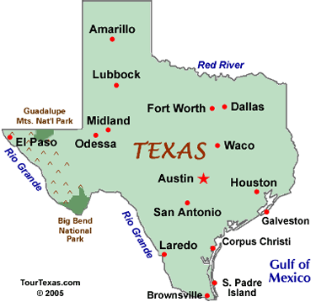
Mentes Fuertes, Pasos Firmes (Strong Minds, Firm Steps)
Mentes Fuertes, Pasos Firmes is a project based in Texas’ Rio Grande Valley counties (Hidalgo, Cameron, Willacy, Starr) that works with older adults to help them age in place.
One unique component of the project is CHW-led home environment scans, which result in home improvements or medical supplies provided by external parties.
Notes:
10-min description of CHW program and outcomes
This program took place in the Rio Grande Valley of Texas. We will describe the participants in a later slide, but I wanted to take a moment to explain some of the unique barriers most Hispanic older adults in the area face:
Language: Most older adults in the RGV that we serve speak Spanish and although many people also speak Spanish, getting information from service providers can sometimes be a challenge
Income: the population served is often living in poverty. They lack the ability to pay for necessary home modifications to be able to stay in their home as they age and often times their homes are in disrepair. They also can struggle with being able to afford healthier food options.
Access to affordable healthcare can be a barrier, especially if an individual is not eligible for Medicaid. IF someone is unwell, especially trying to manage various chronic conditions or disabilities, not being able to access appropriate healthcare can make aging at home very dangerous.
Even though they are very low income, they may be eligible for some benefits. Unfortunately, a lot of people don’t know this or are getting misinformation from friends or family members which makes them think they are ineligible.
Social isolation is a big barrier. Especially for some participants whose families are living in Mexico still. If someone is undocumented and has no family here, they cannot visit their families in Mexico.
Transportation can be a barrier. There is no reliable public transportation that can get to the older adults in more rural Colonias. Sometimes they don’t have vehicles, or even if they do have a vehicle, they do not drive far due to fear of the frequent immigration checkpoints throughout the RGV. If they are unable to get out to buy items for their homes, it can leave the older adult without necessities for aging in place.
Some other cultural factors can make aging in place difficult: Older Hispanic adults expect to age at home and have family care for them. This can facilitate aging in place, but for some Hispanic individuals whose children or other extended family are unable to live with them to take care of them, they are not getting the support that they need. Or if their families are registered as paid, which is not uncommon in Texas within Hispanic households, it can create an uncomfortable dynamic where the older adult feels even more socially isolated.

Slide 19
Activity!
Get up, Stand up! (10 min)
Everyone stands in a line.
When you hear a statement, if it applies to you move 1 step forward. If the statement does not apply to you, take 2 steps back!
Go!

Slide 20
Barriers Older Hispanic Adults Encounter to Safely Aging in Place
Language
Income
Ability to pay for home modifications
Afford healthy foods
Access to affordable healthcare
Knowledge of eligible benefits
Social Isolation
Transportation
Cultural factors
Family caregivers over assisted living

Slide 21
Mentes Fuertes, Pasos Firmes: Program Components
A 12-week CHW-led intervention that helps low-income, Hispanic older adults maintain independence and dignity and remain in their homes with appropriate support.
Community outreach
6 weeks CHW education
6 weeks of CHW case management
Home modification and home safety equipment for eligible participants
Referrals
This program allows older adults to age in place in a holistic way by assessing their social, health, and home safety needs to improve their quality of life.
Notes:
Home modifications will also be included in the program, including ramp construction for eligible participants; and home safety equipment, such as a walker or shower grab-bar/rail. Durable medical equipment, such as scooters, were also provided when appropriate. Athird party contract who MHP with interface with to complete any home modifications or safety equipment. To determine whether a participant will recieve this, the CHW will complete an enviornmental scan of their home between week 1-2.
CHWs conducted outreach in the community through in-person outreach was done through: door-to-door in targeted neighborhoods, visiting local businesses and partners, communicating over the phone and online.
The program included the following health education topics over the course of 6 weeks:
falls prevention,
exercise,
mental agility,
money management,
mental health, and
social connection.
The main component of the program included CHWs visiting the participants’ residence and conducting home assessments to identify areas of concern or danger for the older adult. Many homes had some improvement needs that were relatively easy to fix that were identified by the CHWs. The program would pay to install or build some needs in the built environment. Nothing was every charged to program participants. Referrals were made to local organizations to provide the recommended home modifications. The most common modification included ramps, but other common requests included bathroom grab bars, door handles, etc.)
CHWs provided referrals to other health and social services were made when appropriate and provided case management throughout t the 6-month intervention. When a referral was made to an agency outside of our organization, CHWs would still follow-up to ensure that services were provided and the needs were met.
CHWs collected data using a HIPAA-compliant mobile application, Commcare, on their agency-provided smart phones. This data was cleaned and analyzed regularly for accurate program evaluation

Slide 22
6-Weeks of Education
Sessions are done primarily one-on-one but can be offered in a group setting. Topics include:
Physical Activity
Loneliness and Isolation
Technology (increase self-efficacy)*
Depression
Mental Health and Stress Reduction
Quality of Life
*This component was added in response to COVID-19 needs in our community. Participants who did not have a tablet were provided with one that was pre-loaded with educational content. Participants without internet were able to call a number to join the class
Notes:
Curriculum: https://mhpsalud.app.box.com/file/815848581431
Funder application: https://mhpsalud.app.box.com/file/727386213854

Slide 23
Outcomes: Mentes Fuertes, Pasos Firmes
Number (n) of Participants in 2021:
Reached = 1,249 individuals
n=143 enrolled
n=109 completed 6-week
n=87 completed 12-week program
Outcomes Evaluated: physical activity, social isolation, depressive symptoms, stress, quality of life, & technology self-efficacy.
Program Outcome Highlights:
In 2021, all outcomes demonstrate statistically significant improvements, both at 6 weeks and 12 weeks.
Physical activity demonstrates the largest change, with an 82.0% increase at week 6 and a 102.9% increase at week 12 in comparison to baseline.
Further, participants appear to be improving their mental health throughout the program as demonstrated by decreases in isolation, stress, and depression and improvements in overall quality of life.
Participants saw an increase in self-efficacy related to the use of technology with a 18.2% increase in tools and 76.1% increase in skills at week 12 in comparison to baseline.
Modality of CHW-led service: Virtual 87.4%; In-person 12.6%
Demographic Highlights:
Average Age: 70.22 years (SD=9.29)
Gender Identity: 63.6% Female; 36.4% Male ; 0% Non-binary
Hispanic/Latino: 99.3%
Household income of <$25,000: 85%
Education: 85.3% < Highschool education/GED
Notes:
*may need to be updated – Veronica or Gabriel may have more info*
Tools: computers, tablets, smartphones.
Teck skills: using apps/navigation like skype, facetime, zoom, or browsing the internet.
So far for 2022, CHWs have reached 221, for a total of 1470 reached.
12 home modifications to date, some delays…

Slide 24
Implementing a CHW Program
Notes:
Monica

Slide 25
Program Implementation Stages
Program Planning
Needs Assessment
Program scope
Identify partners
Develop program structure
Recruiting Participants
Community partnerships
Faith based organizations
Community Based Organizations
Area Agencies on Aging
Program Implementation:
Develop Curriculum
Group Activities
Case Management
Environmental Scans (home assessments)
Identify other needs (SDOH)
Referrals
Data Collection
Program Evaluation
Feedback
Show value
Sustainability
Notes:
10- min program implementation and readiness
There are four steps to implementing an Aging in Place CHW-led Program:
The first is program planning: this can involve conducting a community needs assessment or identifying the needs older adults have for aging in place, determining your program scope considering things like where will this program take place, who will we target, what activities and services will our CHWs offer? Identify Project partners or key individuals in the community that can help implement this program (for example, MHP Salud contracted with a local organization to make the home modifications), and developing the program structure or what we expect to implement (what are the goals and objectives and processes and procedures need to be in place to meet these)?
The second step is recruiting participants. This can be done through some of the community partners identified in phase 1. Some ideal partners that can help build relationships and recruit older Hispanic adults include: churches, trusted CBOs like health centers or community centers, Area Agencies on Aging, etc. At MHP Salud our CHW-led programs have our CHWs come together to develop an outreach plan where they identify project partners and develop a comprehensive plan for their programs on how they will reach the target population.
The third step is Program Implementation: This includes developing and implementing your curriculum and group activities for participants, all other program components like case management, home assessments, individual needs assessments (to determine other needs outside of the scope of the program), make referrals, and collect data on the program. Monica shared there is a CHW role in all these stages…
Finally, the last step is to evaluate the program. This helps provide feedback to the current program and ways to improve, it shows the value of the program and CHWs, and finally it can promote sustainability as it can be used to apply for more funding.

Slide 26
Resource: Aging in Place
A collaboration between MHP Salud and National Center for Equitable Care for Elders. This resource includes the following:
Identify the needs of older adults and suggested services to meet those needs
The CHW Role in Aging in Place Programs
Program Implementation Stages
https://mhpsalud.org/portfolio/aging-in-place/
Notes:
This resource is free and can be downloaded on our website. It explains how to identify the needs older adults might have when aging in place, how CHWs can help in this process, and the steps I just discussed.

Slide 27
Do you foresee any hesitancy among leadership or other staff in embracing the CHW role in Aging in Place programs?
Group Discussion!

Slide 28
Are You Ready to Implement a CHW Program?
Getting Started: Basic Considerations
Grow: Establishing Roots
Integrate: Connecting Programs
Sustain: Getting Leadership on Board
Notes:
Now that we have seen an example of an Aging in Place Program and we know a bit more about what that program implementaiton may look like. Some of you might be considering implementing your own CHW programs. If that’s the case, you will want to answer some questions about your organizaitons’ capacity to implement and sustain a CHW program. I’ll briefly ask some questions to get you thinking about implementing a program. I encourage you all to reach out if you have further questions or would like support in starting your programs.
Getting Started: There are some basic considerations you may want to take to know if you are ready to consider starting a CHW program:
How will CHWs benefit our community/clients/patients?
How will a CHW program fit into our current org structure?
How will the CHW program be integrated with other programs?
How will leadership engage with the program?
*How will my organization grow, integrate, and sustain a CHW program?
Grow: establishing roots for your CHW program in your organization
What type of CHW program are you considering (i.e., outreach, health education, etc.)?
What major health problem(s) or goal(s) will the program target (i.e., diabetes management, insurance enrollment, aging in place)?
Where will the CHW program be “housed” (i.e., social services department)?
What resources does your organization currently have to design this program (i.e., current employees with CHW backgrounds, health education curriculums, etc.)?
Does a CHW program conflict with your organization’s current values, goals, or structure?
*These questions can identify areas for growth. If your organization does not know where if the CHW program will fit in in the organization structure, start conversations with leadership to create a strategic fit.
Integrate: connecting your CHW program with other units
* Ensure staff understand and welcome new program and CHWs.. will want to consider:
Do other staff understand role of CHWs and where they may interact?
Will you need to train other staff?
How has your organization worked with CHWs or similar professionals?
How will proposed program work with other programs?
How will your organization engage CHWs (considering that they will be out in the community and away from the facility often)?
Sustain: making sure leadership is on board
Does leadership understand the role and VALUE of the CHW?
Has anyone from leadership worked with a similar program in the past?
Does leadership see how CHWs help the org as contributing or in conflict with mission, vision, goals?
Will anyone in leadership oversee CHWs?
Will leadership be involved in the development or implementation of CHW programs?
*It is important to try and foresee any potential conflicts to make sure that the program can be integrated for long-term. If leadership is not on board it will not be a sustainable program.

Slide 29
Questions?
Notes:
5-min for Q&A

Slide 30
Other Helpful Resources
Aging in Place: A Resource for Health Centers (NCECE + MHP Salud): https://mhpsalud.org/portfolio/aging-in-place/
Aging in Place: The Role of Community Health Workers: https://www.who.int/ageing/features/ageing-in-place/en/
Aging in Place – National Council for Aging Care: https://www.aginginplace.org/
National Institute on Aging - Aging in Place: Growing Older at Home: https://www.nia.nih.gov/health/aging-place-growing-older-home
Notes:
Reach the name of each resource:
These resources are free and easily available for download.

Slide 31
Thank you!
Monica Garcia - Program Director
mogarcia@mhpsalud.org (956) 205-1157
Jose Luis Rucobo - Curriculum & Workforce Engagement Specialist
jrucobo@mhpsalud.org (956) 338-0227
www.mhpsalud.org

