Slide 1
Empowering Vulnerable Populations: Perspectives from the Harris County Area Agency on Aging Aging in Texas Conference August 18, 2022
Carmen Castro, Dr.P.H., M.S.,
Paula Silva
Keith Taylor, MS
Notes:
Good morning Everyone and Welcome to HCAAA and ADRC.
AAA introductions
Rose – AAA, BC, present AAA programs and services
Tanesha –ADRC, BC, who will present ADRC
Dr. Janice Sparks, ADRC Director
Dr. Carmen Castro, Access and Assistance Administration Manager
Questions are welcome, you can enter in the CHAT, or towards the end of presentation.
Before we start, review our questions;
Ask audience members: Questions:
share Program background
what they need most from the AAA and ADRC
how can we best be of help
do they want us to track anything such as how many people we assisted?

Slide 2
Presentation Objectives
By the end of the session, participants will be able to:
Understand the role of the Harris County Area Agency on Aging in promoting the well-being and quality of life with dignity of older adults in Harris County.
Identify ways the Aging Call Center educates and informs consumers about a range of services for older adults under the Older Americans Act.
Recognize how the Veterans Directed Care Program works to reduce barriers to services among veterans and empowers them to obtain the self-directed and person-centered care they need.
Differentiate between services and techniques used to empower older adults, people with disabilities and Veterans.
Notes:
Notes:
HCAAA is part of a nationwide federal grant program.
There are 28 AAA in the state of Texas
We cover Harris County.
AAA/ADRC, in a collaboration effort, work in partnership to provide our services that are included in todays presentation.
.

Slide 3
What is the Harris County Area Agency On Aging?
Harris County Area Agency on Aging, (HCAAA) is part of a nationwide federal grant program
authorized by the Older Americans Act of 1965.
The City of Houston is the grantee agency for
Older Americans Act Services for Harris County.
HCAAA is a city-county partnership housed in the Houston Health Department.
Notes:
Harris County is home to a population of over 4 million people. It is the largest county in Texas and the third most populous county in the nation. Nearly 16% of the population lives in poverty. According to the US Census Bureau 44% of the population is Hispanic and 7% of the population is Asian. After English, the three most common languages spoken are Spanish, Vietnamese and Chinese. The HCAAA has developed strategies to meet the diverse language needs of consumers who reach out to the Call Center and to benefits counselors for assistance and services. The HCAAA has hired bilingual staff (English/Spanish) so that consumers can speak directly with Call Center representatives as well as with benefits counselors who speak their language, in addition to utilization of the Language Line.
.

Slide 4
SERVICES PROVIDED Access and Assistance Services
Benefit Counseling:
Certified Counselors assist clients and/or their caregivers with understanding and applying for Medicare, Medicaid, and other public benefits to include appeals and advocacy.
Medicare open enrollment is October 15-Dec 7
Information, Referral and Assistance Services:
Staff assists older adults by researching and informing them on resources available in their community.
Referrals to consumers to HCAAA services.
Notes:
Front Door -
Intake by IR&A specialist – trained and AIRs (Alliance of Information and Referral System – Certified) > telephone calls, Emails, voicemails, Walk-ins, mail
Benefits Counseling: Certified Counselors assist with understanding and applying for Medicare, Medicaid, and other public benefits. Popular: Medicare AEP Oct 15- Dec 7.

Slide 5
Area Agency on Aging Services
Information Referral & Assistance (Front Door)
Benefits Counseling
Nutrition Services
Home Delivered Meals
Congregate meals
Care Coordination
Personal Assistance
Visiting
Emergency Response
Chore Maintenance
Caregiver Support Services
Health Maintenance
Dental, vision, hearing, prescription assistance, incontinence /nutritional supplies
Legal Assistance
Minor Residential Repair
Non-Emergency Transportation
Evidence Based Programs
Notes:
Health Maintenance (limits apply)
We focus on programs and services not covered by Medicare or other healthcare insurance. Programs of last resort. Benefits counseling-Helps us eliminate waitlists.
Most AAA services are:
Direct services or contracted: means AAA completes intakes than submits PM; PM approves authorization/referral for that service. For example
Nutrition services: HDM/Community Dining
> due to COVID19 pandemic - Delay of re-opening congregate meals sites -Fall;.
Working plan ex. grab-n-go; Seniors pick-up meals and return home.
Some sites used for vaccines; avoid interruptions.
Home delivered meals continue without interruptions. > Which also included congregate participants.
Care coordination services are temporary; CM assist with transition to community long term care services.

Slide 6
Area Agency on Aging Services Cont.
Income Support
Mental Health Counseling
COVID-19
In-home testing
In-home vaccination
Vaccinations and testing are offered to qualifying individuals over the age of 60 through the HCAAA and to qualifying individuals 59years of age and younger through the Aging and Disability Resource Center.
Notes:
AAA COVID -19
AAA Team All activated essential employees -Telecommute/relocated: Call centers coordinated; COVID 19 testing, transition to COVID vaccinations, appts
AAA COVID support services
AAA stepped-up; In-home testing, in-home vaccinations
Facemasks mailed;
> Care Funds: COVID19 rental, mortgage and utility assistance
> Partnership with Houston Food Bank; Food box delivered to homebound clients.
Income support: assist in the form of payment : deposits and 1st month rent, deductibles.

Slide 7
Area Agency on Aging Services Cont.
Veterans Directed Home and Community Based Services
Provide services and supports to eligible Veterans.
HomeMeds
A pharmacist’s review of medication safety for older adults who take five or more medications.
Notes:
HomeMeds BCs incorporated
> with prescription assistance program if we find Clients take more than 3 medications.
> Medicare AEP;

Slide 8
AAA Special Initiatives
Beat the Heat “Stay cool in your home”
Cooling centers access
Air Conditioner (AC) program
Portable Unit
Care packages
Harris county older adults, disabled individuals and families without means to cool their homes
Houston Meals for the Elderly
> hot meals delivered on Thanksgiving day by volunteers

Slide 9
Area Agency on Aging Services
Ombudsman Program: Advocacy for residents in long term care facilities, and their families.
The University of Texas
6901 Bertner, Suite 624
Houston, TX 77030
713-500-9931
800-296-2606 (toll free)
Email: ombudsman@uth.tmc.edu
Notes:
Ombudsman with University of Texas 713-500-9931, staff and volunteers. Training required for volunteers.
Help with obtain listing of nursing homes,
Special requests: accept Medicaid and have secure units for memory care residents ex. Wanders

Slide 10
Eligibility
Access and Assistance
Older adults 60 years or older and their caregivers residing in Harris County.
Benefits Counseling Services –
Medicare beneficiaries of any age and caregivers
Nutrition Services ▪ Older adults 60 years or older, and spouse ▪ Must be home-bound for home delivered meals
Notes:
If you are age 60 or older or care for a person who is older, resides in Harris County AAA services may be offered, last resort. Help also may be available to grandparents who are raising grandchildren
Priority is given to people with the greatest economic and social need. This group includes:
People who are minorities with low incomes
People who live in rural areas
People with limited English proficiency
People with Alzheimer's disease and related disorders
People at risk of being placed in a nursing home or other long-term care facility

Slide 11
Some men see things as they are and ask why. I dream of things that never were and ask why not.
Robert F. Kennedy.
Notes:
Harris County is home to a population of over 4 million people. It is the largest county in Texas and the third most populous county in the nation. Nearly 16% of the population lives in poverty. According to the US Census Bureau 44% of the population is Hispanic and 7% of the population is Asian. After English, the three most common languages spoken are Spanish, Vietnamese and Chinese. The HCAAA has developed strategies to meet the diverse language needs of consumers who reach out to the Call Center and to benefits counselors for assistance and services. The HCAAA has hired bilingual staff (English/Spanish) so that consumers can speak directly with Call Center representatives as well as with benefits counselors who speak their language, in addition to utilization of the Language Line.
.

Slide 12
Empowering Callers from Vulnerable Populations: Perspectives from the Call Center Paula Silva, Customer Service Supervisor Paula.Silva@houstontx.gov 832-393-4397
Human Services Division (HSD)
Notes:
Narrator: Paula Silva
Opening
Hello and Welcome to the afternoon session.
My name is Paula Silva, Customer Service Supervisor and I will present the first part of the session titled: Empowering Callers from Vulnerable Populations: Three Perspectives from Harris County Area Agency on Aging

Slide 13
Caller Empowerment- Front Door
Empowering consumers to resolve
issues with tools and resources needed to be successful.
Listen to consumer’s concerns
Provide a secure experience
Providing consumer’s, the right to opt out
We are the front door
Notes:
Narrator: Paula Silva
We named our AAA call Center the “Front Door” :
At 8:00 am in the morning, we begin our day. The AAA Call Center staff is prepared, our Benefits Counseling room is opened and staffed, and our phones go Live!
At the same Staff check for voice mails, emails, walk-ins, or appointments and mail. Walk-ins and/or appointments are seen in the benefits counseling room.
In today’s session, I will talk about the three perspectives that are important for “Call Empowerment” . We credit these goals to the success of our Caller Center.
First is:
Listen to Consumers’ concerns
Second is:
Provide a Secure Experience
Third is:
Give consumers the right to opt out.
So here is Paula Silva, Customer Service Supervisor for the HCAAA.

Slide 14
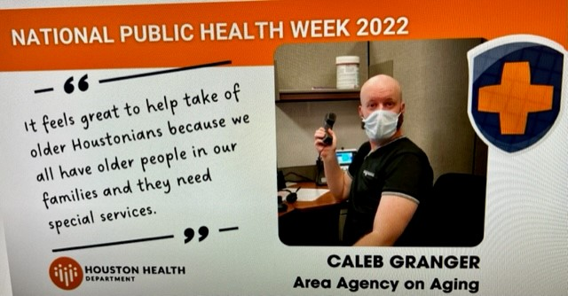
Consumer Goal
Caller Empowerment: Empower Consumers to resolve issues with tools and resources provided by our customer service representatives
Listen- Providing availability for customer service to our consumers. Once the IRA team answers the call, their listening skills will come in to play. They have learned that in order to empower the consumer, they need to first listen and learn to verify what the consumer is needing or is requesting. To do so effectively, we must be able to accurately receive the information the consumer is providing, probe for more information and verify the need.
Provide them with a secure experience- Making sure the consumer feels comfortable when speaking to you, providing a safe environment, letting the consumer know that you will do your best to provide them with the services or resources they need.
Opt-Out- Providing the option to opt-out of services or resources. There are times that a consumer may not want to contact a particular provider to receive services. For example: APS or HHSC or our agency. For whatever the reason, the consumer ultimately has the choice.
Notes:
Narrator: Paula Silva
How do we empower? How do we become successful in empowering our consumers? Here are the three tools we provide our team to empower our consumers:
Listen: Provide our consumers with availability. Making sure we have an adequate number of staff to answer the phones. Once we have the consumer on the line, we listen, and probe to be able to understand what the consumer is calling about and what they are needing.
Secure Experience: we want our consumers to know that we are listening and that their needs matter to us. And that we will try our best to provide them with the service they need or to provide them with resources.
Opt- Out: Providing the consumer the option to receive services or opt out.

Slide 15
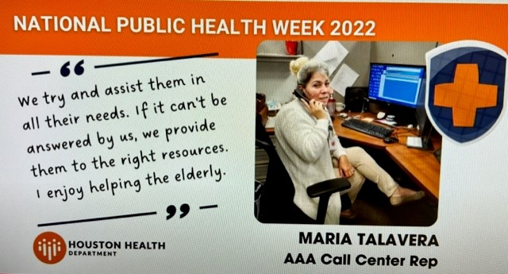
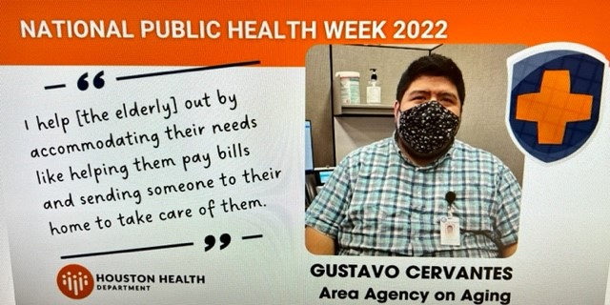
Call Center Goal: Information Referral & Assistance Representatives (IRA)
The keys to the success of our call center is to ensure that our IRA staff is provided with the tools needed to provide adequate tools and resources to our consumers.
Training: We provide training to our staff when a new process or resource is or will be implemented. We also provide weekly team meetings to stay abreast of current or upcoming projects, referrals, or situations.
Resources: Our IRA team uses different resources. For example, we use the ADRC website, the United Way website, and Baker Ripley to name a few. We also use our database Wellsky, to forward any referrals for services our agency provides. Keeping abreast of new services offered and providing that information to our team is key.
Availability: Availability to our IRA representatives in case our representatives need us and availability to our consumers in case of an escalated call or an emergency. We strive to provide availability to both our staff and consumers by managing our call center staff.
Notes:
Narrator: Paula Silva
Let’s talk about our Call Center. Who empowers our consumers? Who listens to them? Who makes them feel secure? Who provides them with the right to opt out? Our IRA team.
And here are the tools we provide our IRA staff for a successful interaction with our consumers.

Slide 16
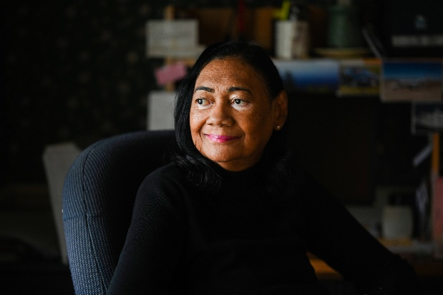
Case Scenario
Mrs. Smith
“ I am calling in to ask for housing because I was just evicted and need to find a place to live. I also fell and do not have any money to pay to see a doctor. I don’t know what to do because I am alone and 68 years old. Can you help me?”
Provide Empathy
Gather demographics
Paraphrased consumers issues/ Probed
Verify the services the consumer will need (Medical Costs, Medicare Benefit Counseling, Housing, Legal)
Provided information for the needs of the consumer
Encouraged the consumer to move forward with services
Once the consumer provides consent to move forward, referrals begin
Notes:
Narrator: Paula Silva
The following scenario that we are calling “Mrs. Smith” is an example where AAA center staff used the three Call empowerment goals.
(Read out loud the Case Scenario) AAA center staff
AAA canter staff:
1) Listen:
> Mrs. Smith is allowed to share her story and situation.
> Develops a sense of trust.
2) Secure Experience
> Paraphrased the issues mentioned and probed questions to avoid missing her Needs: in the Scenario, it was found her needs.
>Gather demographics, and verify the consumer needs.
> Housing – lower-income housing, section 8, or income-based housing.
> Eviction: legal assistance. Attorney consultation to stop the eviction or temporarily delay the eviction.
> Financial assistance: rent, deposit if she has to move, utility assistance.
> Benefits counseling: screen her on medical and prescriptions cost.
3) Opt-Out
> Gave her the opportunity to lead and ensure the practice of self-care. Provide constructive feedback.
Give appropriate referrals.
Obtain Consent to make the referral on their behalf in case the Consumer is overwhelmed and might not be able to call herself, but at the same time ensure their decision is correct.
At the end, the consumer is given the option to accept and receive services or opt-out.

Slide 17
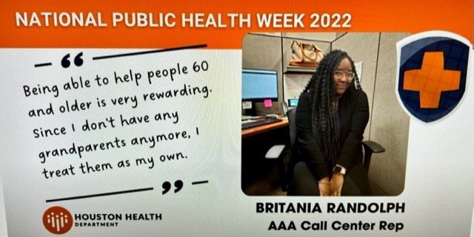
Assistance Provided for Services Listed Below:
Adult Day Care
Chore Maintenance
In-home COVID Testing
In-home COVID Vaccine
Dental
Emergency Response Services
Food Box Codes
Hearing
Home Repairs
In Home/ Respite Provider Services
Income Support
Incontinence Supplies
Legal Assistance
Mail Out
Meals on Wheels
Medicaid
Medicare
Mental Health Services
Nutritional Supplement
Personal Assistance
Prescription Assistance
Residential Repair
Transportation
Vision
Outreach
Notes:
Narrator. Paula Silva
Lastly, here is a sample of topics encountered every day in our HCAAA call center. These services are in place to allow our consumer to age with dignity and to provide services that empower their daily lives.
Thank you. We hope our presentation today can help you.

Slide 18
Contact Us
AAA Call Center
9250 Kirby St.
Houston, TX 77054
Monday – Friday
8:00 am – 5:00 pm
Intake: 832-393-4301
Long Distance: 1-800-213-8471
Walk-ins Welcome
Website:
http://www.houstontx.gov/health/Aging/
Email:
aging@houstontx.gov
Central Office:
Harris County Area Agency on Aging (AAA)
Houston Health Department
8000 N. Stadium Dr. 3rd Floor
Houston, Texas 77054

Slide 19
Veterans Administration & Harris County Area Agency on Aging Veterans Directed Care Program
Keith Taylor, M.S.
Counselor/Veterans Specialist
Human Services Division

Slide 20
What is the Veterans Directed Care Program
It is a non-traditional model of care for eligible Veterans who need in home personal assistance in order to continue living in their homes.
Partnership between the VA and HCAAA that enrolled the 1st Veterans in March 2017.
The program is person-centered and self-directed unlike any other VA models of care.
We have engaged with 85 Veterans since the program launched.

Slide 21
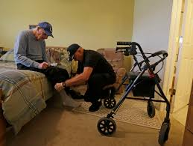
Access and Assistance
Personal Care:
Includes Activities of Daily Living such as: Bathing, Dressing, Cooking, Feeding, Cleaning, Laundry, Transfer and Ambulation, Toileting, Personal Grooming, and Supervising.
In Home Respite Care:
This involves care that mirrors the services shown above. However, this care continues while the Veteran Representative is out of town.

Slide 22
In Home VA Medical Care is still available under this program.
In home doctor or nursing care:
Doctors and nurses come to the homes of Veterans who have conditions that make their mobility a challenge.
Occupational and Physical Therapy:
Many Veterans need this care to help them maintain flexibility, strength, and mobility.
These services prolong the Veteran’s ability to do some things independently such as feeding themselves and brushing their own teeth.
Notes:
Include a piece for advocacy and appeals in the bullet, change font, add photos

Slide 23
Veterans Remain Eligible for VA Institutional Care.
30 Days of Free Institutional Respite is Available in this Program:
Caregiving is tough and burnout is real. Everyone needs a break every now and then. This program helps tremendously.

Slide 24
Benefits of the Program
Veterans or their Representatives are in charge of all administrative aspects of the program such as personnel, scheduling, and timesheets.
Annual Satisfaction Surveys are done to gauge efficacy and results are shown to top policy makers and their staffs.
A Financial Management Services Contractor handles taxes and payroll. The Veteran’s individual tax filing is not affected by this program.
Veterans remain in the program indefinitely subject to compliance with program guidelines. In many cases, institutionalization is avoided.

Slide 25
Budget Development
Veterans are assigned a case mix letter that has a monthly financial value that corresponds to their clinical diagnosis. That amount minus the one-time assessment fee plus the regular monthly fee is what they have available to pay employees. Veterans must stay within the budgetary allotment.

Slide 26
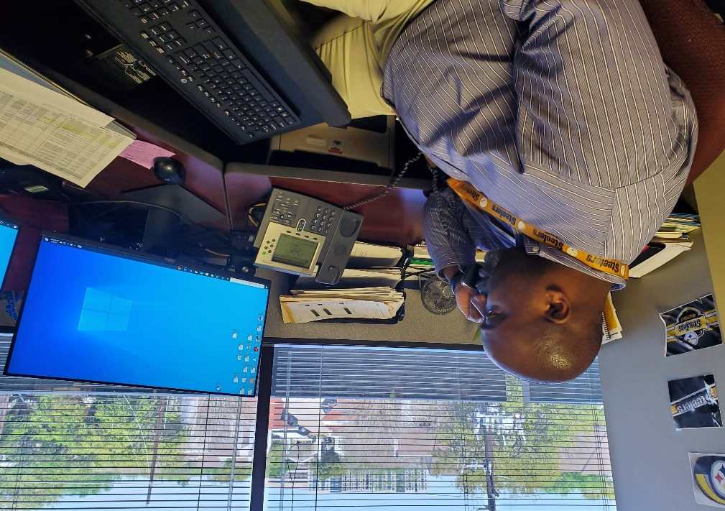
Regular Monitoring and Reassessments
Monthly Monitoring: The Veterans Specialist and the Veteran/Vet Representative talk at least monthly for updates on medical conditions, hospitalizations, or any other related matters.
Bi-Annual and Annual Reassessments: These assessments are done consistent with sound case management processes and the need to keep the VA updated on the Veterans.
Notes:
Change the placement of ombudsman to the end. Include FY 14 consumers served.

Slide 27
Testimonial
Notes:
Change the placement of ombudsman to the end. Include FY 14 consumers served.

Slide 28
Presenters Contact Information
Carmen Castro
832-393-4513
carmen.castro@houstontx.gov
Paula Silva
832-393-4397
paula.silva@houstontx.gov
Keith Taylor
832-393-4488
Keith.taylor@houstontx.gov
Website:
http://www.houstontx.gov/health/Aging/
Email:
aging@houstontx.gov

Slide 29
HCAAA Location
Main Office: Houston Health Department
8000 N. Stadium Dr. 3rd Floor
Houston, Texas 77054
Mon – Fri: 8:00 am – 5:00 pm
Intake: 832-393-4301 local
1-800-213-8471 long distance
http://www.houstontx.gov/health/Aging/
Email: aging@houstontx.gov
Notes:
Email: aging@houstontx.gov

Slide 30
Questions and Answers
Q & A

